Slide 1
Founding Sponsor

Slide 2
Please submit your questions for the moderated question and answer session.

Slide 3
Webinar Objectives
Notes:
Next webinar: how to read your dashboards

Slide 4
Webinar Objectives
Describe the goal of the Patient Navigator Program: Focus MI
Notes:
Next webinar: how to read your dashboards

Slide 5
Webinar Objectives
Describe the goal of the Patient Navigator Program: Focus MI
Discuss how to utilize the data collection tool
Notes:
Next webinar: how to read your dashboards

Slide 6
Webinar Objectives
Describe the goal of the Patient Navigator Program: Focus MI
Discuss how to utilize the data collection tool
Explore the QII website
Notes:
Next webinar: how to read your dashboards

Slide 7
Webinar Objectives
Describe the goal of the Patient Navigator Program: Focus MI
Discuss how to utilize the data collection tool
Explore the QII website
Discuss setting your goals
Notes:
Next webinar: how to read your dashboards

Slide 8
The Problem
Readmission rates for Medicare patients in 2010
Notes:
The HF and AMI readmission rates for Medicare patients averaged 24.4% and 19.5% nationally in 2010.
Nearly 1 in 5 patients hospitalized with an MI and 1 in 4 patients hospitalized with HF were readmitted within 30 days of discharge.
The total cost of these readmissions was $17.4 billion (in 2004).

Slide 9
The Problem
MI patients
HF patients
Readmission rates for Medicare patients in 2010
Readmitted within 30 days
Notes:
The HF and AMI readmission rates for Medicare patients averaged 24.4% and 19.5% nationally in 2010.
Nearly 1 in 5 patients hospitalized with an MI and 1 in 4 patients hospitalized with HF were readmitted within 30 days of discharge.
The total cost of these readmissions was $17.4 billion (in 2004).

Slide 10
The Problem
MI patients
$17.4 B
HF patients
Total cost of readmissions
Readmission rates for Medicare patients in 2010
Readmitted within 30 days
Notes:
The HF and AMI readmission rates for Medicare patients averaged 24.4% and 19.5% nationally in 2010.
Nearly 1 in 5 patients hospitalized with an MI and 1 in 4 patients hospitalized with HF were readmitted within 30 days of discharge.
The total cost of these readmissions was $17.4 billion (in 2004).

Slide 11
Patient Navigator Program
Improves care for cardiovascular
patients
Notes:
Change color of background circles

Slide 12
Patient Navigator Program
patient-centered
Improves care for cardiovascular
patients
Notes:
Change color of background circles

Slide 13
Patient Navigator Program
patient-centered
leverages evidence based best practices
Improves care for cardiovascular
patients
Notes:
Change color of background circles

Slide 14
Patient Navigator Program
patient-centered
team-based approach
leverages evidence based best practices
Improves care for cardiovascular
patients
Notes:
Change color of background circles

Slide 15
Program Goals
Develop compendium of best practices

Slide 16
Program Goals
Develop compendium of best practices
Improve MI transitions of care in inpatient and outpatient settings

Slide 17
Program Goals
Develop compendium of best practices
Improve MI transitions of care in inpatient and outpatient settings
Decrease MI readmission rates

Slide 18
A National and Cohort QI Campaign
National Campaign – broad implementation of the original Patient Navigator program (MI)
National Program
Notes:
Explain what the diplomat hospitals do

Slide 19
A National and Cohort QI Campaign
National Campaign – broad implementation of the original Patient Navigator program (MI)
Cohort Campaign – develop new strategies that support 90-day readmission reduction
National Program
Cohort Program
Notes:
Explain what the diplomat hospitals do

Slide 20
How the 15 Cohort Hospitals Were Chosen
Participation in the original Patient Navigator Program
Completed a recruitment survey
Selection criteria:
Self-Identified Interest
Varied Geographic Location
ACC Member leadership
Infrastructure to support the Navigator Program
Notes:
Selected hospitals are a combination of those which received the hospital readmission reimbursement penalty and those who did not.

Slide 21
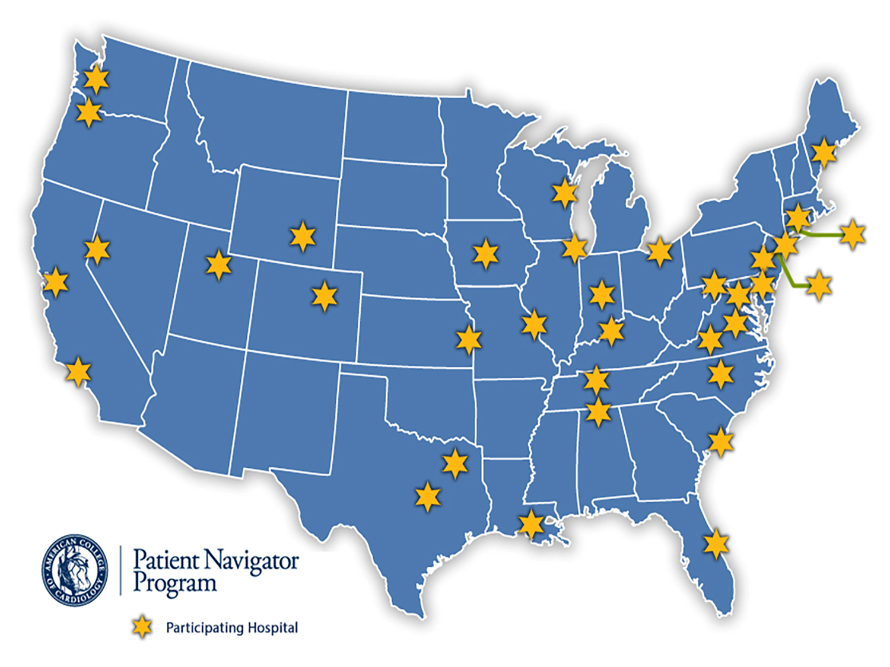
Original Patient Navigator Hospital
Focus MI Hospital
Notes:
Original Patient Navigator Hospitals
Focus MI Hospital

Slide 22
National and Cohort MI Metrics
ACTION Registry
STEMI Performance Composite
NSTEMI Performance Composite
Defect Free Care
Aldosterone blocking agent for LVSD
Bleeding
Mortality
Cardiac rehab referral
Notes:
MI Metrics from (ACTION Registry)

Slide 23
National and Cohort MI Metrics
Other Care Transition Metrics
Readmissions
Patient satisfaction
AMI patients identified
AMI patients assessed for risk of readmission
Medication Reconciliation
Notes:
Non-ACTION care transition metrics
Metrics are captured at baseline, quarterly, and annually. The non ACTION metrics will be captured in survey collection tool.

Slide 24
National and Cohort MI Metrics
Other Care Transition Metrics
Readmissions
Patient satisfaction
AMI patients identified
AMI patients assessed for risk of readmission
Medication Reconciliation
Discharge Summary Communication
Patient Education on self-care plan and medications
Providing community resources
Notes:
Non-ACTION care transition metrics
Metrics are captured at baseline, quarterly, and annually. The non ACTION metrics will be captured in survey collection tool.

Slide 25
Getting Started
Review the program requirements
Opt-in to participate in the Navigator Focus MI Program
Note: You will be required to log in using your NCDR user name and password to Opt into the program.
Establish a multidisciplinary Navigator Focus MI team
Include an administrator, physician, and nurse champion.
Submit your hospital’s baseline data in the data collection survey
Notes:
Reinforce point 3

Slide 26
Notes:
To access the “Opt in” page, the link is found on either the QII home page, or the ACTION Start Page. To Opt In from QII, click Campaigns, and then select Patient Navigator: Focus MI from the drop down.

Slide 27
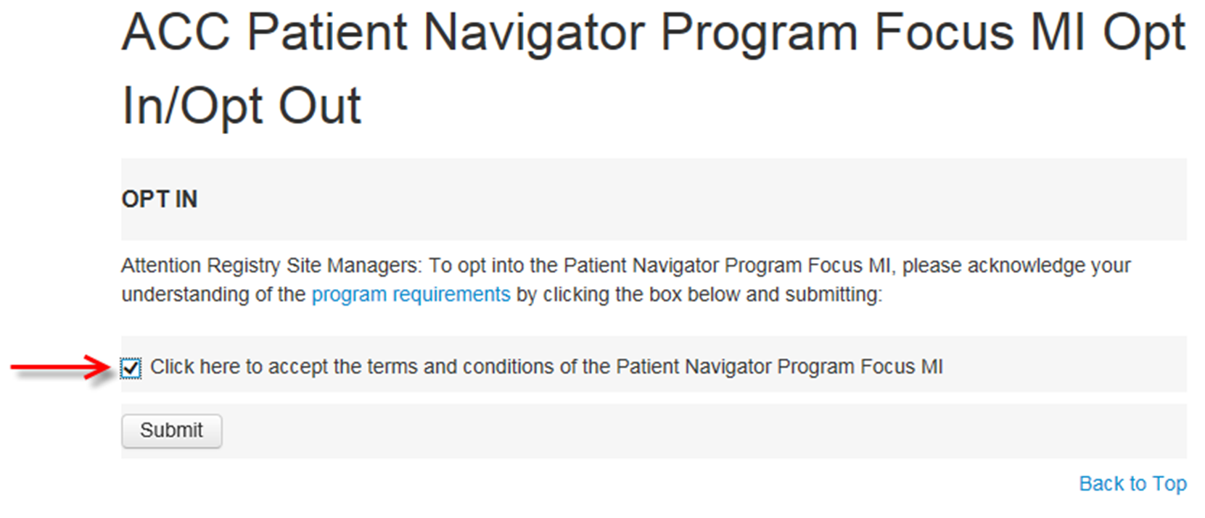
Notes:
On the Pt. Nav Focus MI main page, you can select the hyperlink “opt into the program”, and after you log into NCDR, you will be brought to this screen.
Select the box to accept the terms and conditions of the program, and at that point the submit button will enable.

Slide 28
Notes:
To opt in from the ACTION registry, log in and then click the “Adminstration” tab from the home page. Then, select “Pt. Nav Focus MI” to go to the “Opt In” screen.

Slide 29
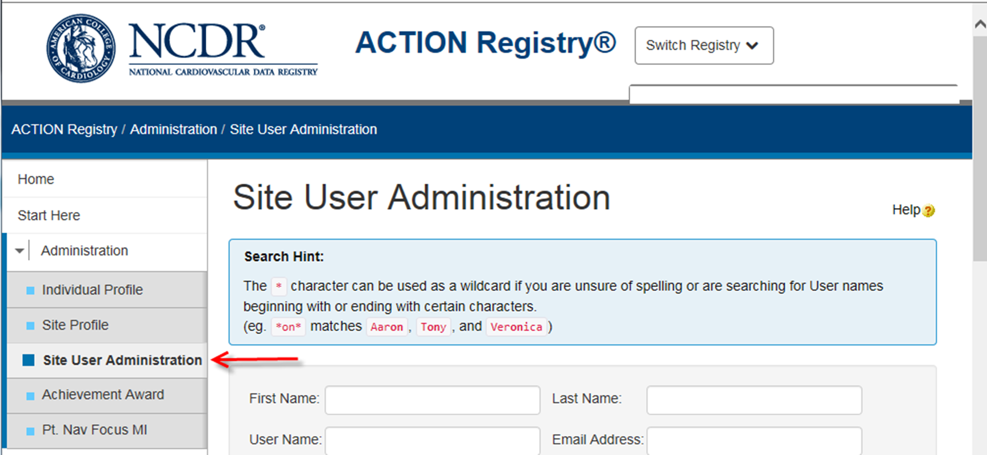
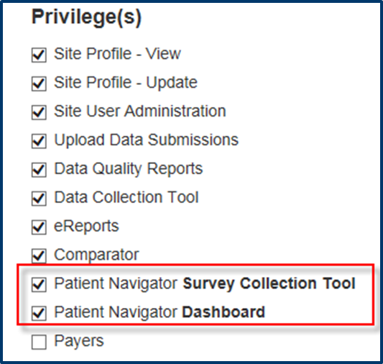
Notes:
Opt In: Once the Registry Site Manager has opted into the program, it is necessary to assign privileges. Go to the site profile to assign privileges
Under the Site User Administration, select the Patient Navigator Survey Collection Tool (for data collection) and/or the Patient Navigator Dashboard (for Dashboard access)

Slide 30
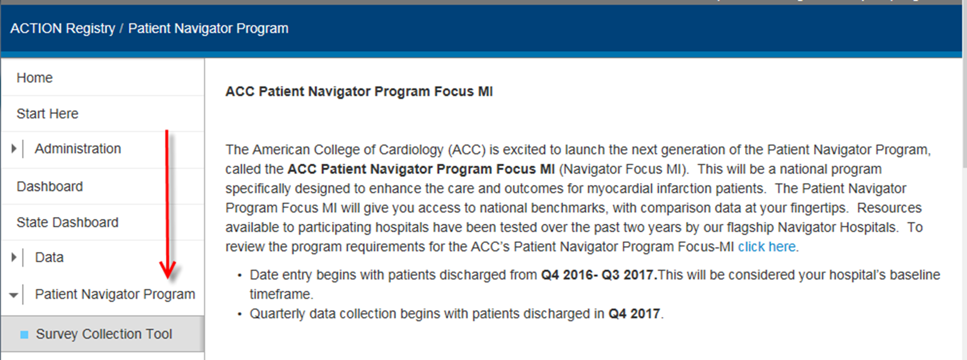
Notes:
Accessing the Tool: By logging into the ACTION registry, the left navigation bar will reflect the Patient Navigator Program Focus MI option.
(Second bullet point has been whited out.)

Slide 31
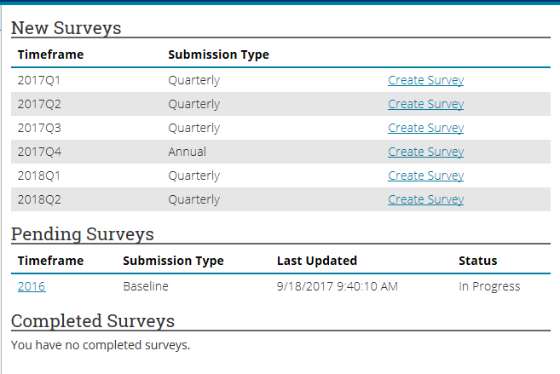
Survey Tool Layout
Upon opening the survey tool, you will see three main pieces:
New Surveys, Pending Surveys, Completed Surveys.

Slide 32
Survey Collection Tool
Notes:
By clicking on Save and Continue, you will be directed to the next section of the survey questions. -Notice a checkmark after “Instructions.” As you complete a section, the survey will check it off for you to help you navigate back where you need to with ease.
Save frequently and often!

Slide 33
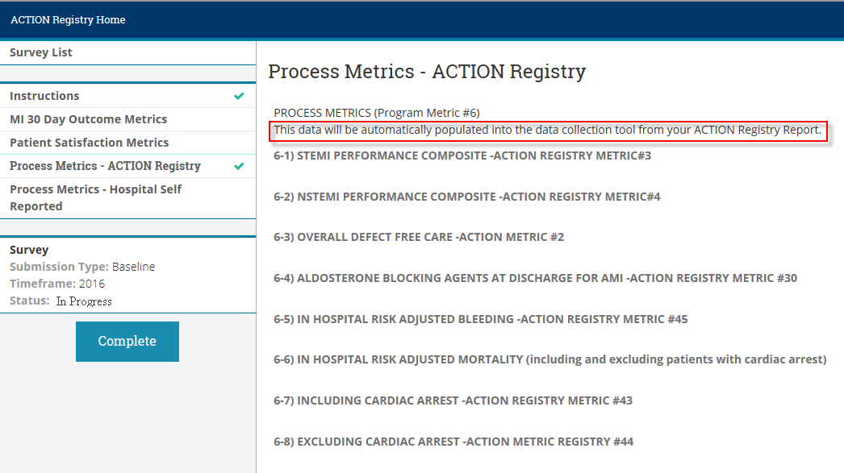
Survey Collection Tool
ACTION Registry Process metrics do not need to be manually entered.
Notes:
The Process Metrics page functions to inform you of the metrics that will automatically pull from the ACTION Registry Report. When you get to this page, simply Save and Continue.

Slide 34
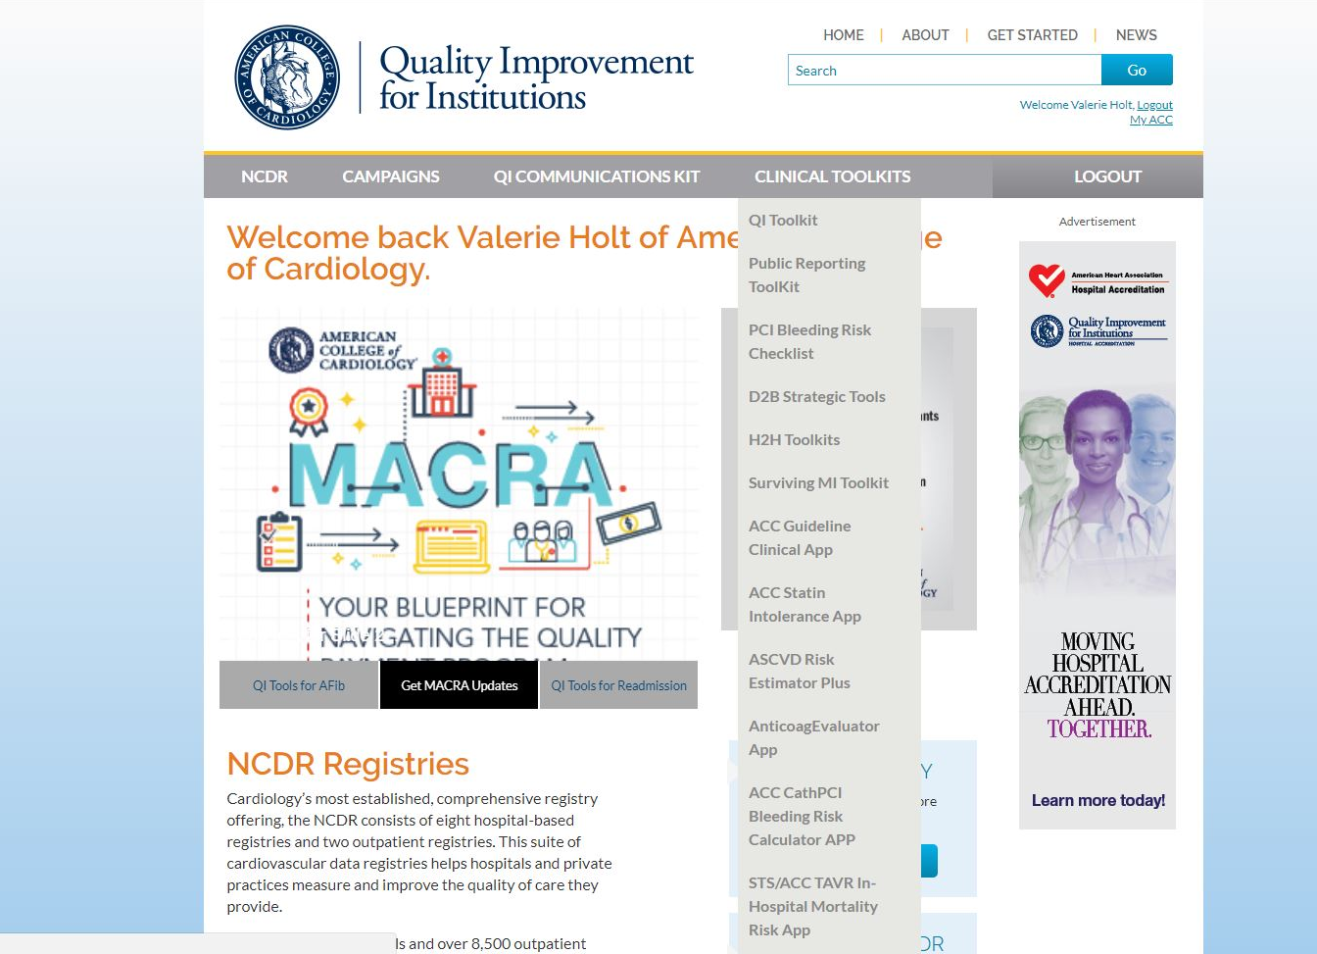
Notes:
Exploring QII

Slide 38
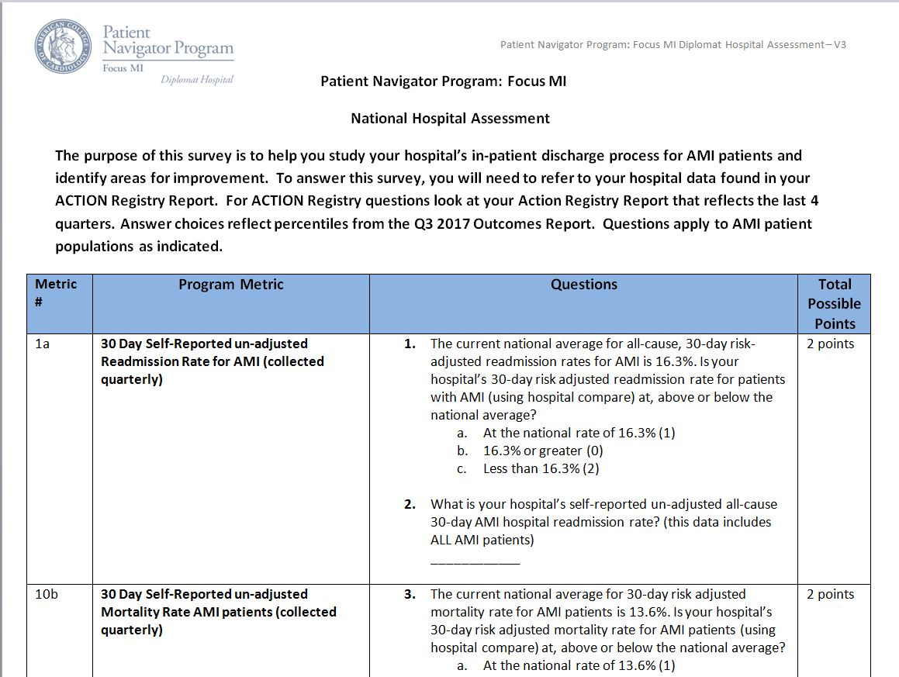

Slide 39
Email pnpfocusmi@lists.acc.org to subscribe! Don’t forget to add this address to your contacts so that emails aren’t marked as spam.
Notes:
NOTE: Check your junk folder to make sure you aren’t missing emails once you’ve been added to the list.

Slide 40
1. 30 day unadjusted readmission | Readmission template Readmit interview tool for Cerner
5. CMS 30 Day Risk Standardized 30 Day Episode of Payment Measure for AMI | How to extract CMS Data
6. Metrics from Action Registry GWTG | Multidisciplinary Rounds; ACS Admission; AMI in General Discharge; Outpatient cardiac rehab order in EPIC; Acute Coronary Syndrome Mini Order; Cardiac Rehab Referral and brochure; STEMINSTEMI PMs; ACTION Bleeding; Manuscript Predicting Hospital Mortality for AMI Patients; AACVPR ACCF AHA Performance Measures for Cardiac Rehab Secondary Prevention
7. Heart Failure Performance Measures | Boost Tool; Core measure quality sheet; HF SmartSet for EPIC; Admission Order Set
8. HF and AMI patients risk of readmission | Core measure quality sheet; Flor chart HF and AMI high risk patients; Admission Risk Assessment HF and AMI
9. Medication reconciliation and documentation | Flow chart Med rec and counseling; Pharmacy Med rec and Counseling;
10. Follow-up visit scheduled | Appointment Card and Medication Education; PostDCAApptFlowcart; Appointment Card
11. HF patient arrives at follow up appt | Call transition question; Integrated Health criteria; Post Discharge callback AMI-CHF
12. Discharge summary available to follow up physician | Discharge Checklist AMI and HF
13. Clinician discussion and documentation | AMI Patient ED RN Instruction checklist; HF Zones; Community Resources brochure; ACS Individualized Patient Education tool; AMI stoplight; HF Education Algorithm; MI Education Algorithm; Sample Patient cards
Patient Navigator: Focus MI
Compendium of
Best Practices

Slide 41
Identify Areas for Improvement
Drill down on each measure
Prioritize your areas for improvement
How does this impact
patients?

Slide 42
Define Your Goals

Slide 43
Define Your Goals
Notes:
Getting started: define your goals

Slide 44
Understand Your Current Process
What standardized order sets/protocols are in place, and how are they used?
How are patients identified
What systems are in place to “catch” oversights

Slide 45
Define and Implement Your Plan for Improvement

Slide 47
Upcoming Events
Webinar #2: Wednesday, April 11th, 12 – 1 pm EST
Webinar #3: Wednesday, June 20th, 12 – 1 pm EST
Webinar #4: Thursday, November 29th, 12 – 1 pm EST

Slide 48
Contact Information
Website: www.acc.org
ACC Call Center: 1.800.257.4737
Email: ncdr@acc.org

Slide 50
Q&A
Please submit your questions for the moderated question and answer session.
The next webinar will be April 11, 2018.

