Slide 1

April 11, 2018
Collaborating with your Community
Webinar #2

Slide 2
Agenda
Time | Topic | Presenter
12:00 pm | Welcome and Introductions | Dr. Ty Gluckman
 | Involving your Community
12:05 pm | Scott & White Emergency Medical Services: Mobile Integrated Health | Julian Longoria, LP, CCP-C, FP-C Mobile Integrated Health Scott & White Emergency Medical Services
12:25 pm | Q&A | All
12:35 pm | Mended Hearts Support for heart patients and their families | Millie Henn National Executive Vice President Mended Hearts
12:50 pm | Q&A | All
12:55 pm | Wrap-up and Next Steps | Dr. Ty Gluckman

Slide 3
Mobile Integrated Healthcare 2.0

Slide 4
State of the Program
3 CPs – M-F 8a-5p
“Program Capacity” = 15-20
80% Success Rate – 20% Readmission Rate
130 Total Patients Enrolled (104 Successful Enrollments)
$1.1M in cost avoidance (SWMC-Temple Business Office)
99% Patient Satisfaction (Press-Ganey Survey)

Slide 5

MIH – Community Paramedics 2.0
24/7 Operation
Fault Tolerant
Never “out of service”
MIH
Operations
Clinical
Finances
Flexibility
ANY Clinical Population (not just CHF)
OLMC
Telemedicine
Reduce Cost of Operations (To date $1.1M)
Flexible Deployment
Match Supply & Demand
Operational workflows that allow for constant change

Slide 6

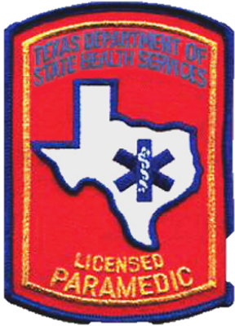
MIH - Network
RN Case Management
Inpatient MDs
Specialty Clinics/MDs
OLMC
Telemedicine
LCSW/CTCTP Coaches
Outpatient Clinics

Slide 7
Reimagine Outpatient Care
Unavoidable Readmission
Emergency Room
CTCTP/ LCSWs / Clinic PCP
OLMC / Telemedicine
Paramedic Home Visits
Specialty Clinic

Slide 8
What are the benefits of MIH 2.0?
Home Visits – Community Paramedics
More patients = bigger impact on readmissions
From CHF focused to All Cause – All Payer
Increased population health
Increased patient satisfaction
Community education
Hospital
Clinic Infrastructure
Hosp. ED Savings
All-Cause Admission Savings
Total Expenditure Savings
Decrease ED visits
Increase PCP Utilization
Decreased Total Cost of Care to Patient

Slide 9
Questions?

Slide 10


Making a Difference in Patients’ Lives

Slide 11
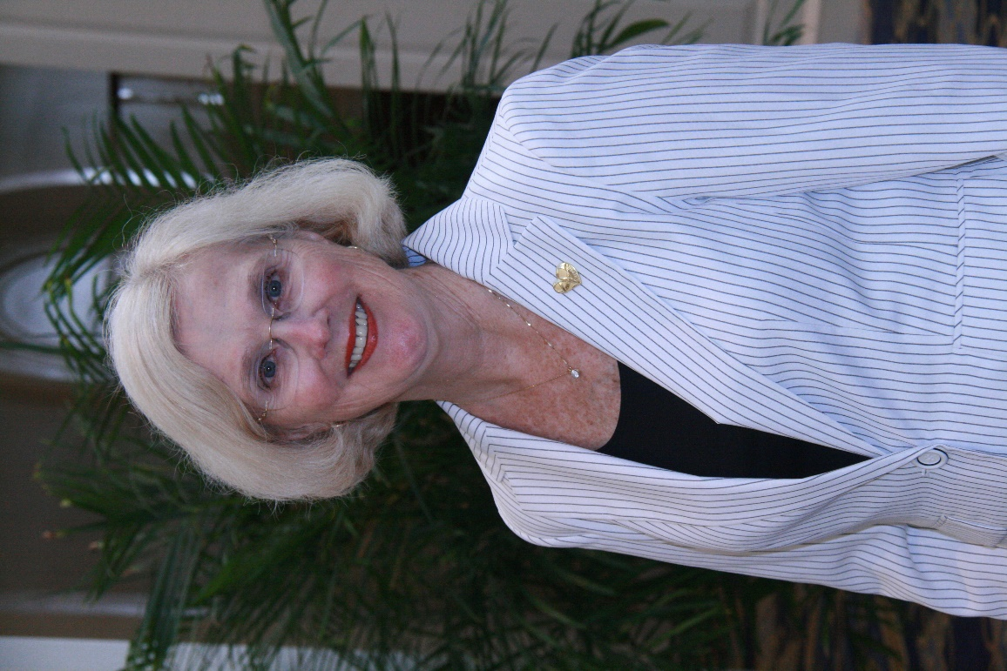

About Millie Henn
Mended Hearts Chapter 12 Temple, TX Visiting Chair
National Exec. Vice President
Heart patient
Family history of CVD
Patient advocate
Certified patient visitor

Slide 12
About Mended Hearts
Founded 1951
Dr. Dwight Harken & 4 patients in Boston
Nonprofit 501(c)3 organization
300 Community-based Chapters
20,000 Members – patients & families
460 Hospitals
200,000 Visits annually to patients & caregivers

Slide 13
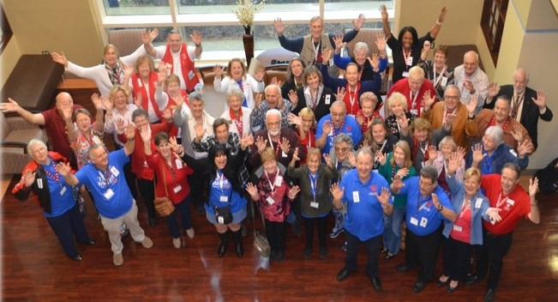
Mended Hearts Mission
“Inspiring hope and improving the quality of life for heart patients and their families through ongoing peer-to-peer support”
Motto: “It is great to be alive – and to help others!”

Slide 14
Mended Hearts Objectives
Visit & support patients/caregivers/families
Offer ongoing education and regular programs
Promote community outreach and awareness
Assist medical professionals by improving outcomes through peer-to-peer connections

Slide 15

MH Accredited Visitor Training
Creates a core knowledge…
  HIPAA, hospital protocols
Provides consistent standards
Builds confidence
Promotes compassion for patients

Slide 16

Patient Visiting Program Goals
                Support all types of heart patients
Provide favorable impact on hospital experience
Provide encouragement from person with similar experience
Deliver helpful education about medical condition
Assist HCPs to improve health outcomes

Slide 17

Patient Visiting Program
Encourage healthy lifestyle, diet and exercise
Encourage cardiac rehab
Encourage medication adherence
Participate in patient discharge activities

Slide 18
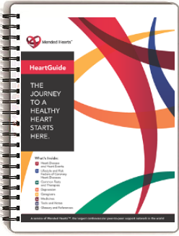
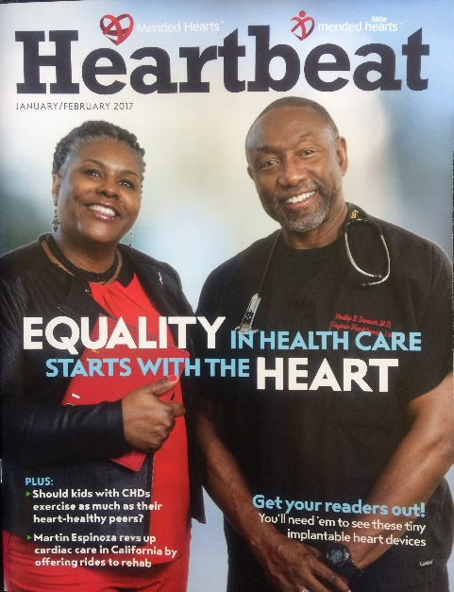
Mended Hearts Patient Resources
HeartGuide education
  English & Spanish
  Print & digital
  Mobile app – Apple & Android
GoToGuides & online tools
Heartbeat
magazine

Slide 19

Patient Follow Up
With patients’ permission:
Contact patient after home
Send chapter newsletters
Invite to monthly chapter educational program
Notes:
Mended Hearts is a venerable organization with many strong assets.

Slide 20

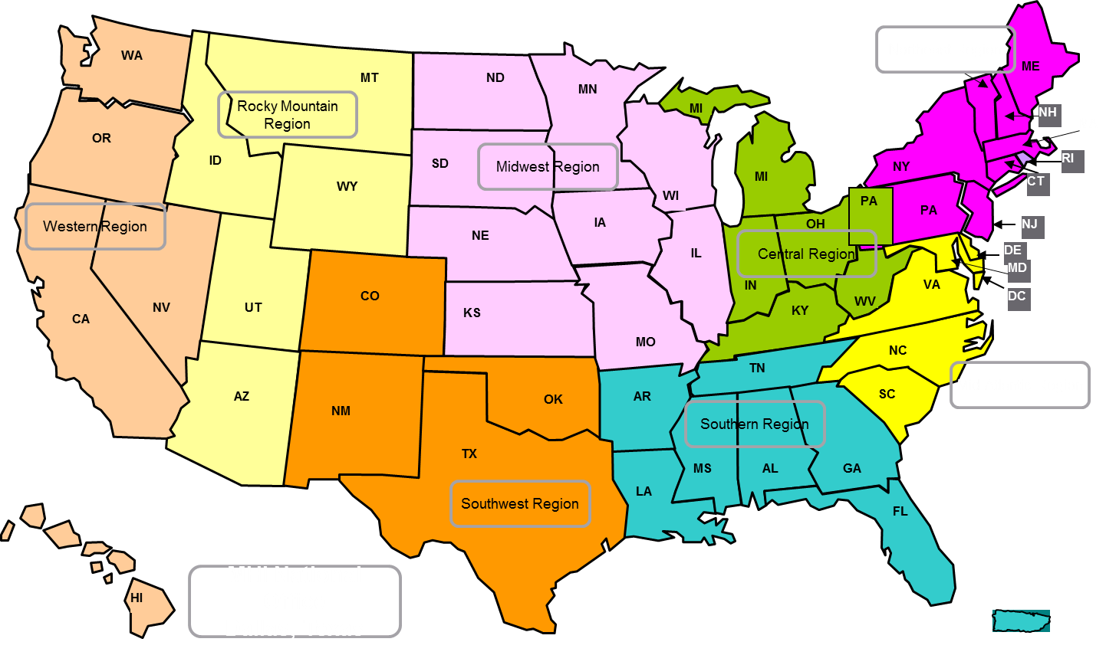
Eight Regions
Notes:
Here’s a look at how the Regions are geographically organized. We are divided into 8 regions.

Slide 21

Questions & Answers
www.mendedhearts.org
1-888-HEART-99
“It’s great to be alive – and to help others!”

Slide 22
Upcoming Webinars
Webinar 3: Wednesday, June 20th from 12-1 pm EDT
Webinar 4: Thursday, November 29th from 12-1 pm EST

Slide 23
Learning Network - Listserv
Join the Patient Navigator Community:
patientnavigatorfocusmi@lists.acc.org

Slide 24
Questions?
Please submit your questions for the moderated question and answer session.

