Slide 1


Slide 2

Shared Best Practices
Implementing a Bleeding Risk Tool Into Your EHR
November 6, 2019
12:00 – 1:00 pm ET
Webinar #6

Slide 3
Hosted by:
Andrea Price MS, CPHQ, RCIS, AACC
Reduce the Risk PCI Bleed Steering Committee Chair
Special Guests:
Cornelia Anderson, BSN, RN, CPHQ, AACC
Product Manager CathPCI Registry
Jennifer Varner, BSN, RN, C4
STEMI Coordinator/Clinical Manager
West TN Heart and Vascular Center
Dylan Wilson, Pharm D
West TN Heart and Vascular Center

Slide 4
Agenda
Welcome and Introductions
Overview of Metric #40 PCI In-Hospital Risk Standardized Bleeding
Shared Best Practices – How a Risk Model Tool was Successfully Integrated into an EMR
Q&A
Announcements

Slide 5
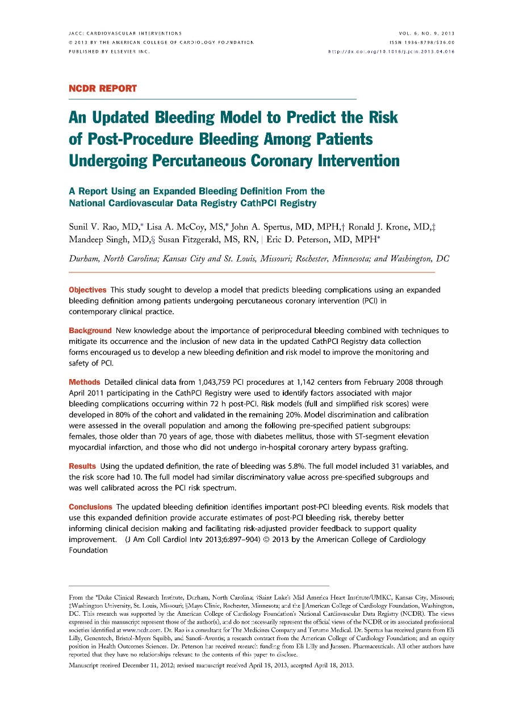
Performance Measure #40:
PCI in-hospital
risk standardized
rate of bleeding events
(all patients)
Notes:
The Risk Adjusted Bleeding model provides accurate estimates of post-PCI bleeding risk and is helpful in providing risk-adjusted feedback on bleeding complications, informing clinical decision-making, and directing the use of bleeding avoidance strategies to improve the safety of PCI procedures.

Slide 6
Risk Standardized Bleeding
Hierarchical risk model
Predictive patient variables
Hospitals factors
  Universal (performance measures, guidelines)
  Specific (volume, location, academic)
Notes:
The risk standardized bleeding metric is a hierarchical model that utilizes predictive patient variables to assess individual patient risk of bleeding. As well, it assesses the hospital ‘risk’ as in, how is the hospital different and/or similar to other hospitals? Some hospital factors are common to all hospitals, performance measures, guidelines are examples. Then there are specific factors that affect a subgroup of hospitals such as the volume of patients treated, the type of patients treated and also, the type of facility they are i.e. academic. These hospital factors are

Slide 7
PCI Bleeding Outcome
Any ONE of the following:
Bleeding event w/in 72 hours OR
Hemorrhagic stroke OR
Tamponade OR
Transfusion for patients with a pre-procedure Hgb >8 g/dL and pre-procedure Hgb not missing; OR
Absolute Hgb decrease from pre-PCI to post-PCI of ≥ 4 g/dL for patients with pre-procedure Hgb ≤ 16 g/dL or mechanical ventricular support device not used
Notes:
Bleeding event w/in 72 hours (Detail Line# 8050); or
1. Hemorrhagic stroke (Detail Line# 8021); OR
2. Tamponade (Detail Line# 8025); OR
3. Post-PCI transfusion (Detail Line# 8040) for patients with a pre-procedure Hgb >8 g/dL and pre-procedure Hgb not missing; OR
4. Absolute Hgb decrease (Detail Line# 7320 and 7345) from pre-PCI to post-PCI of >= 4 g/dl (excluded if any of the following: pre-procedure (Detail Line# 7320) 5. Hgb>16g/dl or IABP (Detail Line# 5330) = yes or MVSupport (5340) = yes)

Slide 8
Patient Eligibility
Patient’s with PCI performed during the Episode of Care
Patient risk variables are obtained from the index PCI procedure
Exclude patients who died on the same day of the procedure
Exclude patients with CABG
Notes:
Include patient’s with a PCI procedure performed during the Episode of Care
Include only index PCI procedures when patients have multiple PCI procedures (subsequent PCIs during a single Episode of Care are excluded).
Include patient procedures with non-missing values for outcome variables of bleeding event w/in 72 hours (8050) AND transfusion (8040).
Exclude patients who died on the same day of the procedure [Discharge date (9035)=procedure date (5300) AND discharge status=deceased (9040)]
Exclude patients with CABG (9000)=yes

Slide 9
Patient Eligibility
Patient’s with PCI performed during the Episode of Care
Patient risk variables are obtained from the index PCI procedure
Exclude patients who died on the same day of the procedure
Exclude patients with CABG

Slide 10
Patient Eligibility
Patient’s with PCI performed during the Episode of Care
Patient risk variables are obtained from the index PCI procedure
Exclude patients who died on the same day of the procedure
Exclude patients with CABG

Slide 11



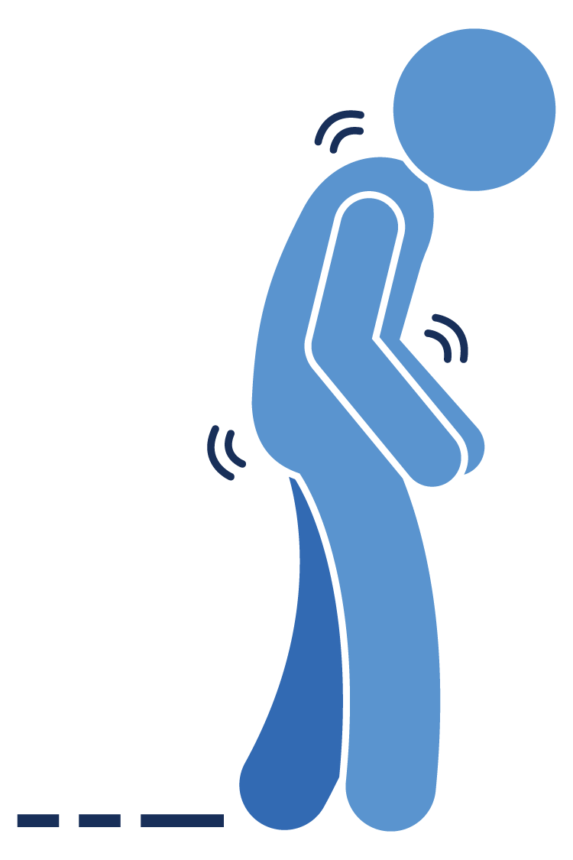
Index PCI Procedure

Slide 12
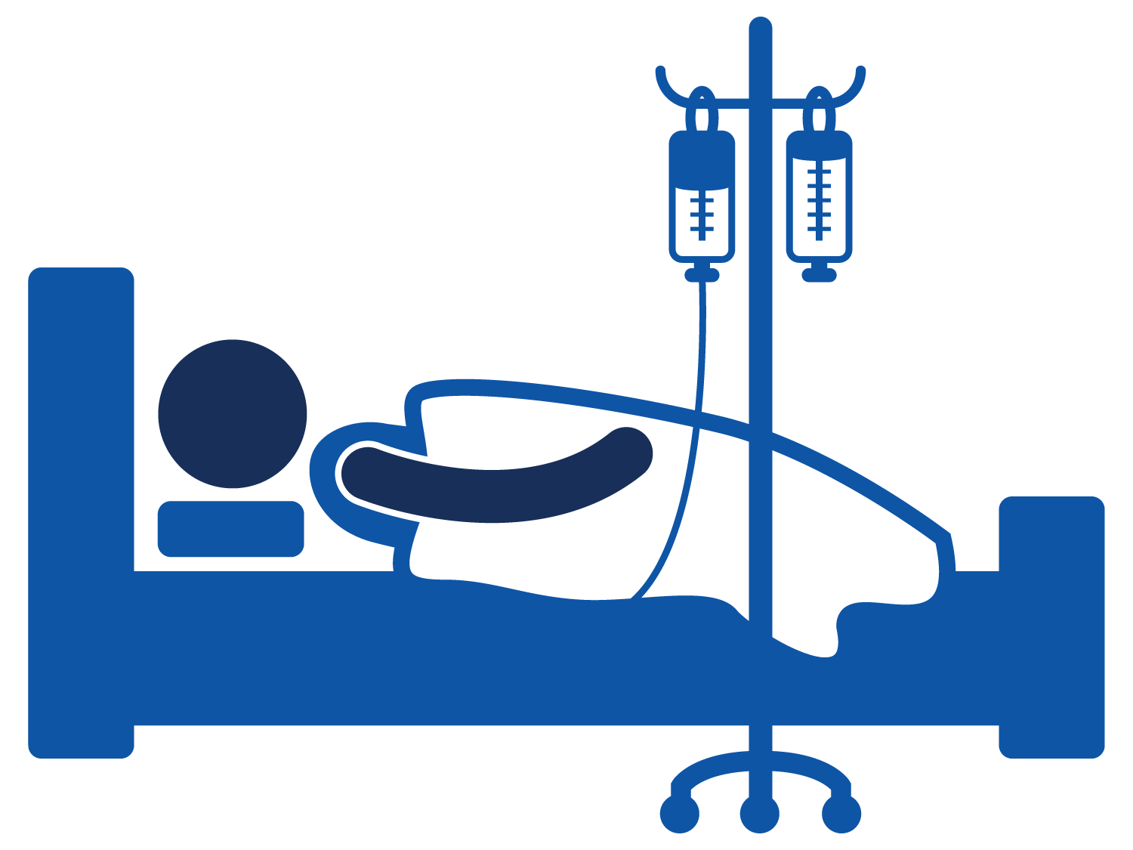
Index PCI Procedure

Slide 13
Model Variables that Remained
Pre-Procedure RISK Predictive Variables |  | PCI RISK Predicative Variables
Age (spline at 70) | Female | PCI Status
Cerebrovascular Disease | STEMI | Pre-PCI LVEF
Peripheral Arterial Disease | Thrombolytics | Cardiogenic Shock start of PCI
Chronic Lung Disease | Diabetes | Stenosis Immediately Prior to Rx
Heart Failure w/in 2 weeks | Diabetes Therapy | Pre-PCI TIMI Flow
NYHA Scale | Currently on Dialysis | Chronic Total Occlusion
Prior PCI | Cardiogenic Shock w/in 24hrs | Lesion Complexity
Cardiac Arrest w/in 24hrs | Calculated BMI | PCI of Left Main or Proximal LAD
Pre Procedure Hemoglobin (spline at 13) | Coronary Territory (number of diseased vessels) | Previously Treated Lesion Treated w/ stent In-stent restenosis In-stent thrombosis
 | Calculated GFR
Notes:
Parsimonious patient variables used to determine ‘risk’ of bleeding

Slide 14
Patient Eligibility
Patient’s with PCI performed during the Episode of Care
Patient risk variables are obtained from the index PCI procedure
Exclude patients who died on the same day of the procedure
Exclude patients with CABG

Slide 15
Patient Eligibility
Patient’s with PCI performed during the Episode of Care
Patient risk variables are obtained from the index PCI procedure
Exclude patients who died on the same day of the procedure
Exclude patients with CABG

Slide 16

Hierarchical Risk Model
Patient
Variables
Outcome:
Bleeding
Rate
MATH
Hospital Variables
Notes:
A hierarchical risk model will assess the risk of individual patients, consider universal and specific hospital factors and run the algorithm to provide your hospitals bleeding rate (which is expressed as a percentage).
Not transparent, however…

Slide 17
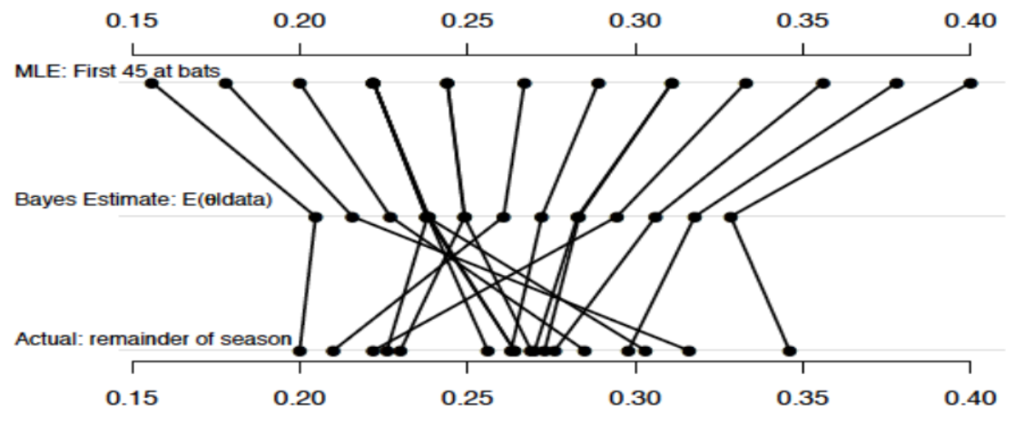
Regression to the Mean
Notes:
Highly predictive of performance. In this example (Dr. Klein’s major league baseball example) the actual performance of batters top row in pre-season is used by a hierarchical model to predict performance for the season…this is displayed by the middle row. The model applies what is known about the individual batter (in this case their 1st 45 at bats) and what it knows about major league baseball hitters perform on average

Slide 18
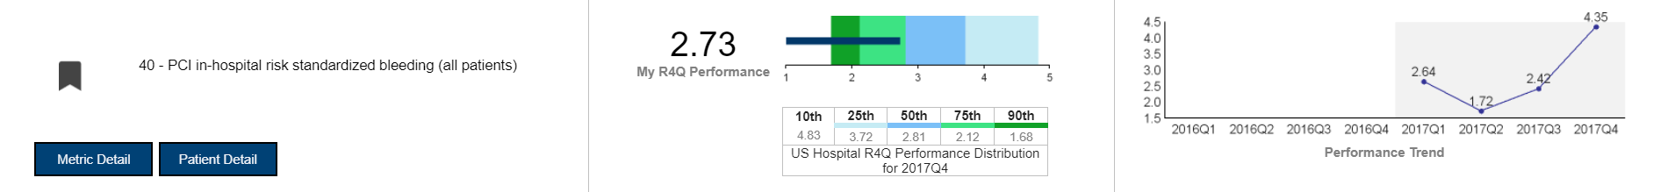
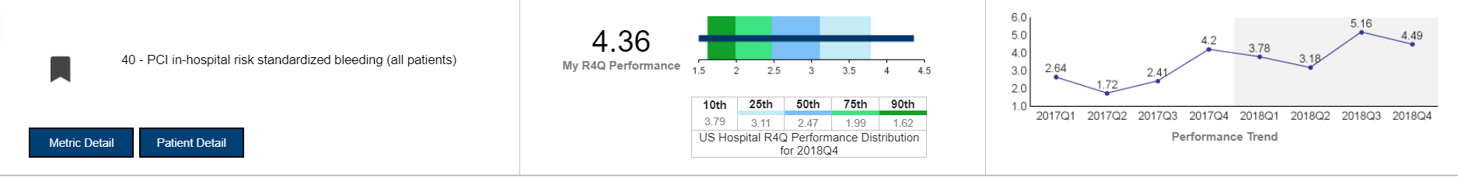
Where are we now?
2017Q4 benchmark 2.81
2018Q4 benchmark 2.47

Slide 19


Bleeding Risk Modeling

Slide 20
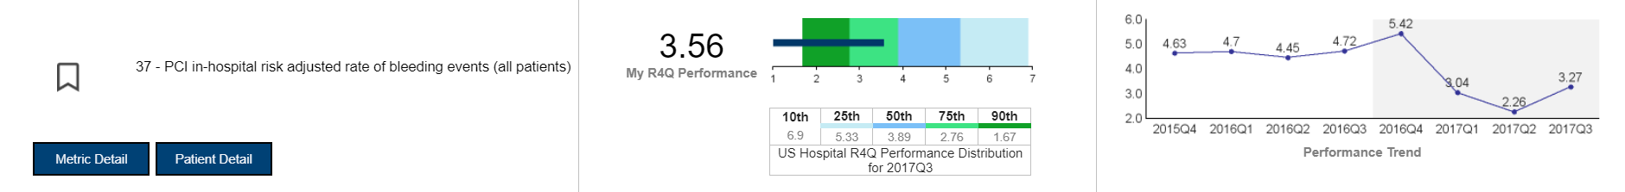


RAB vs RSB
2017Q3 benchmark 3.89
2017Q4 benchmark 2.81

Slide 21
What’s next?
Develop hierarchical risk modeling for mortality & AKI
Continue to report all traditional risk models in the detail lines

Slide 22
PCI Bleeding Outcome
Any ONE of the following:
Bleeding event w/in 72 hours OR
Hemorrhagic stroke OR
Tamponade OR
Transfusion for patients with a pre-procedure Hgb >8 g/dL and pre-procedure Hgb not missing; OR
Absolute Hgb decrease from pre-PCI to post-PCI of ≥ 4 g/dL for patients with pre-procedure Hgb ≤ 16 g/dL or mechanical ventricular support device not used
Notes:
Bleeding event w/in 72 hours (Detail Line# 8050); or
1. Hemorrhagic stroke (Detail Line# 8021); OR
2. Tamponade (Detail Line# 8025); OR
3. Post-PCI transfusion (Detail Line# 8040) for patients with a pre-procedure Hgb >8 g/dL and pre-procedure Hgb not missing; OR
4. Absolute Hgb decrease (Detail Line# 7320 and 7345) from pre-PCI to post-PCI of >= 4 g/dl (excluded if any of the following: pre-procedure (Detail Line# 7320) 5. Hgb>16g/dl or IABP (Detail Line# 5330) = yes or MVSupport (5340) = yes)

Slide 23

Reduce the Risk: pci bleed Campaign

Slide 24
West Tennessee Healthcare
Public, Not-for-Profit
Serve 500,000 across 19 Counties
Offer several clinics throughout Region
7 Emergency Departments
Treat over 185,000 people per year
EMS serves 5 Counties
3 Acute Care Facilities that hold Chest Pain Center Accreditation
Jackson General, Dyersburg Hospital and Volunteer Hospital in Martin
Notes:
West TN Healthcare is a public, not-for-profit healthcare system serving over 500,000 people across 19 counties in West TN
We offer several clinics located throughout the region for easier access for the communities we serve
We have 7 Emergency Departments treating over 185,000 people per year and EMS that serves 5 counties
We have 3 acute care facilities that hold Chest Pain Center Accreditation – Jackson General, Dyersburg Hospital and Volunteer Hospital in Martin

Slide 25
West Tennessee Healthcare
Jackson Madison County General Hospital is considered the “flag-ship”
Operates about 700 beds
Includes Cardiovascular Surgery
Serve over 9,000 heart patients a year
State’s leader in treating heart attacks
Received the Chest Pain MI Platinum Award
Notes:
Jackson Madison County General Hospital is considered the “flag-ship” and operates about 700 beds including cardiovascular surgery
We serve over 9,000 heart patients a year and Jackson General is the state’s leader in treating heart attacks
We have received the Chest Pain MI Platinum award for the last several years

Slide 26
PCI Reduce the Risk Bleed Campaign
Opted into the Campaign in October of 2018
Presented to administration for approval
Incorporated the Campaign into already existing Cardiac Interventional Modality Group
Advantages
      Intravascular Cardiology, IT, CCL Director, Pharmacy, Administration and Nursing
Notes:
We opted into the Campaign in October of 2018
We did have to present to administration for approval
We incorporated the Campaign into our already existing Cardiac Interventional Modality Group
Advantages: We already had intravascular cardiology, IT, CCL Director, pharmacy, administration and nursing as a part of this group

Slide 27
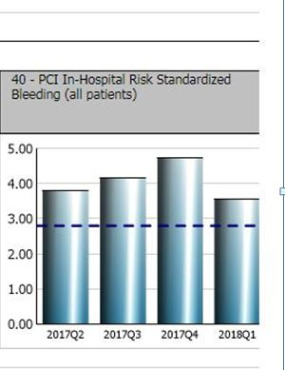
Metric # 40
We educated the team on Metric #40 and the definitions for a “bleeding event”

Slide 28
Drill Down Data
Reviewed individual patients that had a bleed during those quarters
Reviewed several key elements
Reviewed data from different angles
Recommended next steps
Added the Bleed Risk Calculator
Notes:
We looked at the individual patients that had a bleed during those quarters
Looked at types of bleeds, medications used, site access, closure devices
Looked at data from different angles based on suggestions from the group
We then informed the group that the next step recommended from the Campaign and based on our facility assessment that had been done initially was to add the Bleed Risk Calculator

Slide 29
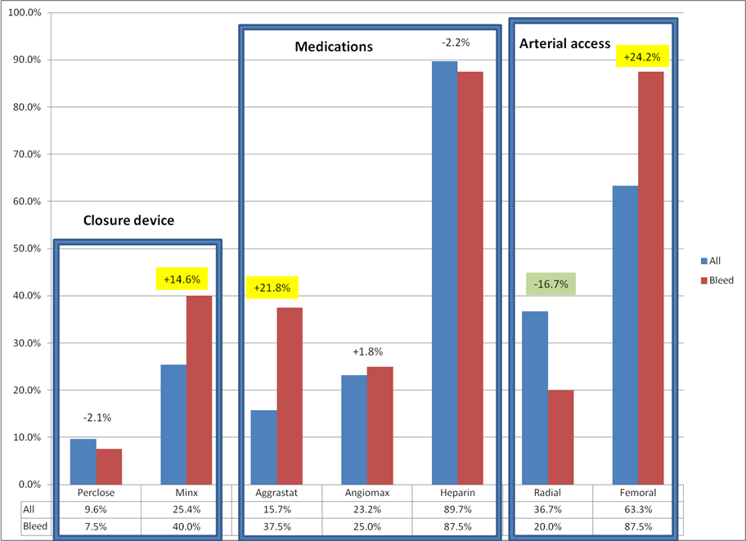
Old Business – Initiative updates

Slide 30
Implementing a bleed risk tool in the EMR
Agreement to use the Cath PCI Bleeding Risk Calculator
IT department was on a build freeze
Use the internet tool
Provided education
Internet access made available
Notes:
Everyone agreed on using the Cath PCI Bleeding Risk Calculator from the ACC
IT department was on a build freeze
We decided to use the tool from the internet and copy and paste it into the chart electronically
Education was provided to our CCL and PPU area and internet access was made available on all the computers in these areas

Slide 31
AFTER THE IT BUILD FREEZE
IT collaboration
Building algorithms
Making it work
Next steps….

Slide 32
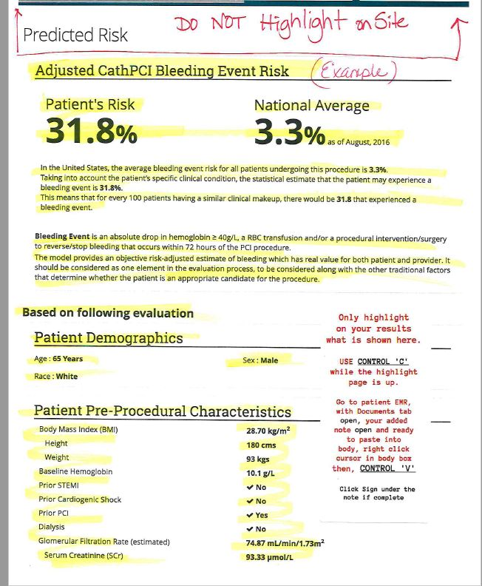
Go Live was 2/25/2019
Highlight, Copy and Paste
Score was added to the CCL documentation
Communicated at the Time Out
Notes:
Had to decide where to put so everyone could access – nsg progress notes,

Slide 33
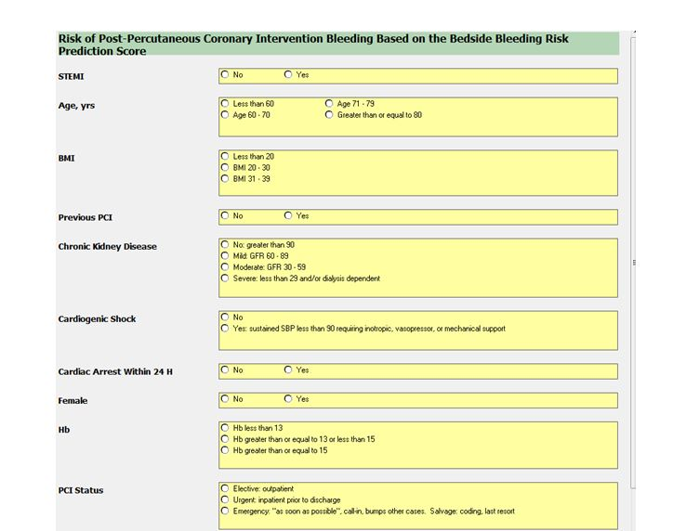
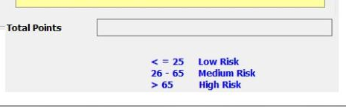
PCI Bleed Risk calculator built in the EMR
PCI Bleed Risk calculator built in the EMR

Slide 34

CathPCI Bleed Risk Assessment
Low: ≤ 25
  Consider 1 bleed avoidance strategy
Step 1
Assess bleed risk
Mod: 26-65
  Implement 1 bleed avoidance strategy
High: > 65
  Implement 2 bleed avoidance strategies
Bleed Avoidance Strategies (BAS)
Step 2
Choose BAS
Access site
GPIIb/IIIa inhibitor
Closure device
#1 Radial
#2 No GPI or bolus-only GPI
#3 Perclose
**For Impella, implement #2 and #3 above**

Slide 35
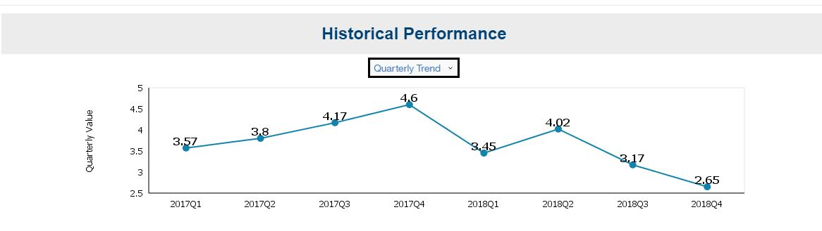
Metric #40 Historical Data

Slide 36

QUESTIONS?

Slide 37
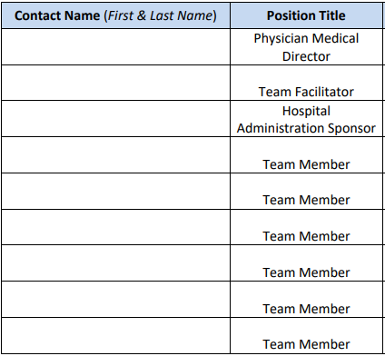
Team Roster
Multidisciplinary Team
Identify Champion and Roles
Contact Information
Submit to NCDR within 45 days
ncdr@acc.org or ncdrmail@acc.org
Notes:
When opting in to the Reduce the Risk: PCI Bleed Quality Campaign, the facility must designate a core team
Select a Physician Leader, Team Facilitator, Executive Sponsor, and other team members Identify the roles that each team member should fill.
Typically, there is one Physician team leader and one team facilitator, but you can assign co-leaders or co-facilitators if desired or necessary.
Physician Leader – responsible for representing project, primary decision-maker, and serves as the liaison to medical staff.
Team Facilitator – responsible for serving as the primary point of contact for the Program.
Hospital Administration Sponsor – responsible for allotting adequate resources to support Program activities.
Team Members – a key contributor as a process owner, content expert, or data analyst responsible for implementing specific project activities. (i.e. pharmacist, social worker, nurse, physician assistant, case manager, data specialist)

Slide 38
Webinars
All Webinars are archived and available for review
Webinar #7 January 22, 2020
Notes:
Please note that all Webinars are archived and available for review –both slides and oral presentation. Simply go to the cv quality homepage, select Reduce the Risk: PCI Bleed Campaign, scroll to the bottom of the screen and where it says to access archived webinars, simply click the blue hyperlink.
The next Webinar is Wednesday, January 22, 2020 from 12 pm -1pm ET.

