Slide 1


Slide 2

Webinar # 5
Using the PCI Bleeding Risk Campaign to Affect Patient Outcomes
August 23, 2018
12:00-1:00pm EST
ACC Reduce the Risk: PCI Bleed
Notes:
Strategies: Improving data collection processes
Increase interdisciplinary communication
Involving community providers (HHA, SNF)
Addressing social issues, offering resources and knowing what resources are available
Improving transition of care through communication with PCP’s and physicians outside of the hospital system.

Slide 3
Hosted by;
Andrea Price MS, CPHQ, RCIS, AACC
Director- Quality Databases, Indiana University Health
Reduce the Risk PCI Bleed Steering Committee Chair
Sunil Rao MD, FACC
Reduce the Risk PCI Bleed Steering Committee Member

Slide 4
Agenda
ACC Quality Campaign Framework and Design and History
Reduce the Risk: PCI Bleed Campaign Goals
Campaign Metrics
The Change Package/the Campaign Features
Getting Started

Slide 5
Quality Campaign Goals…
Help hospitals improve cardiovascular care.
To improve the quality and value of cardiovascular care and outcomes.
Leverage evidence-based practices.

Slide 6
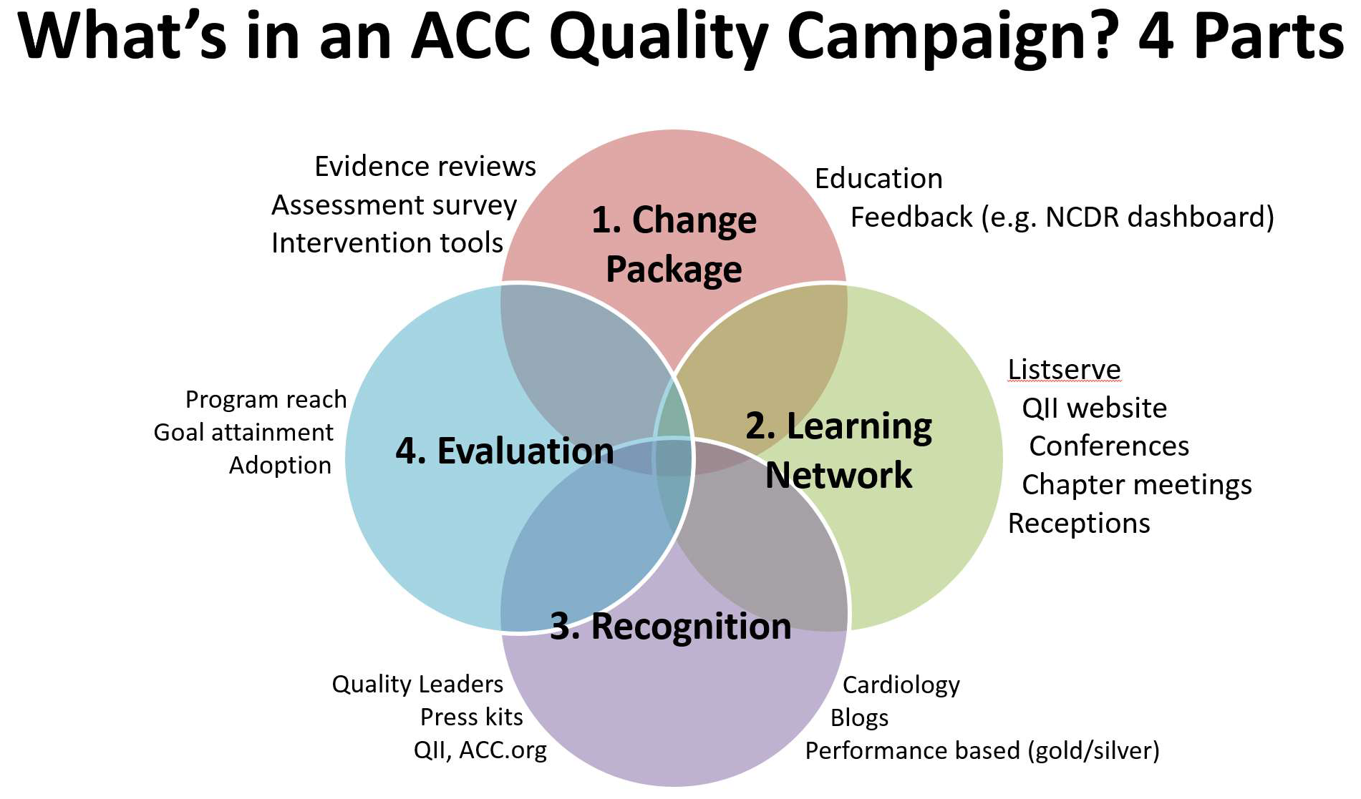
NCDR QI Need
*Key characteristics of a successful QI program
Influential
Credible
Simple
Strategically aligned for participant
Offers practical implementation tools
Offers Networking
Sets Attainable goals
*Bradley, E. H., Nembhard, I. M., Yuan, C. T., Stern, A. F., Curtis, J. P., Nallamothu, B. K., & ... Krumholz, H. M. (2010). What Is the Experience of National Quality Campaigns? Views from the Field What Is the Experience of National Quality Campaigns?. Health Services Research, 45(6p1), 1651-1669.

Slide 7
Potential Quality Campaign
Feasibility Framework
 |  |  |  | Evidence-based
Need to | Strategic | Internal/ | Measureable | implementation
improve | alignment | external levers | Outcomes | strategies | Champions | Funding

Slide 8
Reduce the Risk: PCI Bleed–Feasibility Assessment
A. Primary Purpose To decrease PCI associated bleeding adverse events | D. Drivers Stakeholders BCBSA MACRA CPI NQF MOC | G. Evidence based Implementation metrics Bivalirudin for high risk patients Radial Access PCI bleeding toolkit on QII | J. Program Champions and experts Amit Amin Ty Gluckman
B. Aligned with ACC strategic plan and mission Transformation of Care Member Value Purposeful Education
 | E. Draft QI aim statement(s) Improve PCI bleeding rates for hospitals participating in the ACTION and CathPCI Registry by motivating widespread adoption of evidence-based practices to improve quality of care. | H. Internal levers Registry data source CathPCI ACTION Guideline references PCI DAPT Accreditation CathLab related standards Tools PCI bleeding toolkit ACC Quality programs PMAC pathway | Overall program design Change package Evidence-based strategies Assessment survey Intervention tools Education Feedback Learning Network Listserv QII website Conferences Chapter meetings Receptions Recognition Quality Leader Hospitals General recognition Evaluation Plan Program reach Clinical care Adoption
C. Evidence of need to improve Published evidence Median PCI risk adjusted bleeding = 5.1%, range is 2.65% to 9.36% 70% of hospital variability due to unexplained causes Guidelines Evaluate bleeding risk (1C PCI) ACS treated with DAPT after stent and not high risk of bleeding and no hx of stroke/TIA use prasagrel over clopidogrel (IIA DAPT) NCDR dashboard ½ CathPCI sites have median RAB = 4.16% or higher. 90th percentile of hospitals have RAB - 1.6% or lower.
 | F. Outcome measures CathPCI (#37)PCI in hospital risk adjusted rate of bleeding events for all PCI pts #1289) Post proc bleeding (#1602) Bivalirudin w/I 24hrs of all PCI pts (#1827) Unadjusted bleeding events (#1871) Post proc bleeding for STEMI pts ACTION (#42) In-hospital RAB
 |  | I. Funding No obvious funding other than ACC/NCDR at the moment. Pharma: AZ-Brillinta Daiichi Sankyo/Eli Lilly – Prasugrel TMC – Bivalirudin Transradial: St. Jude, Medtronic, BSC
A. Primary Purpose
D. Drivers
G. Evidence based implementation metrics
J. Program champions and experts
B. Aligned with ACC strategic plan and mission
E. Draft QI aim statement(s)
H. Internal levers
K. Overall program design
C. Evidence of need to improve
F. Outcome measures
I. Funding
Notes:
This slide has transitions

Slide 9
Agenda
ACC Quality Campaign Framework and Design and History
Reduce the Risk: PCI Bleed Campaign Goals
Campaign Metrics
The Change Package /the Campaign Features
Getting Started

Slide 10
Reduce the Risk: PCI Bleed
Quality Campaign
Improve bleeding rates and decrease variances in data
motivating widespread adoption of evidence-based practices to improve quality of care
Decreasing Bleeding Rates

Slide 11
All patients should be evaluated for risk of bleeding before PCI.
Patients considered high risk for PCI should be part of a collaborative decision to use a radial approach.
In patients with ACS treated with DAPT after coronary stent implantation who are not at high risk for bleeding complications and who do not have a history of stroke or TIA, it is reasonable to choose Prasugrel over Clopidogrel for maintenance P2Y12 inhibitor therapy.
In patients with SIHD treated with DAPT after DES implantation who are at high risk of severe bleeding complication or develop significant overt bleeding, discontinuation of P2Y12 inhibitor therapy after 3 months may be reasonable.
In patients with SIHD treated with DAPT after BMS or DES implantation who have tolerated DAPT without a bleeding complication and who are not at high bleeding risk (e.g., prior bleeding on DAPT, coagulopathy, oral anticoagulant use), continuation of DAPT with clopidogrel for longer than 1 month in patients treated with BMS or longer than 6 months in patients treated
with DES may be reasonable.
What are the ACC/AHA Guidelines Saying
Notes:
Speak to the guidelines.
All patients should be evaluated for risk of bleeding before PCI. 2011 ACCF/AHA/SCAI Guideline for PCI
Patients considered high risk for PCI should be part of a collaborative decision to use a radial approach.
In patients with ACS treated with DAPT after coronary stent implantation who are not at high risk for bleeding complications and who do not have a history of stroke or TIA, it is reasonable to choose prasugrel over clopidogrel for maintenance P2Y12 inhibitor therapy.

Slide 12
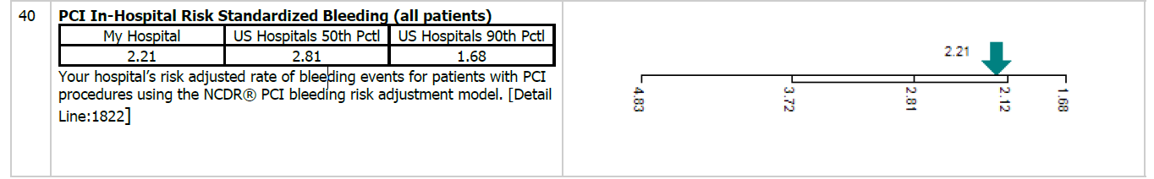
Opportunity for Improvement
2.81%
.
Notes:
Percutaneous Coronary Interventions (PCI’s) are an increasingly common procedure. Bleeding events are associated with multiple negative affects to patient QoL and mortality. We observe wide variation in bleeding outcomes between facilities, and an opportunity for improvement.

Slide 13
Steering Committee Members
Andrea Price, MS, RCIS, CCA Committee Chair | Indiana University
Amit Amin, MD, FACC | Barnes Jewish Hospital
John Messenger, MD, FACC | University of Colorado Hospital
Julie Miller, MD, FACC | Johns Hopkins Hospital
Issam Moussa, MD, FACC | Robert Wood Johnson University Hospital
Sunil V. Rao, MD, FACC | Duke University Medical Center

Slide 14
Agenda
ACC Quality Campaign Framework and Design and History
Reduce the Risk: PCI Bleed Campaign Goals
Campaign Metrics
The Change Package/the Campaign Features
Getting Started

Slide 15
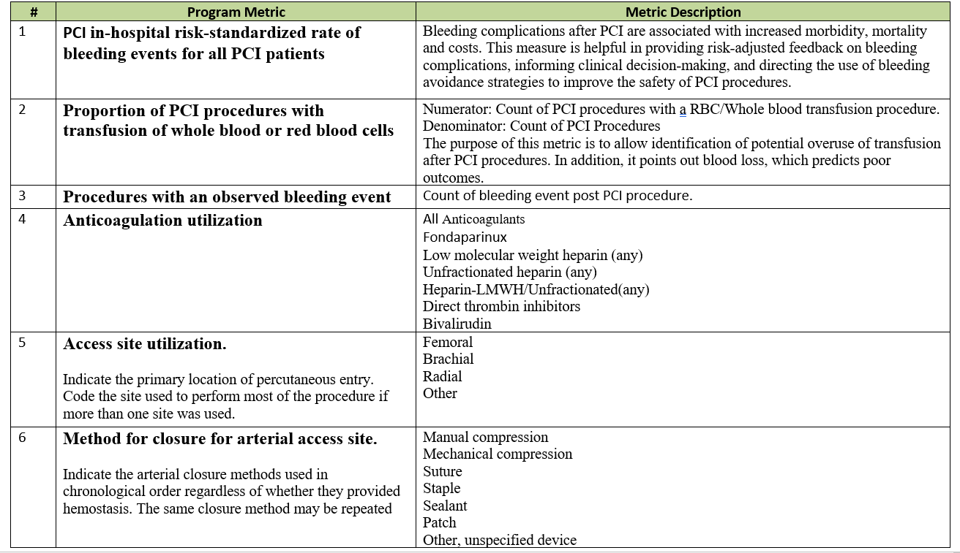

Slide 16
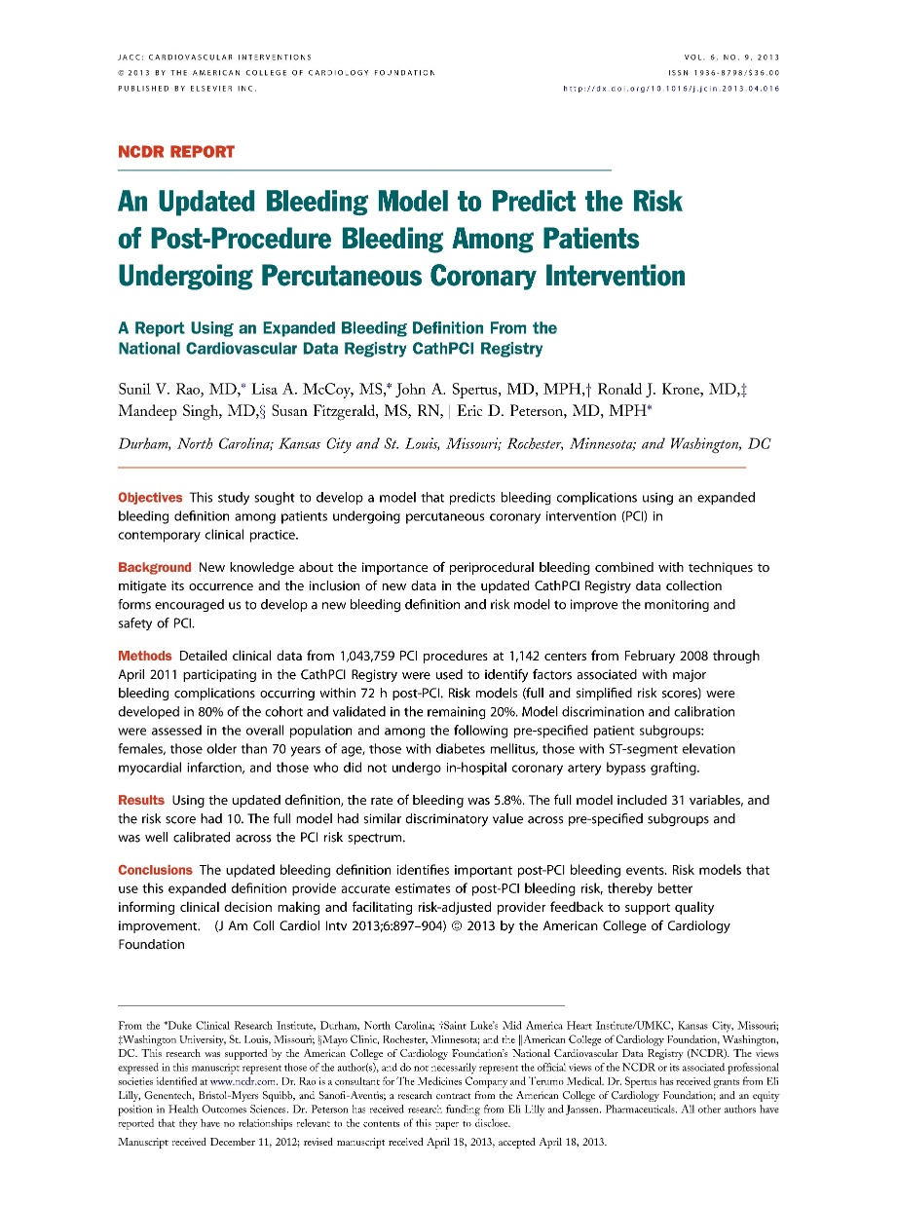
Performance Measure #40:
A new, hierarchical risk-standardized model
PCI in-hospital
risk standardized
rate of bleeding events
(all patients)
Notes:
The Risk Adjusted Bleeding model provides accurate estimates of post-PCI bleeding risk and is helpful in providing risk-adjusted feedback on bleeding complications, informing clinical decision-making, and directing the use of bleeding avoidance strategies to improve the safety of PCI procedures.

Slide 17
Performance Measure #40: What’s new
Hierarchical model
Fewer patient variables
Risk relationships within and amongst hospitals
Absolute Hgb decrease from pre-PCI to post-PCI of 4g/dL (previously 3g/dL)

Slide 18
Performance Measure #40: Model Details
Post-PCI bleeding defined as any ONE of the following:
Bleeding event w/in 72 hours OR
Hemorrhagic stroke OR
Tamponade OR
Post-PCI transfusion for patients with a pre-procedure Hgb >8 g/dL and pre-procedure Hgb not missing; OR
Absolute Hgb decrease from pre-PCI to post-PCI of ≥ 4 g/dL
Notes:
Bleeding event w/in 72 hours (Detail Line# 8050); or
1. Hemorrhagic stroke (Detail Line# 8021); OR
2. Tamponade (Detail Line# 8025); OR
3. Post-PCI transfusion (Detail Line# 8040) for patients with a pre-procedure Hgb >8 g/dL and pre-procedure Hgb not missing; OR
4. Absolute Hgb decrease (Detail Line# 7320 and 7345) from pre-PCI to post-PCI of >= 4 g/dl (excluded if any of the following: pre-procedure (Detail Line# 7320) 5. Hgb>16g/dl or IABP (Detail Line# 5330) = yes or MVSupport (5340) = yes)

Slide 19
Performance Measure #40: Model Details
Patient eligibility:
Patient’s with a PCI procedure performed during the Episode of Care.
Patients with multiple PCI procedures Include only index PCI procedure.
Include patient procedures with non-missing values for outcome variables of bleeding event w/in 72 hours AND transfusion.
Exclude patients who died on the same day of the procedure.
Exclude patients with CABG.
Notes:
Include patient’s with a PCI procedure performed during the Episode of Care
Include only index PCI procedures when patients have multiple PCI procedures (subsequent PCIs during a single Episode of Care are excluded).
Include patient procedures with non-missing values for outcome variables of bleeding event w/in 72 hours (8050) AND transfusion (8040).
Exclude patients who died on the same day of the procedure [Discharge date (9035)=procedure date (5300) AND discharge status=deceased (9040)]
Exclude patients with CABG (9000)=yes

Slide 20
Agenda
ACC Quality Campaign Framework and Design and History
Reduce the Risk: PCI Bleed Campaign Goals
Campaign Metrics
The Change Package/ the Campaign Features
Getting Started

Slide 21

QII Participant Change Package
Notes:
This is how Participant access the QII (Quality Improvement for Institutions) Reduce the Risk PCI Bleed suite of support materials

Slide 22
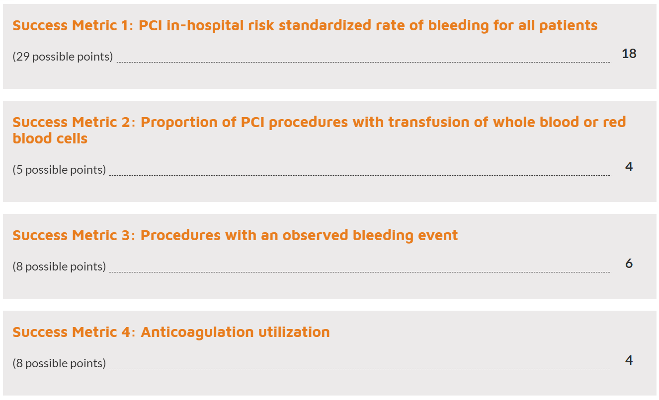
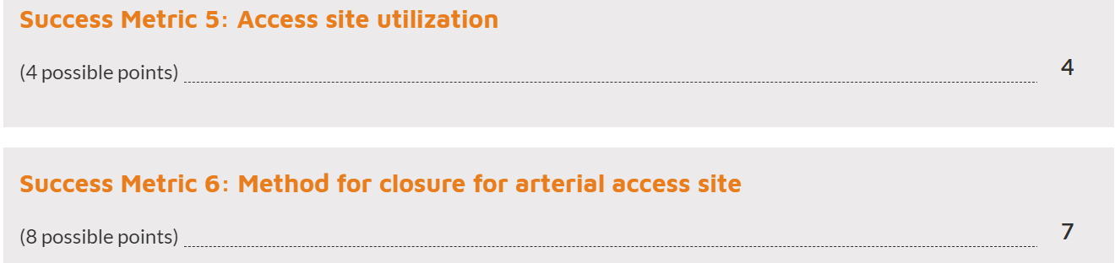
Campaign Assessment
Tool
Notes:
The assessment tool use to look at each facilities practices assessing the facilities current standard of practice and identifies potential areas of improvement. There are 38 questions in the assessment tool. An overall score is provided and a breakdown of the score is provided allowing each participant to visualize how their hospital scored on each metric. This is the results page that is sent to person at the hospital that completes the assessment.

Slide 23
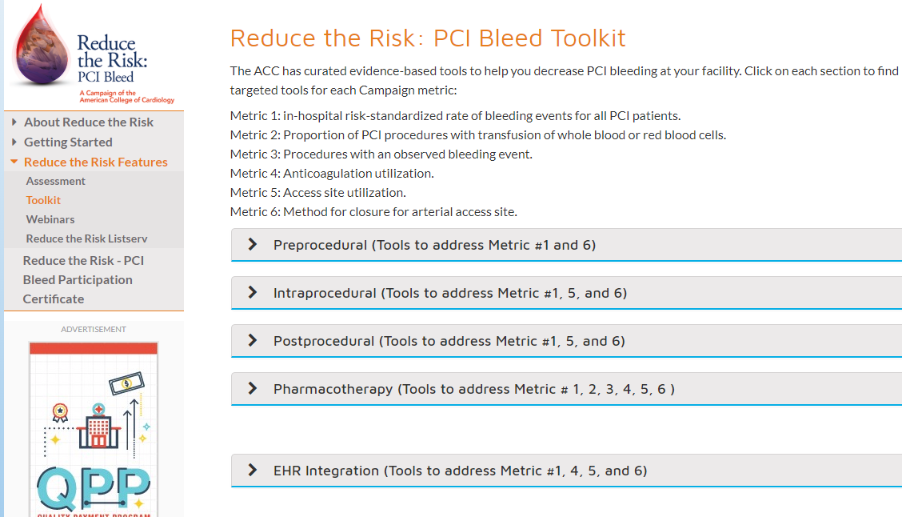
Notes:
The Reduce the Risk PCI Bleed tool kit is set up as Preprocedural tools, Intraprocedural tools, Post procedural tools, Pharmacology tools, and an EHR integration tool. There are 25 tools and 1 app- the bleeding risk calculator.
Each toolkit subheading identifies the Campaign metric and the clinical references.
For example….. (go to the next slide)

Slide 24
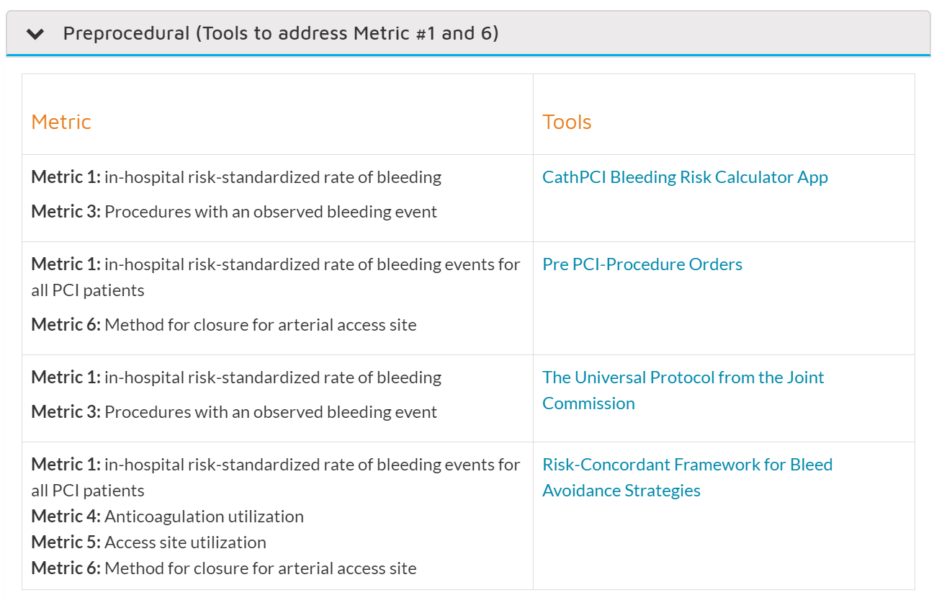
Notes:
The tools are divided by
Preprocedural tools, Intra procedural tools, Post Procedures metrics.
The drop down shows tools and which metric they support.

Slide 25
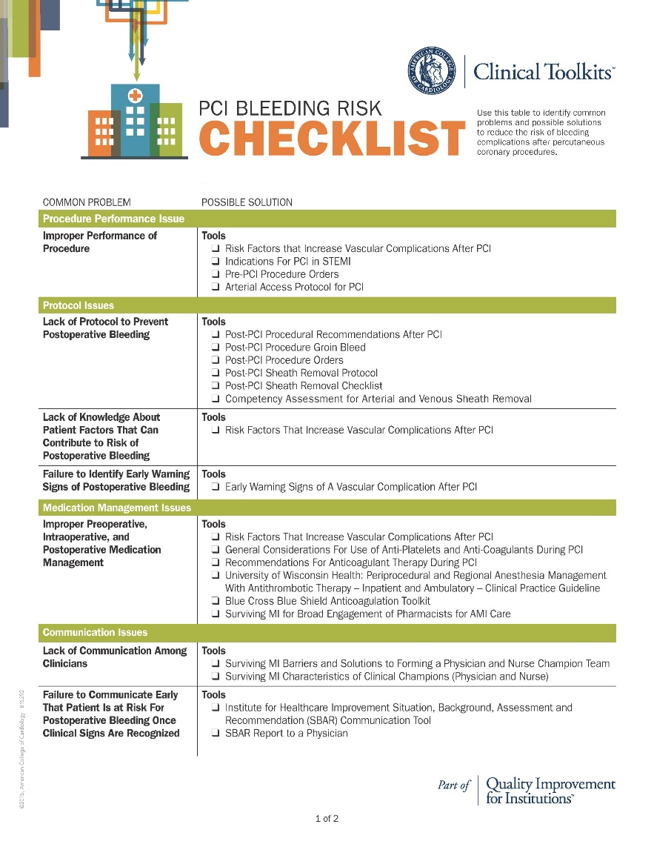
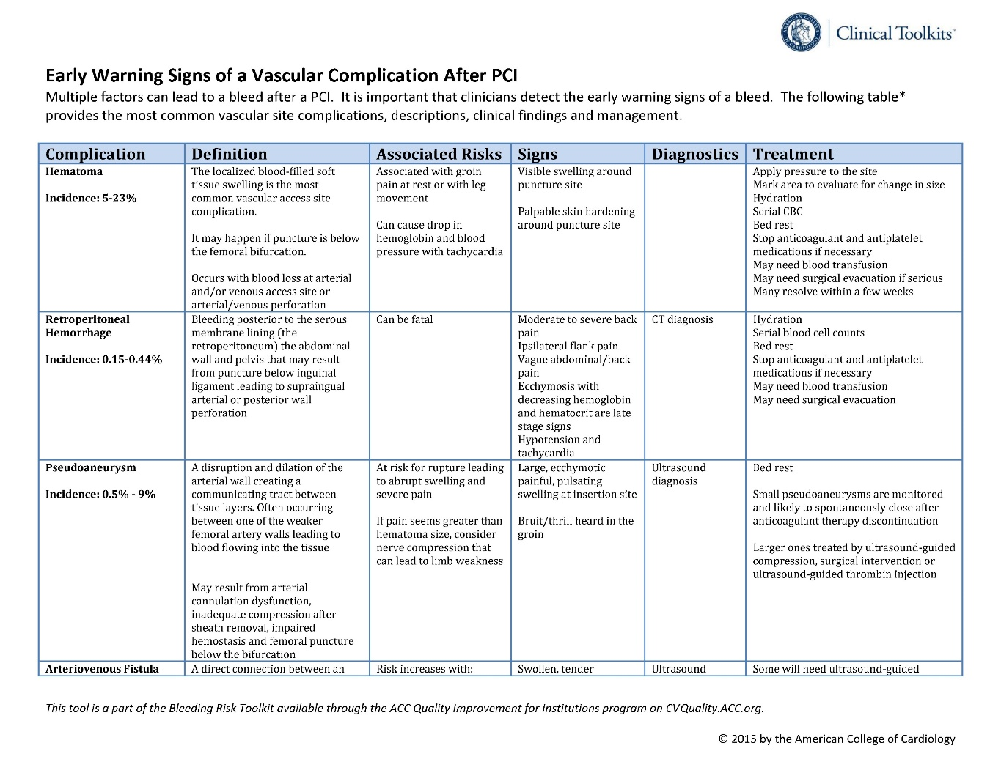
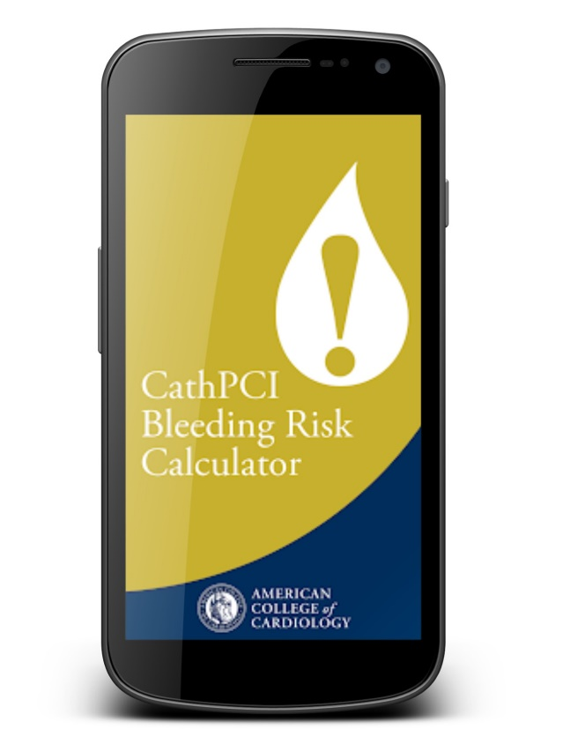
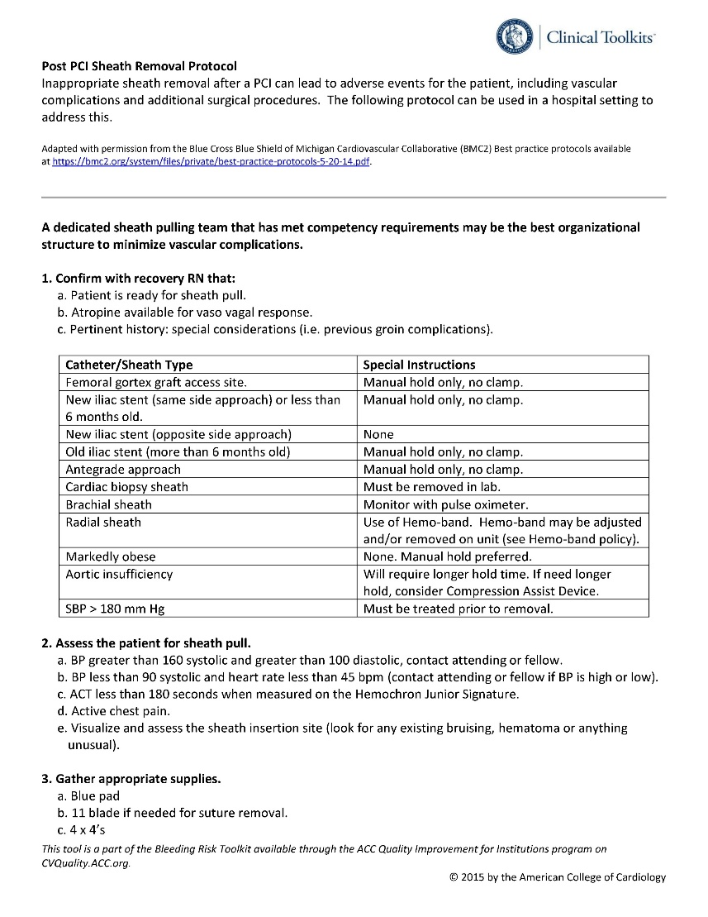
Toolkit Aligned to Metrics
Notes:
CathPCI Bleeding Risk Calculator
PCI Bleeding Risk Checklist
Campaign-specific toolkit, aligned with
improvement metrics
Risk Factors that Increase Vascular Complications
Indications for PCI in STEMI
Pre PCI Procedure Orders
Arterial Access Protocol for PCI
Post PCI Procedural Recommendations After PCI
Post PCI Procedure Groin Bleed
Post PCI Procedure Orders
Post PCI Sheath Removal Protocol
Post PCI Sheath Removal Checklist
Competency Arterial and Venous Sheath Removal
Risk Factors That Increase Vascular Complications After PCI
Early Warning Signs of A Bleed After PCI
Risk Factors That Increase Vascular Complications After PCI
General Considerations for Use of Anti-Platelets and Anti-Coagulants during PCI
Recommendations for Anticoagulant Therapy during PCI
University of Wisconsin Health: Periprocedural and Regional Anesthesia Management with Antithrombotic Therapy – Adult – Inpatient and Ambulatory – Clinical Practice Guideline
Blue Cross Blue Shield Anticoagulation Toolkit
SAMI Strategies for Broad Engagement of Pharmacists in the Care of AMI Patients
SAMI Barriers and Solutions to Forming a Physician and Nurse Champion Team
SAMI Characteristics of Clinical Champions (Physician and Nurse)
IHI SBAR Communication Tool
SBAR Report to a Physician

Slide 26

Webinar #1: September 18, 2018 Webinar #2: November 7, 2018
Webinar #3: January 23, 2019 Webinar #4: May 22, 2019
Webinar #5: August 23, 2019 Webinar #6: November 6, 2019
Notes:
The Campaign offers 1 National webinar every quarter. These webinars are recorded and archived for future viewing.

Slide 27

Notes:
Join the listserve. It is an opportunity to be part of a network of facilities sharing success and asking questions of each other.

Slide 28
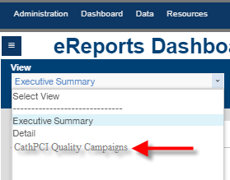
The Campaign Dashboard
*This is a draft
Notes:
The Reduce the Risk PCI Bleed Campaign Dashboard will be located on the CathPCI Registry Dashboard page.

Slide 29
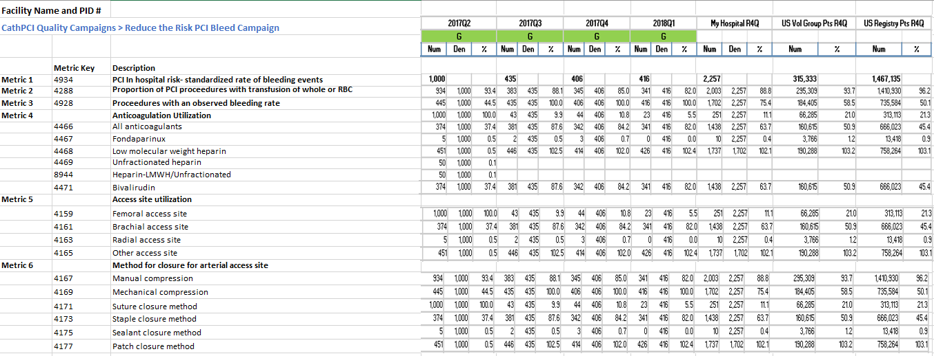
Dashboard Example
Notes:
This is an example of what the Reduce the Risk PCI Bleed dashboard will provide.
The Campaign metrics will be pulled from the main CathPCI quarterly report.
Each participating facility will visualize their date compared to other facilities in the Campaign, and facilities who are not participating in the Campaign

Slide 30

Earn “High” weighted credit for this MACRA MIPS Improvement Activity!
.

Slide 31
Agenda
ACC Quality Campaign Framework and Design and History
Reduce the Risk: PCI Bleed Campaign Goals
Campaign Metrics
The Change Package/ the Campaign Features
Getting Started

Slide 32
Opt in today!
To become a Reduce the Risk: PCI Bleed facility”
  1. Log into NCDR
  2. Go to your CathPCI Registry® home page
  3. Click “Start Here” on the left navigation bar
  4. Opt in!
The Registry Site Manager will be required to log in to opt your facility into the program.

Slide 33


https://cvquality.acc.org

Slide 34
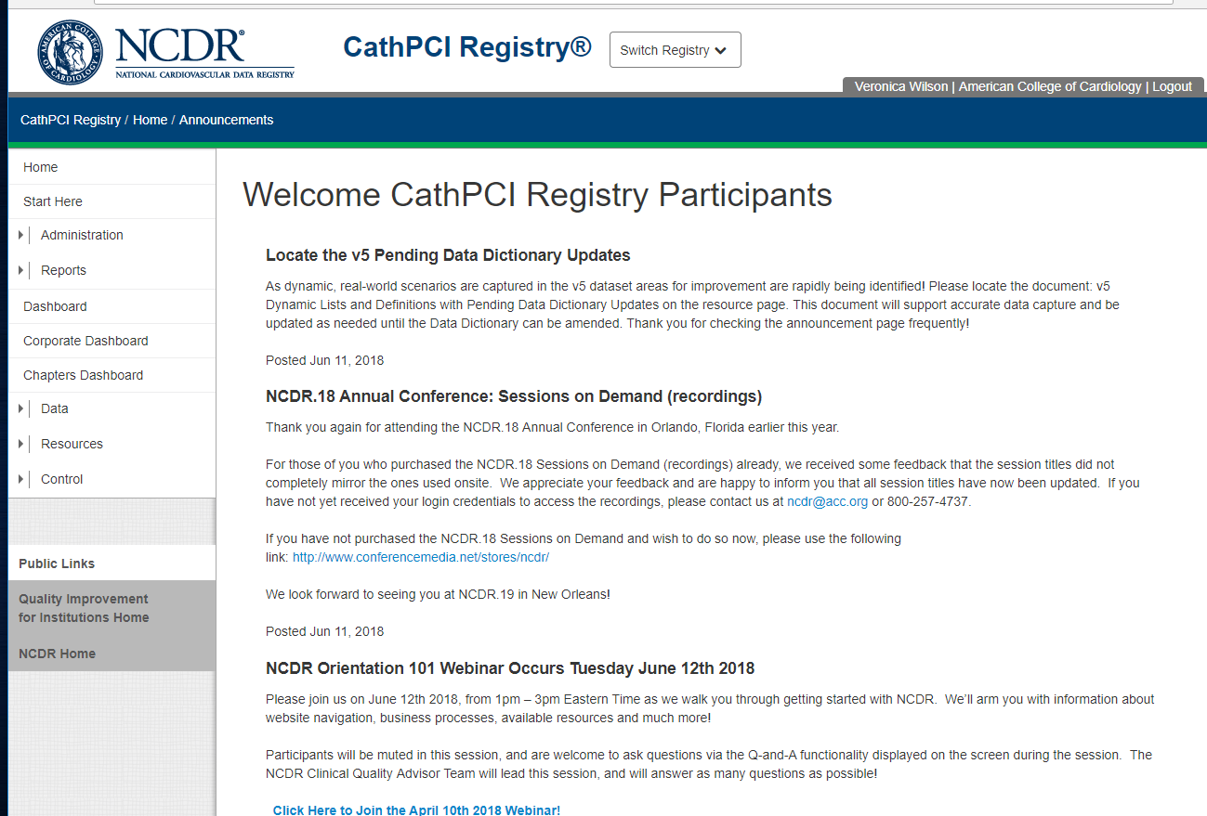
Opting in Link
START HERE
Notes:
To access the “Opt in” page the link is found on either the QII home page, or the ACTION Start Page

Slide 35

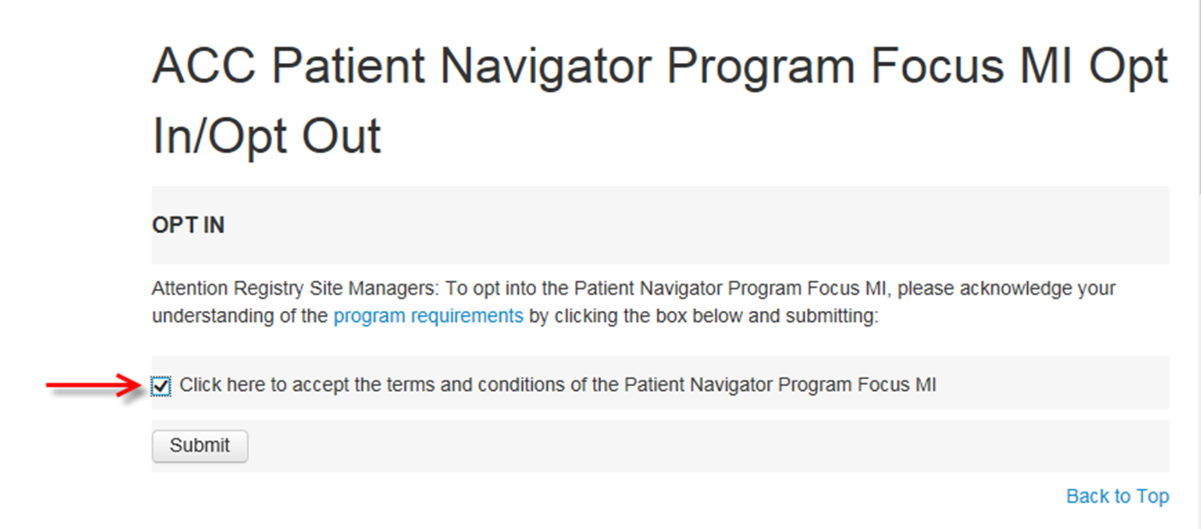
Opt In
Select the box
Reduce the Risk: PCI Bleed Campaign Opt in Opt out page
Notes:
Select the box to accept the terms and conditions of the program, and at that point the submit button will enable.

Slide 36
QUESTIONS?

