Slide 1

ACC Reduce the Risk: PCI Bleed Campaign Webinar
May 21, 2019

Slide 2
Agenda May Webinar
Welcome and Introductions “How We Got Started: Two Real-World Examples to Operationalize the ACC Reduce the Risk: PCI Bleed Quality Campaign | Andrea Price
INOVA Heart and Vascular Institute Fairfax, Va. Medical Campus | Marian Hartle RN
The Ohio State University, Wexner Medical Center | Quinn Capers IV M.D, FACC
Questions | Andrea Price

Slide 3
Reduction of Bleeding Complications
Marian Hartle RN; Outcomes Specialist
Julieanne George MSN RN MBA PCCN-K CCRN-K; Clinical Director ICAR
Stephen Ives BS RCIS; Clinical Director Cardiovascular Procedure Labs
Dr. Benham Tehrani- Co-Medical Director Cardiovascular Catherization Lab
Dr. Matthew Sherwood Co-Medical Director Cardiovascular Catherization Lab
Dr. Charles Murphy CPPS; Chief Patient Safety Officer

Slide 4

About INOVA
9 Invasive Labs
4 Cath/PCI Labs 1300 PCI’s/year
3 EP Labs
2 Interventional Radiology
1 Hybrid Lab
5 Cardiac OR’s
39-bed Interventional Admission/ Recovery Unit
6 Inpatient Units
INOVA HEART AND VASCULAR INSTITUTE FAIRFAX MEDICAL CAMPUS

Slide 5
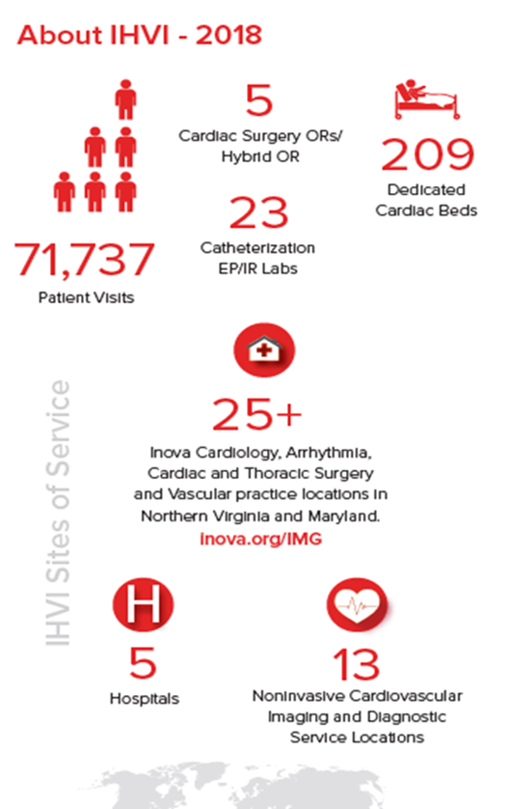
Who are we
Inova is a not-for-profit healthcare system based in Northern Virginia that serves >2 million patients/yr.
Serving the Washington, DC, metro areas and beyond.
Inova is a comprehensive network of hospitals, outpatient services and facilities, primary and specialty care practices, and health and wellness initiatives.

Slide 6
Team Members
Name | Department | Job Title
Dr. Behnam Tehrani | Inova Medical Group; Interventional Cardiology | Cardiac Catherization Lab Co-Director
Dr. Matthew Sherwood | Inova Medical Group; Interventional Cardiology | Cardiac Catherization Lab Co-Director
Dr. Charles Murphy | Inova Administration, Chief Patient Safety Officer | Cardiovascular Intensive Care Unit (CVICU) Medical Director
Julieanne George MSN RN | ICAR | Clinical Director-Co-Lead for Collaborative Bleeding Initiative
Stephen Ives RCIS | Cardiac Catherization Lab | Clinical Director-Co-Lead for Collaborative Bleeding Initiative
Marian Hartle RN | Outcomes-National Registry for PCI | Outcomes Specialist
Francine DeHaan MSN RN CCRN-K | Professional Practice | Educator ICAR, CVICU- IHVI support
Jayne O’Conner RN | ICAR | Patient Navigator-ICAR
Aaron Bagnola | Pharmacy | Clinical Specialist-IHVI
Megan Rupe MSN, RN | CTU-S | Clinical Director
Rebecca Petros RN and Louisa Villanueva RN | CTU-N | RN Unit Supervisors
Stephanie and Carrie, RN | PCCU | Unit Supervisor
Sharri Robinson, MSN, RN | CTU-N | Clinical Director/Senior Director IHVI
Marina Ocasio BSN RN | PCCU/Interim CICU | Clinical Director
Notes:
Including the right people on your team is critical to a successful improvement effort. Sharing your team composition illustrates your inclusion of all of the key stakeholders to make the project successful.
It’s also an opportunity to acknowledge the team members for their contributions to the project.

Slide 7
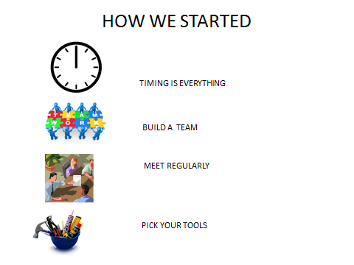
Its all about the Patient Centered Care-Collaborative approach

Slide 8
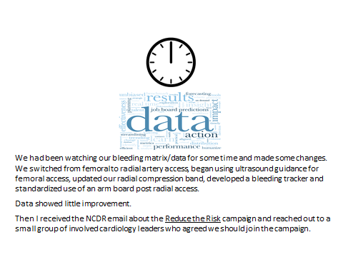
Watch and Learn-Seek to Improve

Slide 9

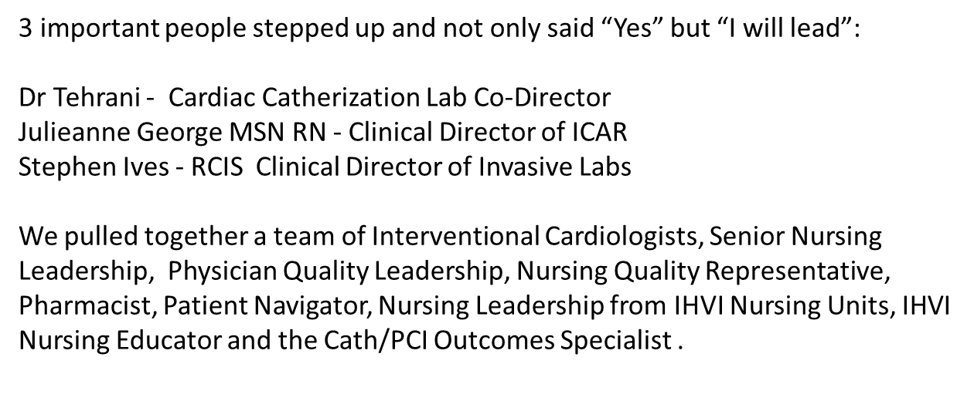
Lets get Started

Slide 10
Lets Discuss and Challenge
Julie George immediately set up an initial meeting with the team members.
We reviewed the data with Team to show where we were coming from and where we wanted to go.
I shared the tools provided by the NCDR. We reviewed and evaluated the available tools to determine what was useful in our environment.
We agreed to meet monthly, as a full team, and set up a recurrent schedule.
Assignments were made with follow up due at the next meeting.
A smaller “executive group” would meet weekly to review bleeding issues from the previous week.

Slide 11
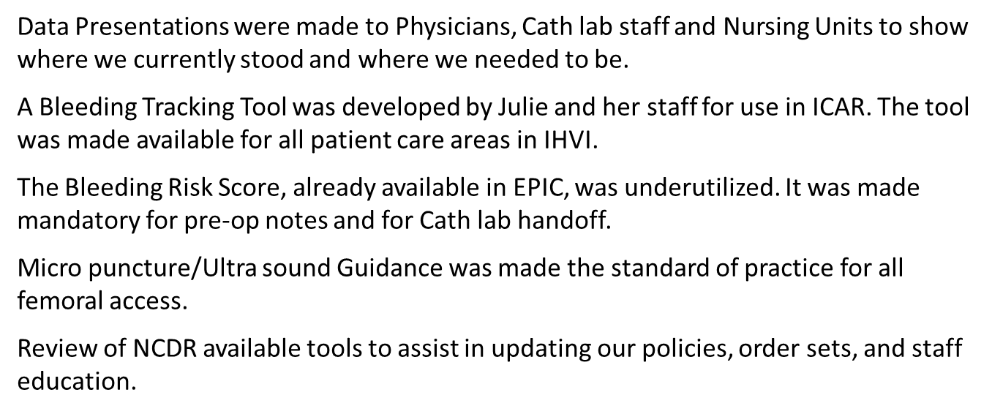


What we did

Slide 12
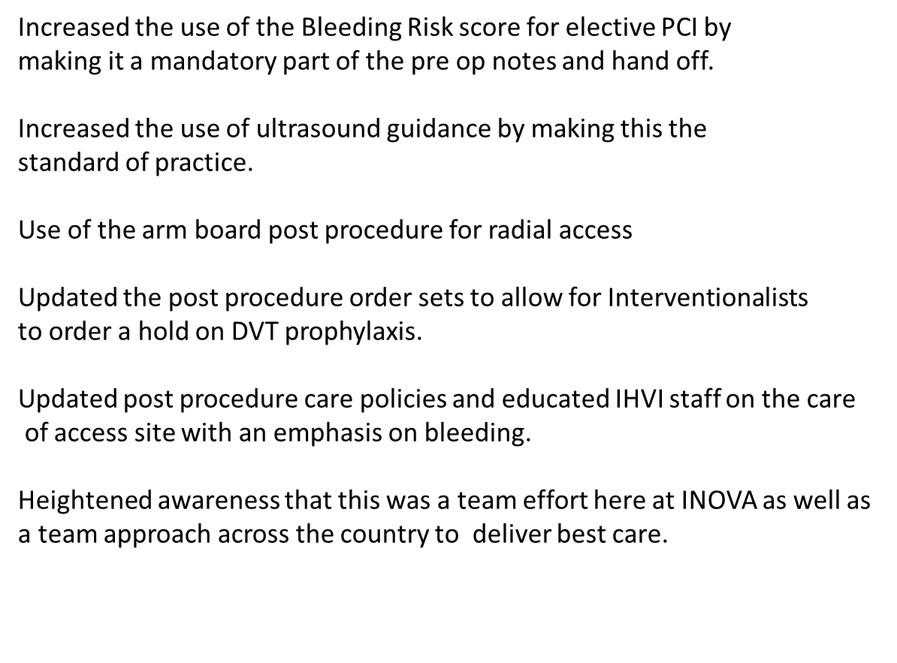
Celebration

Slide 13
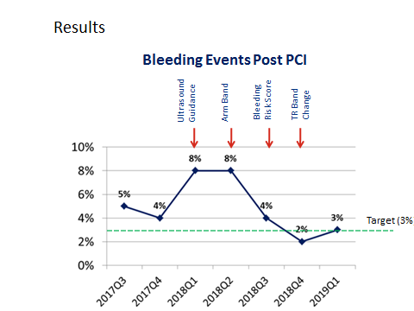

Slide 14
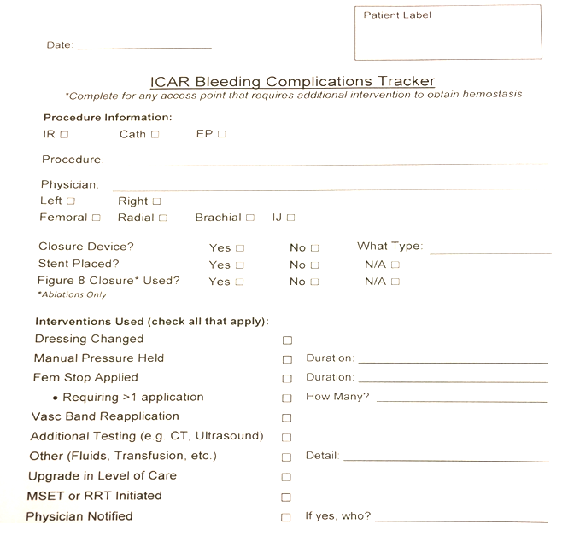
Bleeding Tracking Form

Slide 15
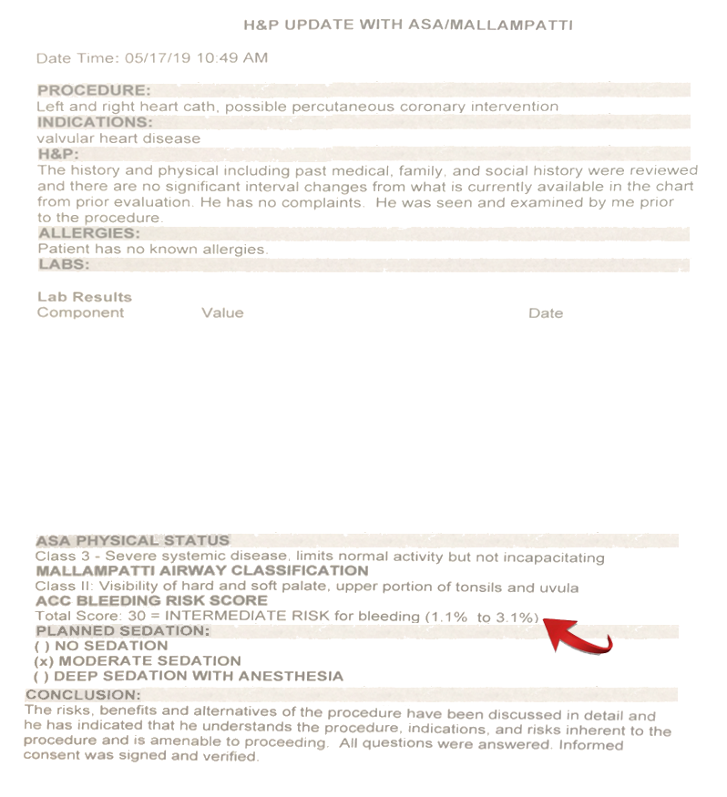
Physician Pre Procedural Note

Slide 16
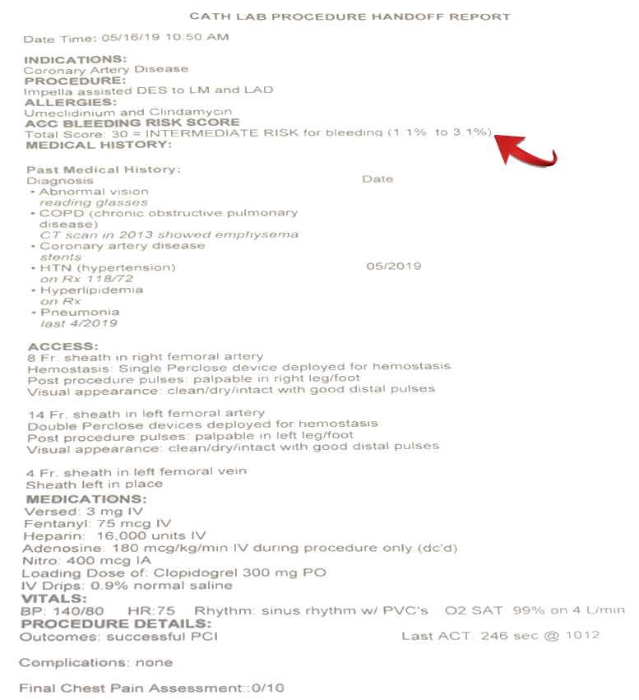
Cath Lab Procedure Handoff Report

Slide 17

Questions

Slide 18
ACC-NCDR Cath/PCI Registry
Reduce the Risk of PCI Bleeding
The Ohio State Wexner Medical Center
Quinn Capers IV M.D, FACC
Danielle Blais PharmD, BCPS-AQ Cardiology
Mindy Hazlett BSN, RN, NE-BC
Patricia A. Blake RN, MSN
Julia Salinas RN, BSN

Slide 19


OSU Recognized as Top 25 in the U.S. in Cardiovascular Quality
Consistently recognized as one of America’s Best Hospitals by U.S. News & World Report

Slide 20
About Ohio State
A world-class public research university
  59,000 undergraduate, graduate and professional students
  34,000 full-time employees
One of the largest and most diverse academic medical centers in the country, the only academic medical center in central Ohio and the Midwest’s highest-ranked hospital for safety and patient care.
Our seven hospitals and our network of community-based offices and care centers manage more than 1.7 million patient visits each year.
The University Hospital - 900 beds
  Ross Heart Hospital - 150 bed hospital
High volume center -diagnostic cath’s- ~ 5000, PCI’s ~1800 per year
  Cath labs - 8
  Interventional Cardiologists - 8
  Fellowship Program

Slide 21
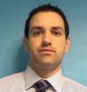
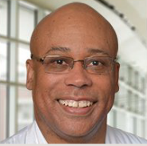
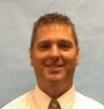
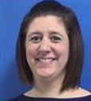
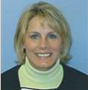
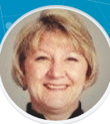
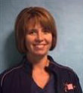
Team
Dean Boudoulas MD, FACC Medical Director Cath Lab
Quinn Capers MD, FACC-Director of Interventional Cardiology Fellowship Program
Eric Ballinger- Director Cardiac Catherization Lab
Danielle Blais- PharmD, BCPS-AQ Cardiology
Mindy Hazlett- Manager Cardiac Catherization Lab
Patty Blake- Senior Cardiovascular Quality Manager
Julia Salinas- Cath/PCI Program Manager

Slide 22
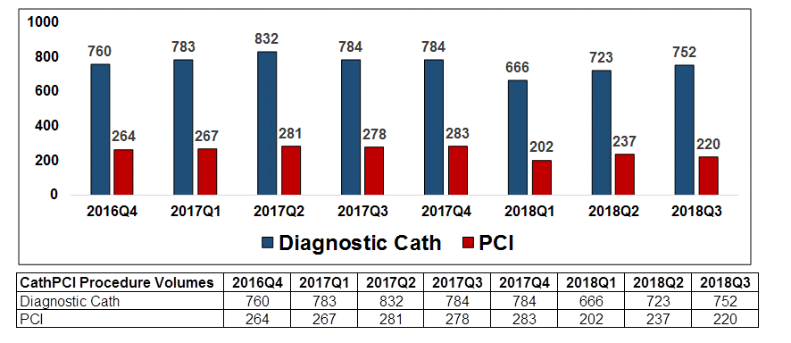
Cath/PCI Volumes

Slide 23
Bleed Reduction
Two Pronged Approach- Radial, Blood Use
How did our facility decide to work on bleeding rates? How did you get your team engaged in radial first approach?
  ACUITY Trial indicated patients receiving blood fared worse outcomes
  Radial approach had less vascular complications, less blood transfusions
  Physician education and commitment
  Physician reports comparing radial approach to their peers
  Patients preferred radial approach
Are you using any tools that have been helpful?
  Bleeding risk calculator
  Protocols for Heparin Dosing, Transfusions and Sheath Pulling
Rao SV, et al. JACC. 2013; 6(9); 897-904.​​

Slide 24
Bleeding/Vascular Complication Reduction Task Force
Originated in March of 2013
Review of RP bleeds and mortalities
Missions of the task force
  Increase use of radial approach to a goal of 70%
  Reduction in blood usage
  Engaged front line staff to improve the process
  Reporting of quality metrics to evaluate the process
  Improve patient satisfaction and safety as well as staff satisfaction

Slide 25
Example of physician report
Radial Access By Operator
July 2012 - March 2013
Target = 70 % Radial
Percent Radial Access

Slide 26
Bleeding/Vascular Complications Task Force
Radial First go live on October 1st, 2013
  Revised order sets
  Specific communication plan when complication occurs
  Extensive training for nurses pulling sheaths using the simulation lab
  Transfusions- Stringent Approach
    Protocol driven transfusion, standardize transfusion threshold (i.e. below Hg 8 or only if patient symptomatic)
    MD to MD discussion prior to ordering blood
    Resident/Fellow mandated to call interventionalist prior to ordering blood

Slide 27
Reduction of Bleeding Quality Initiatives
  Radial first approach (2011)
  Sheath pulling team to standardize process (2013)
  Transfusion protocol (2013)
  Bleeding risk calculator (2014)
  Ticagrelor preferred P2Y₁₂ inhibitor/Reduce GP IIb/IIIa use (2016)
  Heparin dosing protocol (Start 2017/Revised April 2018)
  ACC definition Access site change (3 gram drop to 4 gram drop) (2018)
  Mandatory Comorbidities documented in post op EMR note (2018 )
  Reduce the Risk: ACC PCI Bleed Quality Campaign (2018)
Notes:
Footnote reference for bleed calculator,

Slide 28
Heparin Dosing and ACT Goals for PCI
(Round Heparin doses UP to the nearest 1,000 units)
Not on heparin drip - give Heparin 70 units/kg
Received heparin in the past 2 hours or recent DOAC* or Warfarin Use - Check baseline ACT prior to starting PCI and give heparin according to the following nomogram
*DOAC: Direct Oral Anticoagulant e.g. Apixaban (Eliquis®), Betrixaban (Bevyxxa®), Dabigatran (Pradaxa®), Edoxaban (Savaysa®), Rivaroxaban (Xarelto®)
Heparin + GP IIb/IIIa or Thrombolytics Target ACT 200 – 250 seconds
ACT | Weight Based Heparin Dose (units/kg)
Less than 150 | 50
151 – 175 | 25
176 – 199 | 12.5
Heparin Only Target ACT 300 – 350 seconds
ACT | Weight Based Heparin Dose (units/kg)
Less than 150 | 70
151 – 175 | 62.5
176 – 200 | 50
201 – 225 | 37.5
226 – 250 | 25
251 – 299 | 12.5
Check ACT
  3 - 5 minutes after initial bolus to confirm heparin went into the patient
  10 - 15 minutes after first bolus and then every 10 - 15 minutes to adjust
Re-dose heparin according to above nomogram

Slide 29
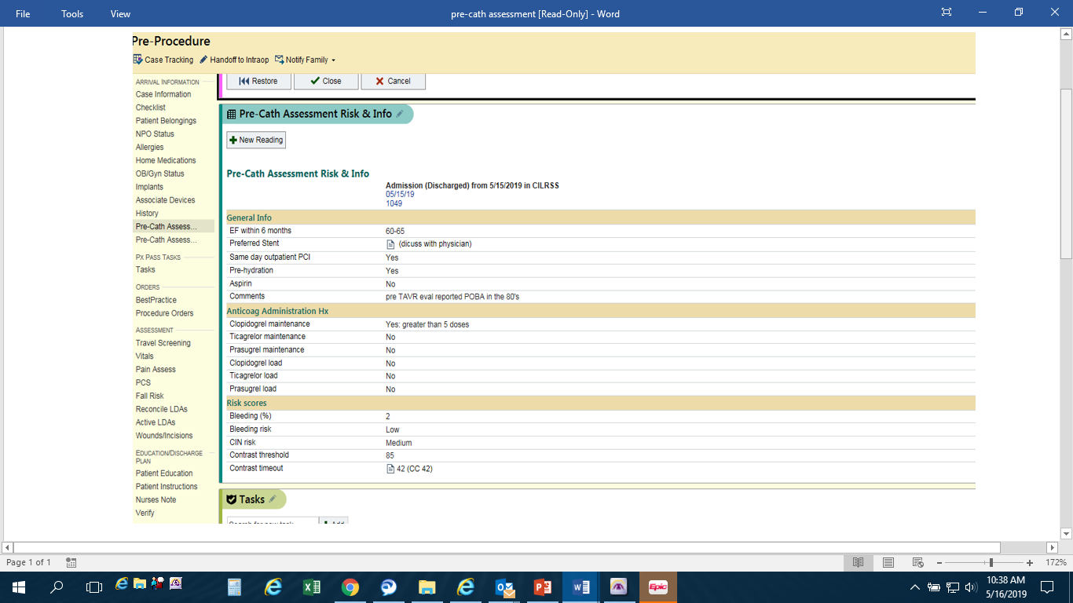

Slide 30
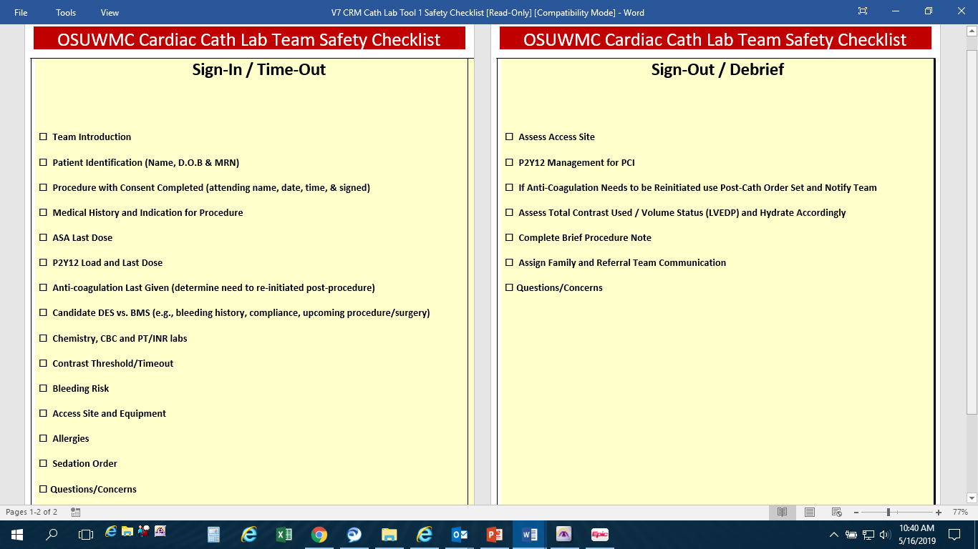

Slide 32
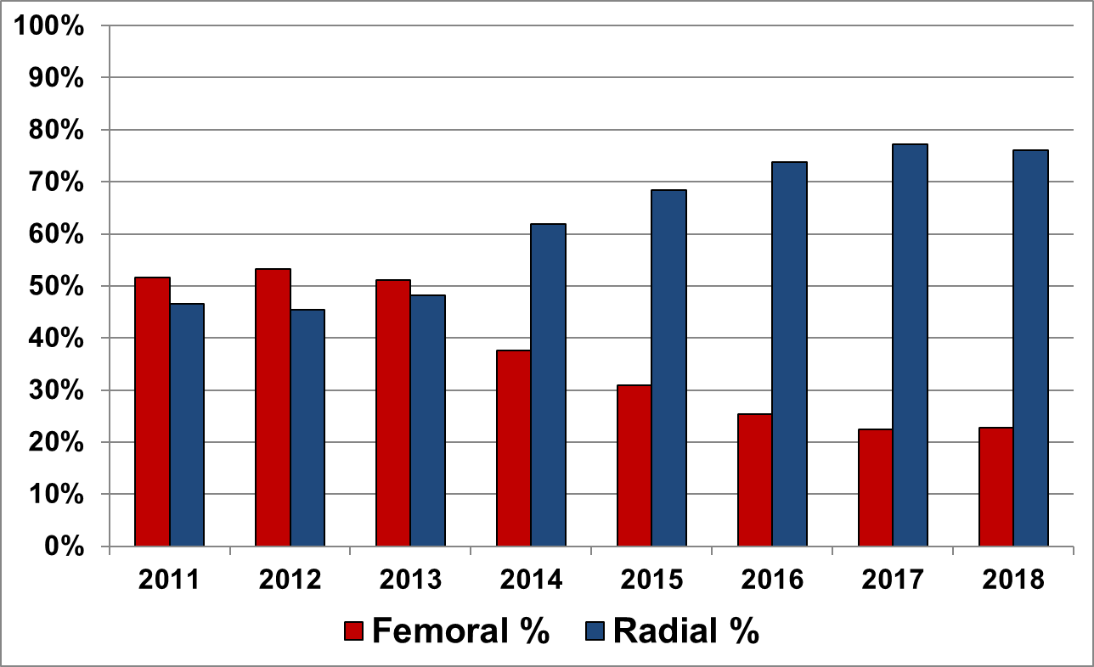
Radial vs Femoral Evolution

Slide 33
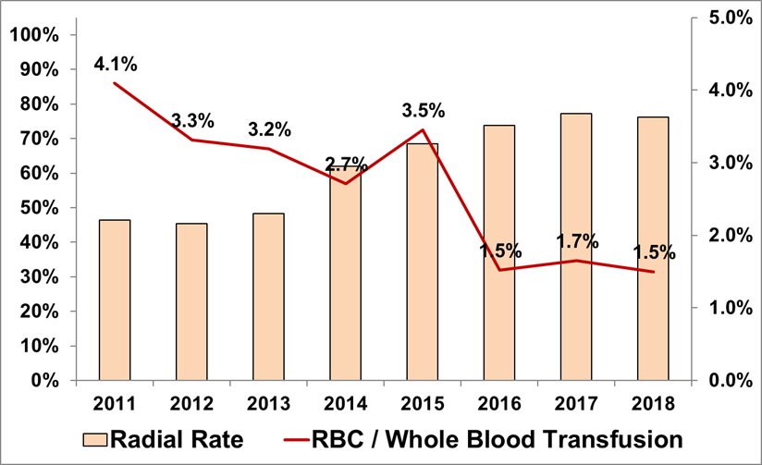
RBC/Transfusions Excluding CABG

Slide 34
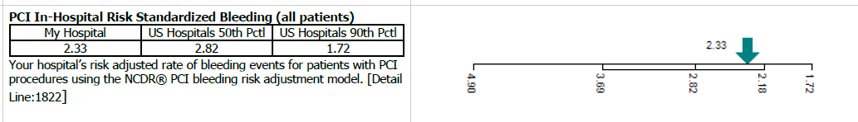
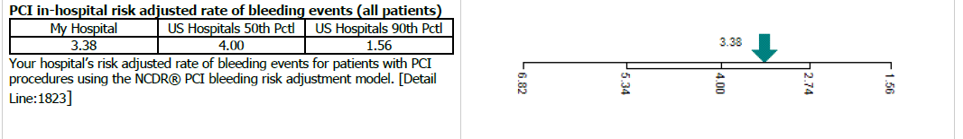
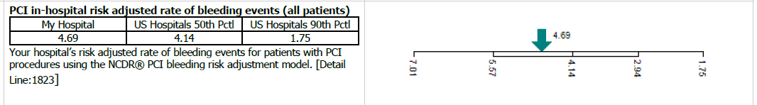
ACC-NCDR
PCI Risk Adjusted Bleeding
Moving in the Right Direction
Currently no data after Q2 2018 - Q3 2018 due to registry update
2018
Q1
2017
Q1
2016
Q1

Slide 35


