Slide 2
September 18, 2018
ACC Reduce the Risk: PCI Bleed Campaign
Andrea Price, MS, CPHQ, RCIS, CCA
Veronica Wilson, CPHQ
Notes:
Strategies: Improving data collection processes
Increase interdisciplinary communication
Involving community providers (HHA, SNF)
Addressing social issues, offering resources and knowing what resources are available
Improving transition of care through communication with PCP’s and physicians outside of the hospital system.

Slide 3
Please submit your questions for the moderated question and answer session

Slide 4
Webinar Objectives
Describe the goal of the ACC Reduce the Risk: PCI Bleed Quality Campaign
Verbalize an understanding of next steps for getting started.

Slide 5
NCDR QI Need
*Key characteristics of a successful QI program
Influential
Credible
Simple
Strategically aligned for participant
Offers practical implementation tools
Offers Networking
Sets Attainable goals
*Bradley, E. H., Nembhard, I. M., Yuan, C. T., Stern, A. F., Curtis, J. P., Nallamothu, B. K., & ... Krumholz, H. M. (2010). What Is the Experience of National Quality Campaigns? Views from the Field What Is the Experience of National Quality Campaigns?. Health Services Research, 45(6p1), 1651-1669.
Notes:
Mention the feasibility study and the work that goes on prior to starting the campaign.
Look for current solutions to help the problem

Slide 6
Steering Committee Members
Andrea Price, MS, RCIS, CCA, CPHQ Committee Chair | Indiana University Health
Amit Amin, MD, FACC | Barnes Jewish Hospital
Jon Jennings, RN | HCA
John Messenger, MD, FACC | University of Colorado Hospital
Julie Miller, MD, FACC | Johns Hopkins Hospital
Issam Moussa, MD, FACC | Robert Wood Johnson University Hospital
Sunil V. Rao, MD, FACC | Duke University Medical Center

Slide 7
The Problem: Our Opportunity for Improvement
2.81%
.
Notes:
Percutaneous Coronary Interventions (PCI’s) are an increasingly common procedure. Bleeding events are associated with multiple negative affects to patient QoL and mortality. We observe wide variation in bleeding outcomes between facilities, and an opportunity for improvement.

Slide 8
All patients should be evaluated for risk of bleeding before PCI.
Patients considered high risk for PCI should be part of a collaborative decision to use a radial approach.
In patients with ACS treated with DAPT after coronary stent implantation who are not at high risk for bleeding complications and who do not have a history of stroke or TIA, it is reasonable to choose Prasugrel over Clopidogrel for maintenance P2Y12 inhibitor therapy.
In patients with SIHD treated with DAPT after DES implantation who are at high risk of severe bleeding complication or develop significant overt bleeding, discontinuation of P2Y12 inhibitor therapy after 3 months may be reasonable.
In patients with SIHD treated with DAPT after BMS or DES implantation who have tolerated DAPT without a bleeding complication and who are not at high bleeding risk (e.g., prior bleeding on DAPT, coagulopathy, oral anticoagulant use), continuation of DAPT with clopidogrel for longer than 1 month in patients treated with BMS or longer than 6 months in patients treated with DES may be reasonable.
What are the ACC/AHA Guidelines Saying
Notes:
All patients should be evaluated for risk of bleeding before PCI. 2011 ACCF/AHA/SCAI Guideline for PCI
Patients considered high risk for PCI should be part of a collaborative decision to use a radial approach.
In patients with ACS treated with DAPT after coronary stent implantation who are not at high risk for bleeding complications and who do not have a history of stroke or TIA, it is reasonable to choose prasugrel over clopidogrel for maintenance P2Y12 inhibitor therapy.

Slide 9
The Program Goal
Improve bleeding rates and decrease variances in data
motivating widespread adoption of evidence-based practices to improve quality of care
Decreasing Bleeding Rates
Notes:
Goal to take the shared learnings, improve bleeding rates

Slide 10
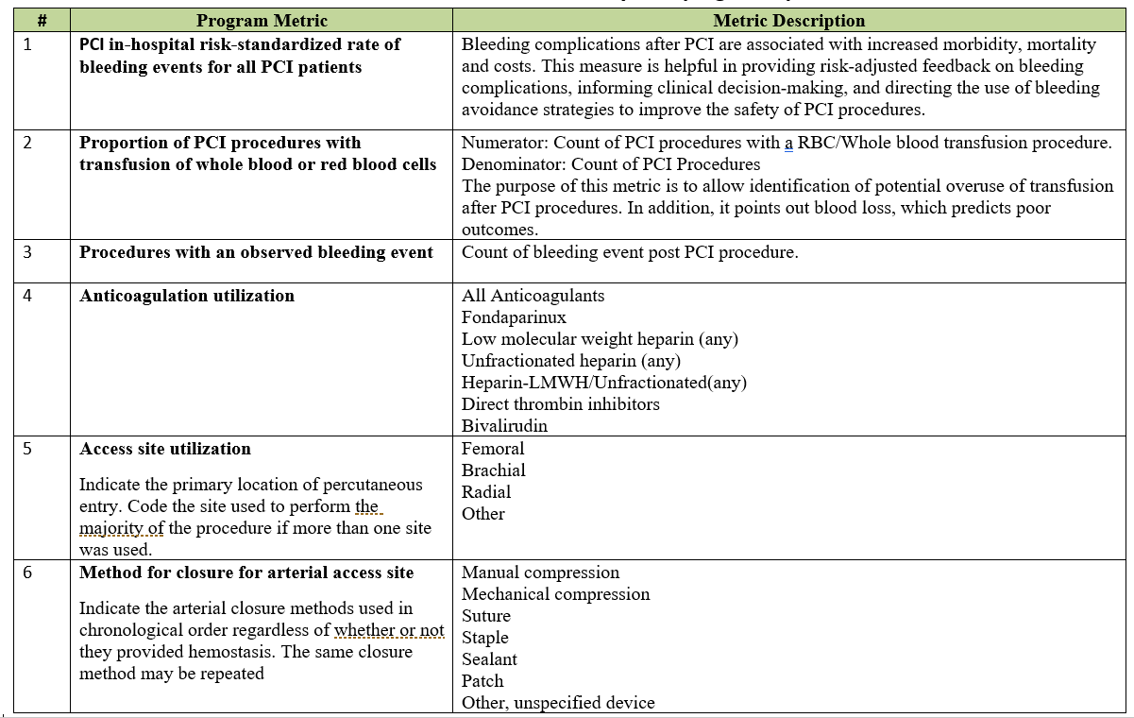
Program Metrics

Slide 11
Outcome Metric
Outcome Metric

Slide 12
Process Metric
Process Metric
Process Metric
Process Metric
Notes:
Best descriptive as behavioral changes. These metrics will show these behavioral changes

Slide 19
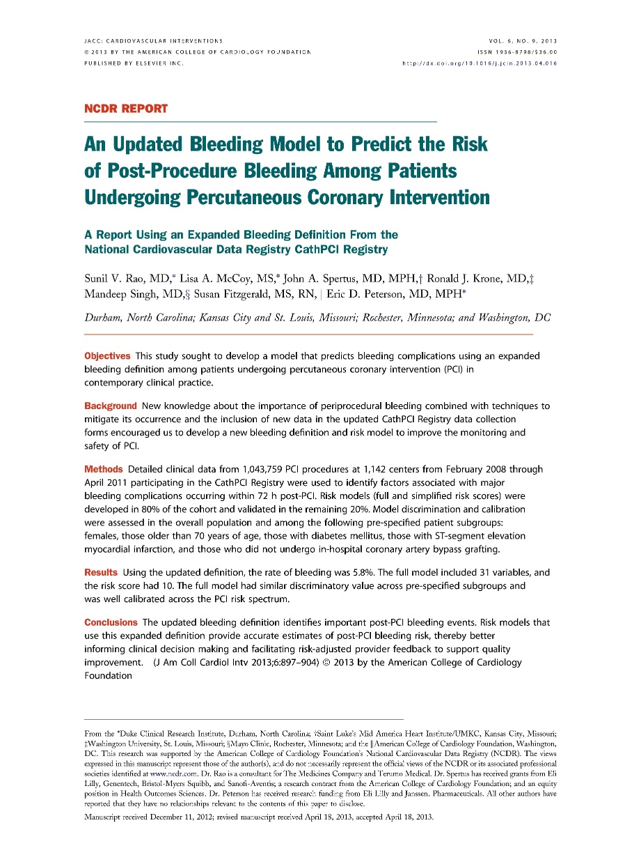
Performance Measure #40:
A new, hierarchical risk-standardized model
PCI in-hospital risk standardized rate of bleeding events (all patients)
Notes:
The Risk Adjusted Bleeding model provides accurate estimates of post-PCI bleeding risk and is helpful in providing risk-adjusted feedback on bleeding complications, informing clinical decision-making, and directing the use of bleeding avoidance strategies to improve the safety of PCI procedures.

Slide 20
Performance Measure #40: What’s new
Hierarchical model
Fewer patient variables
Risk relationships within and amongst hospitals
Absolute Hgb decrease from pre-PCI to post-PCI of 4g/dL (previously 3g/dL)

Slide 21
Performance Measure #40: Model Details
Post-PCI bleeding defined as any ONE of the following:
Bleeding event w/in 72 hours OR
Hemorrhagic stroke OR
Tamponade OR
Post-PCI transfusion for patients with a pre-procedure Hgb >8 g/dL and pre-procedure Hgb not missing; OR
Absolute Hgb decrease from pre-PCI to post-PCI of ≥ 4 g/dL
Notes:
Bleeding event w/in 72 hours (Detail Line# 8050); or
1. Hemorrhagic stroke (Detail Line# 8021); OR
2. Tamponade (Detail Line# 8025); OR
3. Post-PCI transfusion (Detail Line# 8040) for patients with a pre-procedure Hgb >8 g/dL and pre-procedure Hgb not missing; OR
4. Absolute Hgb decrease (Detail Line# 7320 and 7345) from pre-PCI to post-PCI of >= 4 g/dl (excluded if any of the following: pre-procedure (Detail Line# 7320) 5. Hgb>16g/dl or IABP (Detail Line# 5330) = yes or MVSupport (5340) = yes)

Slide 22
Performance Measure #40: Model Details
Patient eligibility:
Patient’s with a PCI procedure performed during the Episode of Care.
Patients with multiple PCI procedures Include only index PCI procedure.
Include patient procedures with non-missing values for outcome variables of bleeding event w/in 72 hours AND transfusion.
Exclude patients who died on the same day of the procedure.
Exclude patients with CABG.
Notes:
Include patient’s with a PCI procedure performed during the Episode of Care
Include only index PCI procedures when patients have multiple PCI procedures (subsequent PCIs during a single Episode of Care are excluded).
Include patient procedures with non-missing values for outcome variables of bleeding event w/in 72 hours (8050) AND transfusion (8040).
Exclude patients who died on the same day of the procedure [Discharge date (9035)=procedure date (5300) AND discharge status=deceased (9040)]
Exclude patients with CABG (9000)=yes

Slide 23
QII Participant Change Package
Notes:
Participant access to suite of support materials

Slide 25
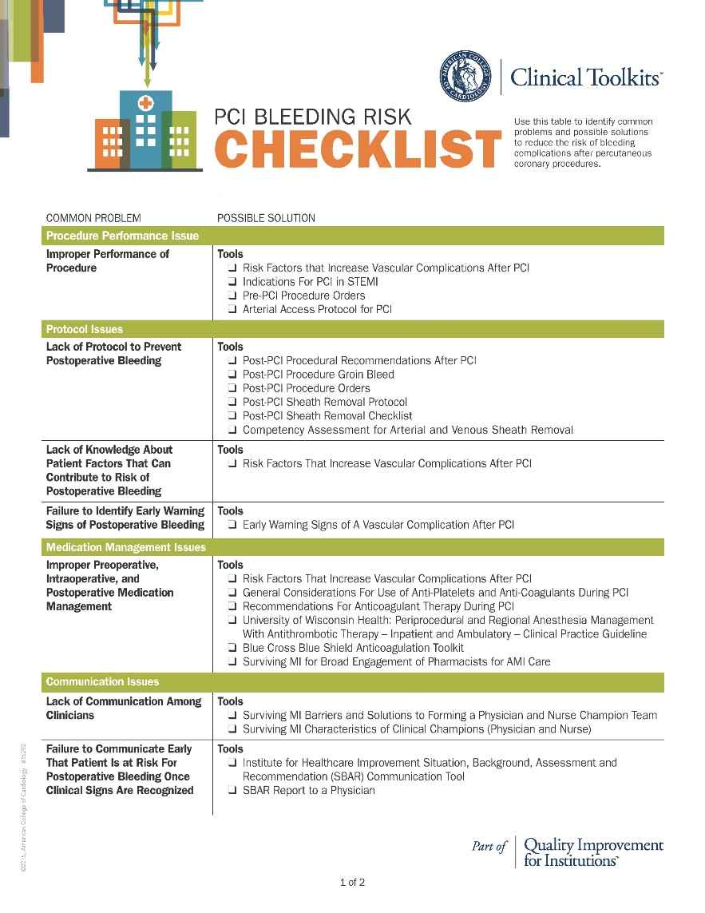
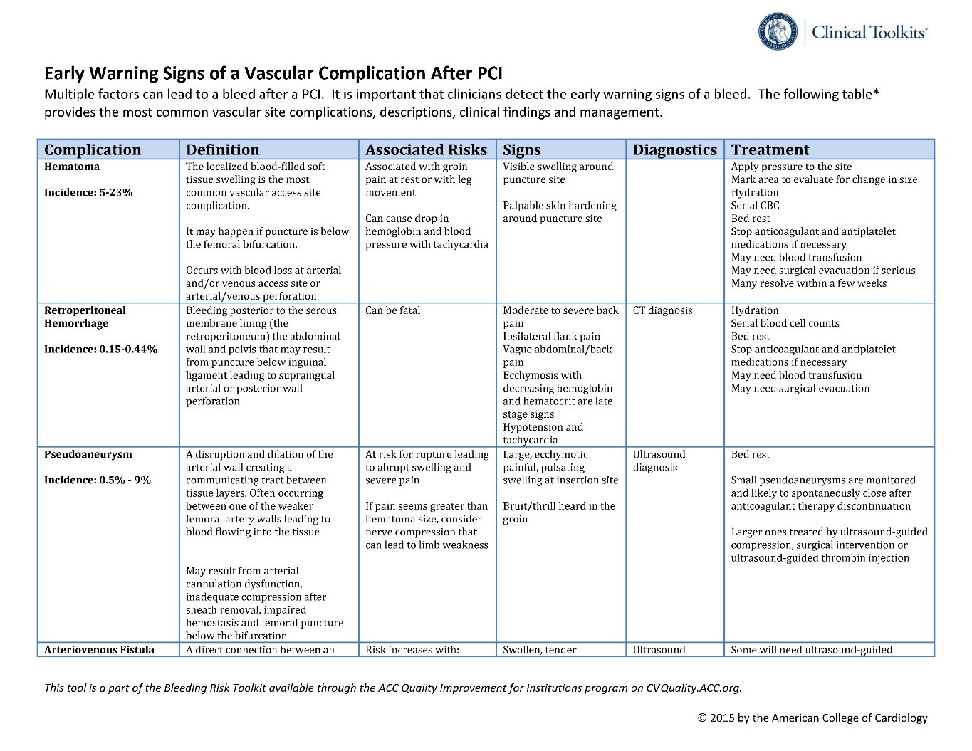
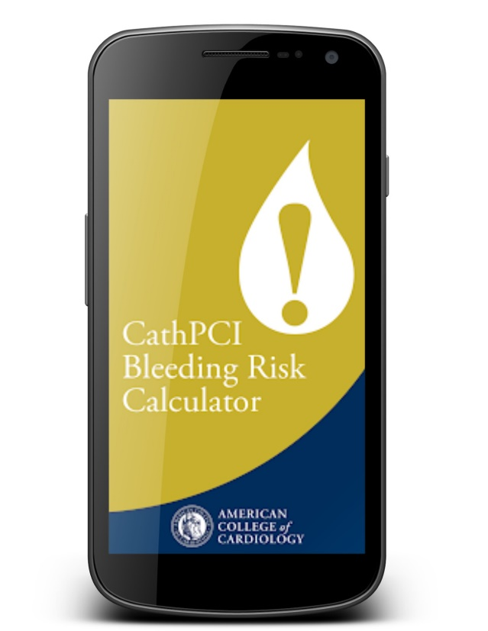
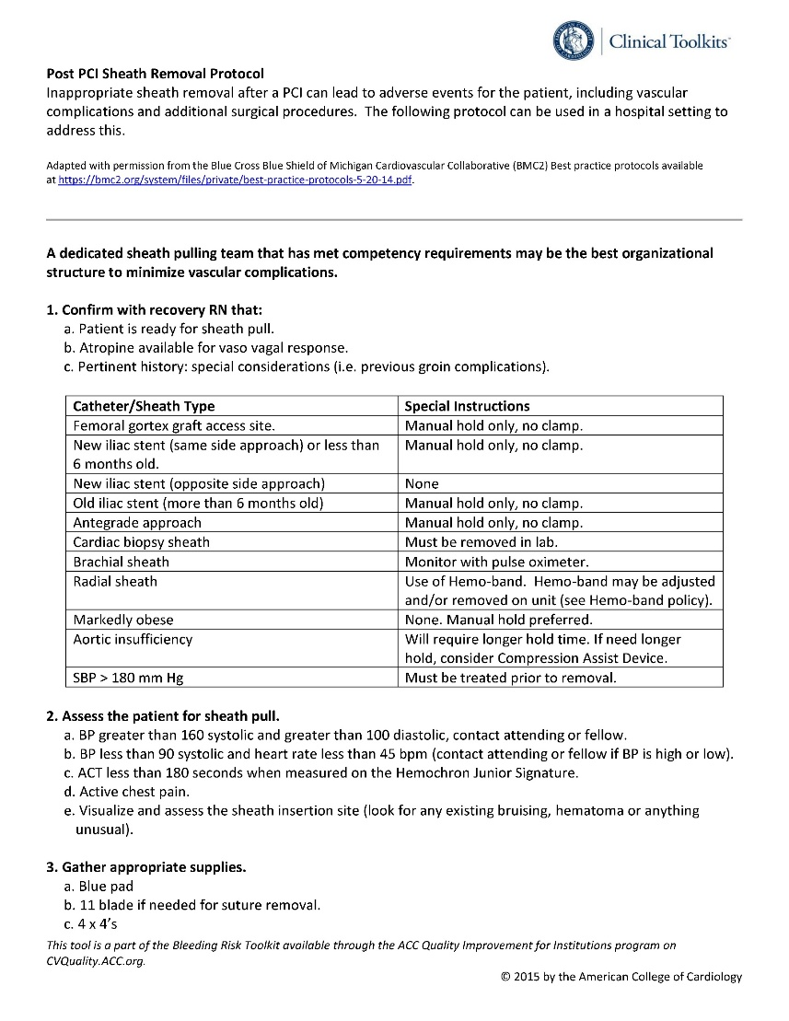
Toolkit Aligned to Metrics
Notes:
CathPCI Bleeding Risk Calculator
PCI Bleeding Risk Checklist
Campaign-specific toolkit, aligned with improvement metrics
Risk Factors that Increase Vascular Complications
Indications for PCI in STEMI
Pre PCI Procedure Orders
Arterial Access Protocol for PCI
Post PCI Procedural Recommendations After PCI
Post PCI Procedure Groin Bleed
Post PCI Procedure Orders
Post PCI Sheath Removal Protocol
Post PCI Sheath Removal Checklist
Competency Arterial and Venous Sheath Removal
Risk Factors That Increase Vascular Complications After PCI
Early Warning Signs of A Bleed After PCI
Risk Factors That Increase Vascular Complications After PCI
General Considerations for Use of Anti-Platelets and Anti-Coagulants during PCI
Recommendations for Anticoagulant Therapy during PCI
University of Wisconsin Health: Periprocedural and Regional Anesthesia Management with Antithrombotic Therapy – Adult – Inpatient and Ambulatory – Clinical Practice Guideline
Blue Cross Blue Shield Anticoagulation Toolkit
SAMI Strategies for Broad Engagement of Pharmacists in the Care of AMI Patients
SAMI Barriers and Solutions to Forming a Physician and Nurse Champion Team
SAMI Characteristics of Clinical Champions (Physician and Nurse)
IHI SBAR Communication Tool
SBAR Report to a Physician

Slide 26
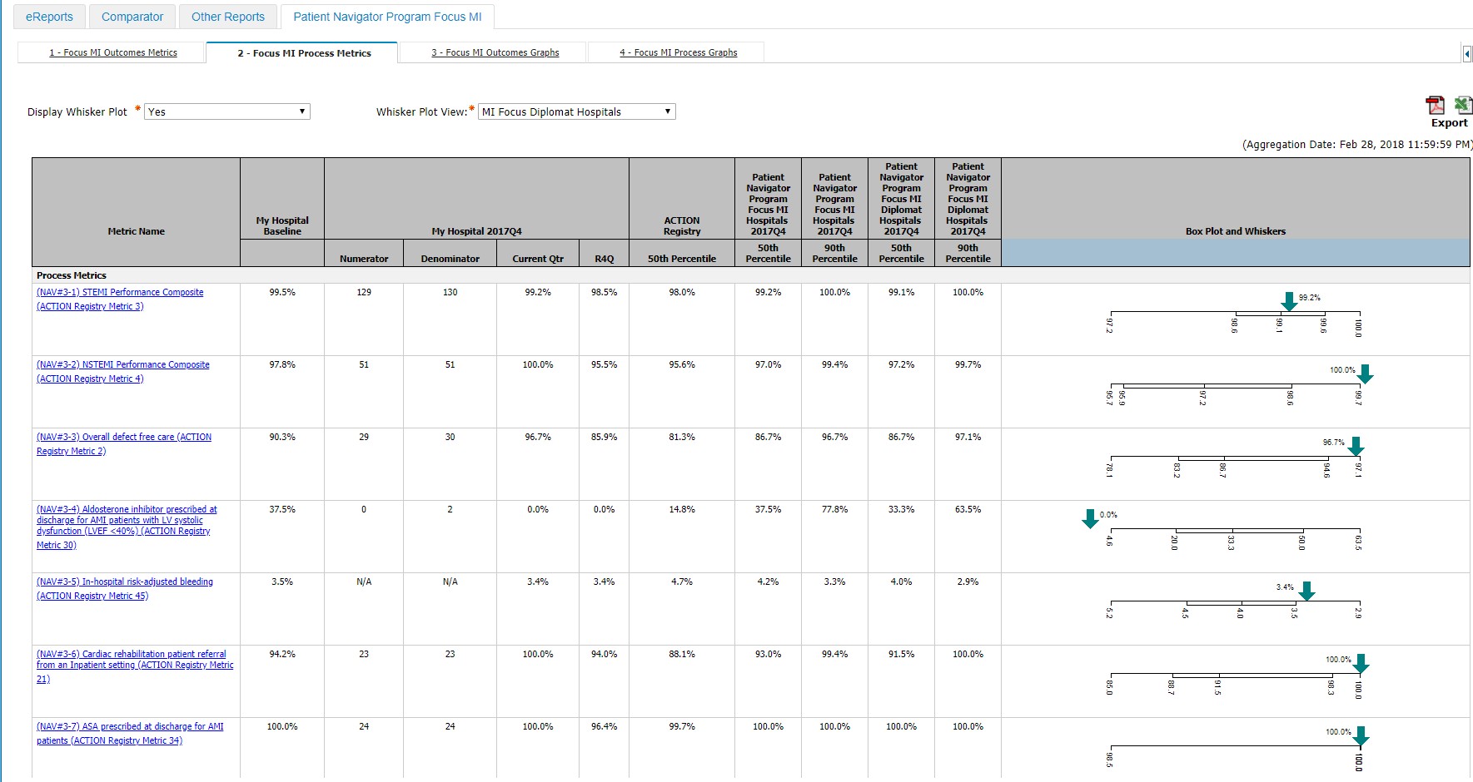

Slide 27
Webinar #1: TODAY!
Webinar #2: November 7, 2018
Webinar #3: January 23, 2019

Slide 28
Join the Listserv
Notes:
Listserve

Slide 29
Earn “High” weighted credit for this MACRA MIPS Improvement Activity!
.

Slide 30
Why Should My Hospital Participate?
Our Core Purpose:
Improve Patient Outcomes
Leader in QI process improvement.
External recognition:
Support Accreditation
Strengthen MAGNET Recognition application
Efficiency:
No additional data collection
Custom data dashboard
No cost to participate
Reimbursement:
High-weight MIPS Improvement Activity credit

Slide 31
Opt in today!
To become a Reduce the Risk: PCI Bleed facility”
1. Log into NCDR
2. Go to your CathPCI Registry® home page
3. Click “Start Here” on the left navigation bar
4. Opt in!
The Registry Site Manager will be required to log in to opt your facility into the program.

Slide 32
https://cvquality.acc.org

Slide 33
START HERE

Slide 34
Opt In
ACC Reduce the Risk: PCI Bleed Campaign Opt in

Slide 35
Build Your
Core Team
Facilitator
Physician Medical Director
Hospital Administration Team Sponsor
Multidisciplinary Team

Slide 36
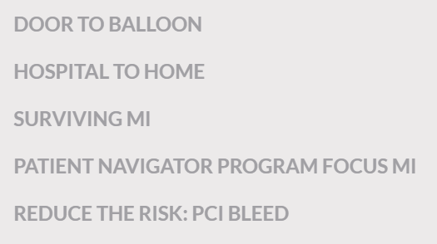

Slide 37
Reduces the Risk Features

Slide 38
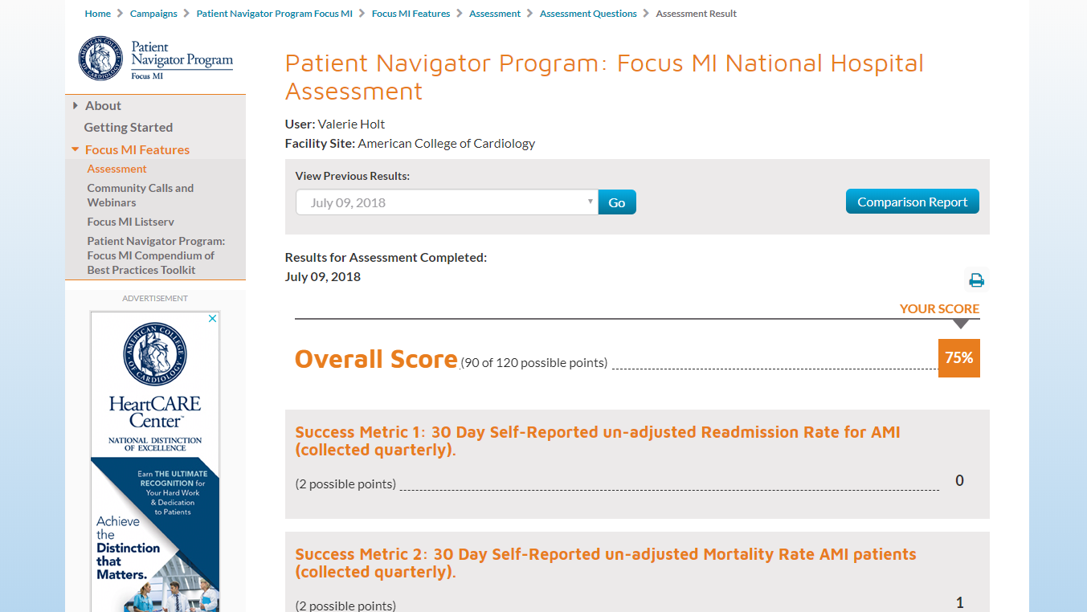
Facility Assessment

Slide 39
F
requently
NO Cost to participate
No Additional data collection
15 minute Delay
MIPS is annual for 2 years
A
sked
Q
uestions

Slide 40
Q&A
Please submit your questions for the moderated question and answer session

Slide 41
Opt In NOW!
Notes:
Select the box to accept the terms and conditions of the program, and at that point the submit button will enable.

