Slide 1
November 29, 2018
Spotlight: Cardiac Rehabilitation Best Practices Webinar #4

Slide 2
Agenda
Time | Topic | Presenter
12:00 pm EDT | Welcome and Introductions | Julie Mobayed, MPH, BSN, RN
 | Spotlight: Cardiac Rehabilitation Best Practices
12:05 | Getting to 70% Cardiac Rehabilitation Participation – How ACC’s Patient Navigator Program: Focus MI Hospitals Can Help | Hilary K. Wall, MPH Centers for Disease Control and Prevention
12:25 | Q&A | All
12:35 | Improving Cardiac Rehabilitation Utilization at Lake Regional Health System | Jennifer Newman, RN, BSN, cPT Lake Regional Health System
12:50 | Q&A | All
12:55 | Wrap-up and Next Steps | Julie Mobayed, MPH, BSN, RN

Slide 3
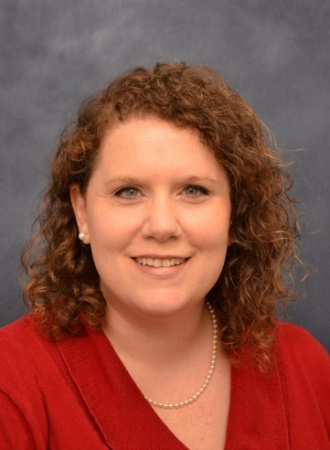
Getting to 70% Cardiac Rehabilitation Participation – How ACC’s Patient Navigator Program: Focus MI Hospitals Can Help
Hilary K. Wall, MPH
Senior Scientist/Million Hearts Science Lead
Centers for Disease Control and Prevention
ACC Patient Navigator Program: Focus MI Webinar
November 29, 2018

Slide 4
Overview
Burden of CVD in the U.S.
Million Hearts® 2022
Cardiac rehabilitation
Million Hearts® Cardiac Rehabilitation Change Package
The opinions expressed by authors contributing to this project do not necessarily reflect the opinions of the US Department of Health and Human Services, the Public Health Service, the Centers for Disease Control and Prevention, or the authors’ affiliated institutions. Use of trade names is for identification only and does not imply endorsement by any of the groups named below.

Slide 5
Heart Disease and Stroke in the U.S.
More than 1.5 million people in the U.S. suffer from heart attacks and strokes per year
More than 800,000 deaths per year from cardiovascular disease (CVD)
CVD costs the U.S. hundreds of billions of dollars per year
CVD is the greatest contributor to racial disparities in life expectancy

Slide 6
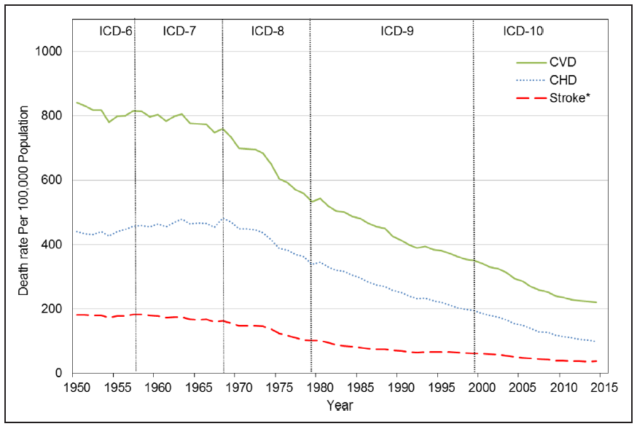
Heart Disease and Stroke Trends 1950-2015
All Cardiovascular Disease
Heart Disease
Stroke
Mensah GA, Wei GS, Sorlie PD, et al. Decline in Cardiovascular Mortality – Possible Causes and Implications. Circulation Research. 2017;120:366-380.

Slide 7
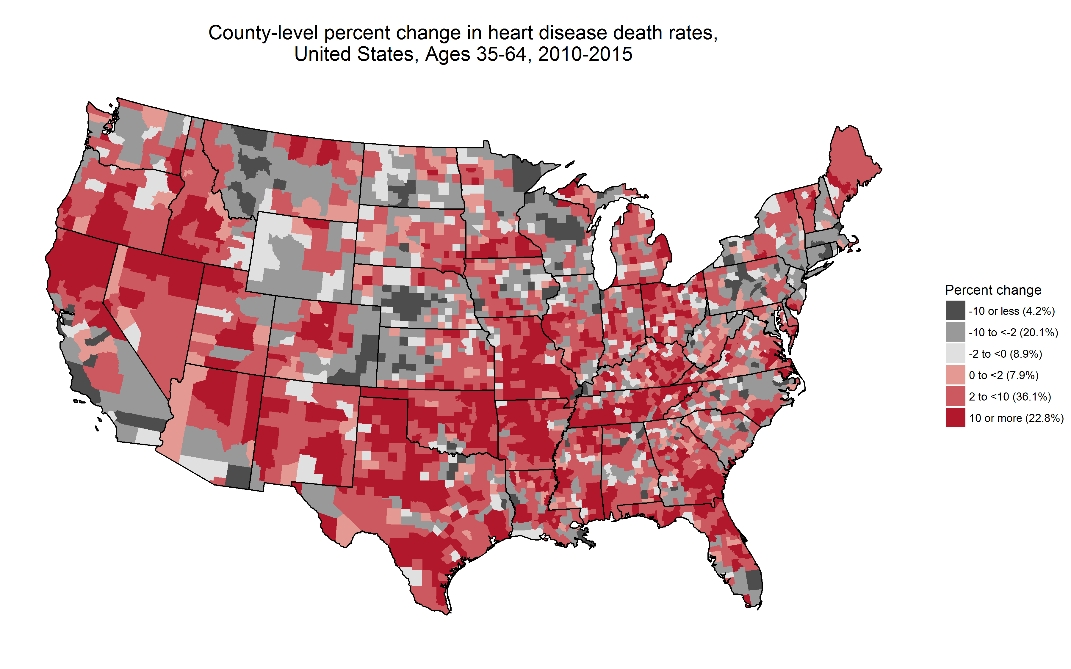
Heart Disease Mortality Rates
County-level percent change in heart disease death rates,
Ages 35-64, 2010-2015
Over 50% of counties had increases in heart disease mortality from 2010-2015.
Vaughan et al. Widespread recent increases in county-level heart disease mortality across age groups. Annals of Epidemiology. 2017;27:796-800

Slide 8
Million Hearts® 2022 Priorities
Keeping People Healthy
Reduce Sodium Intake
Decrease Tobacco Use
Increase Physical Activity
Optimizing Care
Improve ABCS*
Increase Use of Cardiac Rehab
Engage Patients in Heart-Healthy Behaviors
70%
Improving Outcomes for Priority Populations
Blacks/African Americans with hypertension
35- to 64-year-olds
People who have had a heart attack or stroke
People with mental health or substance use disorders who use tobacco
*Aspirin use when appropriate, Blood pressure control, Cholesterol management, Smoking cessation

Slide 9
Contributors to “the Million”
Cardiac Rehabilitation
¹Reflects preliminary findings from simulation modeling conducted using the CVD Policy Model, ModelHealth: CVD, and PRISM (unpublished). Baseline risk factor data were determined for: aspirin when appropriate using 2013-14 NHANES; BP control and cholesterol management using 2011-14 NHANES; smoking cessation and physical inactivity using 2015 NHIS; and sodium reduction using 2011-12 NHANES.

Slide 10
What is Cardiac Rehabilitation?
Comprehensive, team-delivered out-patient program
Typically administered in 36 sessions over ~12 weeks
25 sessions = healthy ‘dose’
Strong evidence for individuals who have:
Had a heart attack
Chronic stable angina
Received a coronary angioplasty or stent
Chronic heart failure
Undergone coronary artery bypass surgery, heart valve replacement or repair, or a heart or heart-lung transplant
Numerous benefits

Slide 11
Cardiac Rehabilitation Continuum

Slide 12
Referrals
Referral to CR varies by diagnosis
~80% for patients with a heart attack
~60% for patients who undergo angioplasty
~10% for patients with heart failure
Lower referrals for women, minorities
Variability by hospital, provider, department
Beatty AL,, et al. Trends in referral to cardiac rehabilitation after myocardial infarction: data from the National Cardiovascular Data Registry 2007 to 2012. J Am Coll Cardiol. 2014;63:2582–2583.
Aragam KG, et al. Gaps in referral to cardiac rehabilitation of patients undergoing percutaneous coronary intervention in the United States. J Am Coll Cardiol. 2015;65:2079–88.
Golwala H, et al. Temporal trends and factors associated with cardiac rehabilitation referral among patients hospitalized with heart failure: findings from Get With The Guidelines-Heart Failure Registry. J Am Coll Cardiol. 2015;66:917–26.
Ghisi GL, et al. Physician Factors Affecting Cardiac Rehabilitation Referral and Patient Enrollment: A Systematic Review. Clin. Cardiol. 2013;36:323-335.
Colella TJF, et al. Sex bias in referral of women to outpatient cardiac rehabilitation? A meta-analysis. Eur J Prev Cardiol. 2015;22:423–441.

Slide 13
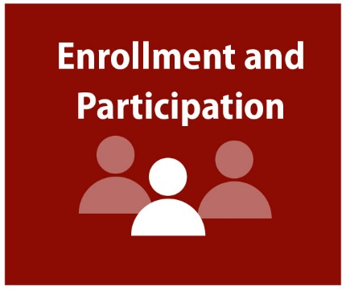
Enrollment and Participation
Participation rates vary by diagnosis
Higher for heart attack (~14%) and bypass surgery (31%)
Lower for patients with heart failure (<3%)
Lower participation rates among
People of color
Women
People with co-morbidities or low SES
Significant geographic variation
Suaya JA, Shepard DS, Normand SL, et al., Use of cardiac rehabilitation by Medicare beneficiaries after myocardial infarction or coronary bypass surgery. Circulation. 2007;116(15):1653-62; Park LG, Schopfer DW, Zhang N, et al. Participation in Cardiac Rehabilitation Among Patients with Heart Failure. J of Cardiac Failure. 2017;23(5):427-431; Castellanos LR, Viramontes O, Bains NK, et al. Disparities in Cardiac Rehabilitation Among Individuals from Racial and Ethnic Groups and Rural Communities-A Systematic Review. J. Racial and Ethnic Health Disparities. 2018 Mar 13. [Epub ahead of print].; Fang J, Ayala C, Luncheon C, et al. Use of Outpatient Cardiac Rehabilitation Among Heart Attack Survivors - 20 States and the District of Columbia, 2013 and Four States, 2015. MMWR Morb Mortal Wkly Rep. 2017;66(33):869-873.; Beatty AL, Truong M, Schopfer DW, et al. Geographic Variation in Cardiac Rehabilitation Participation in Medicare and Veterans Affairs Populations: An Opportunity for Improvement? Circulation, 2018.117.029471.

Slide 14
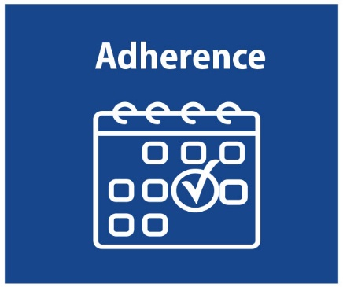
Adherence
~450K beneficiaries were eligible in 2013
20% of those eligible initiated within 12 months
57% of CR users completed > 25 sessions (~53K)
→ Only 12% of ‘eligibles’ received a healthy dose of CR
McNeely J, Ritchey MD, Maresh S, et al. Abstract 15035: Regional Variation in the Availability and Utilization of Cardiac Rehabilitation Services Among Eligible Medicare Fee-for-Service Beneficiaries: Where Are the Opportunities for Improvement?" Circulation. 2016;134(Suppl 1): A15035-A15035.

Slide 15
Road Map to Achieve 70% Participation

Slide 16
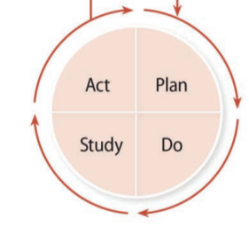
“It is not necessary to change. Survival is not mandatory.” – W. Edwards Deming

Slide 17
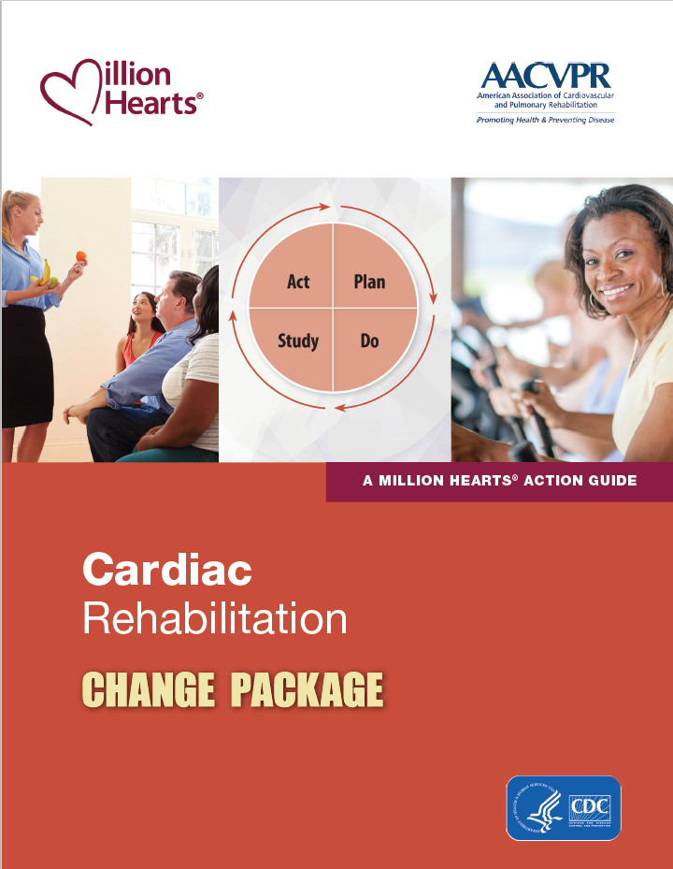
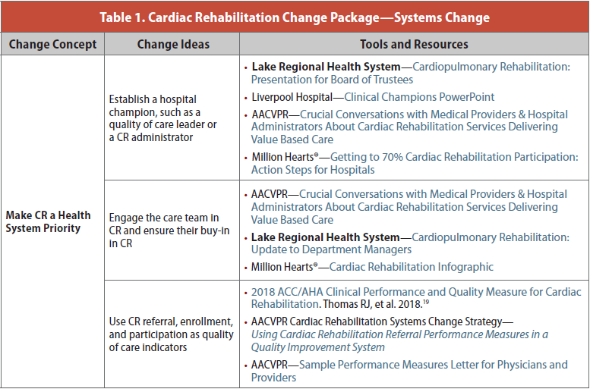
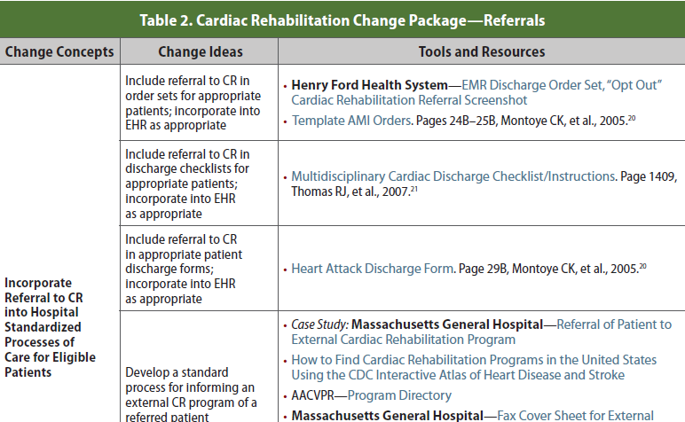
Cardiac Rehabilitation Change Package
Access the Change Package at: https://millionhearts.hhs.gov/files/Cardiac_Rehab_Change_Pkg.pdf

Slide 18
CDC & AACVPR Collaboration
American Association of Cardiovascular and Pulmonary Rehabilitation (AACVPR) board members, headquarters staff
100+ tools and resources
Expertise, tools, and resources from:
18 states
22 institutions
36 CR professionals and researchers

Slide 19
Change Package Format
Change Concept
General notions that are useful in the development of more specific ideas for changes that lead to improvement
Change Idea
Actionable, specific ideas for changing a process
Tools & Resources
Can be adapted by or adopted in a health care setting

Slide 20
Tools and Resources
AACVPR Strategies
Case studies
Program-specific tools
Organization-specific tools
CDC, AHA, ACC

Slide 21
Cardiac Rehabilitation Change Package Focus Areas
Systems change
Referrals
Enrollment and participation
Adherence

Slide 22
Referrals
Change Concepts:
Incorporate referral to CR into hospital standardized processes of care for eligible patients
Standardize the CR referral process
Use data to drive improvement in referrals to CR

Slide 23
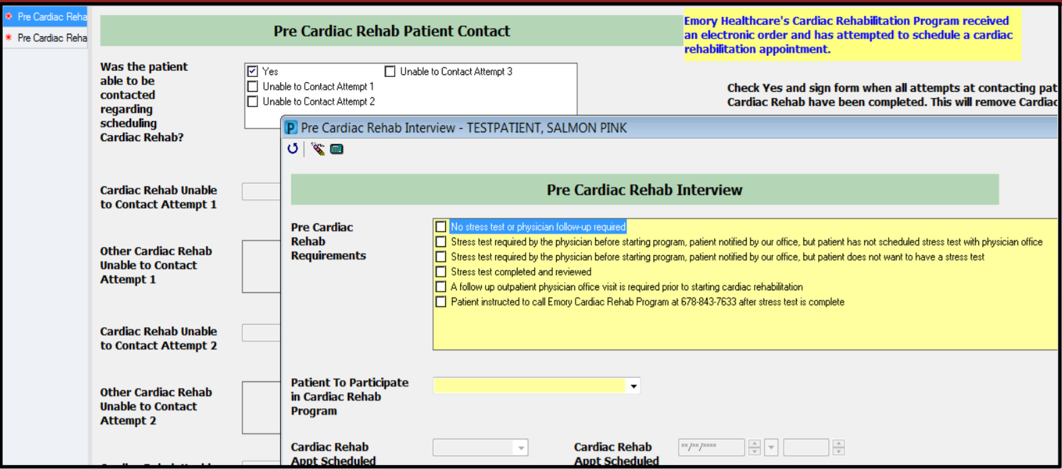
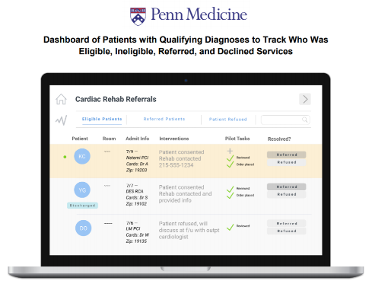
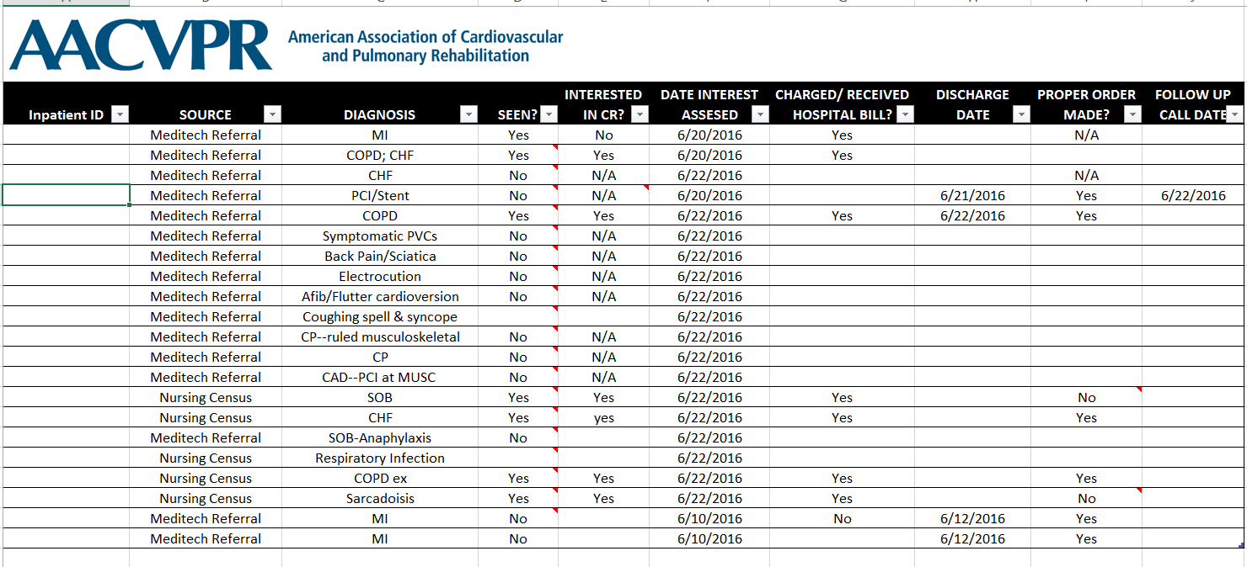
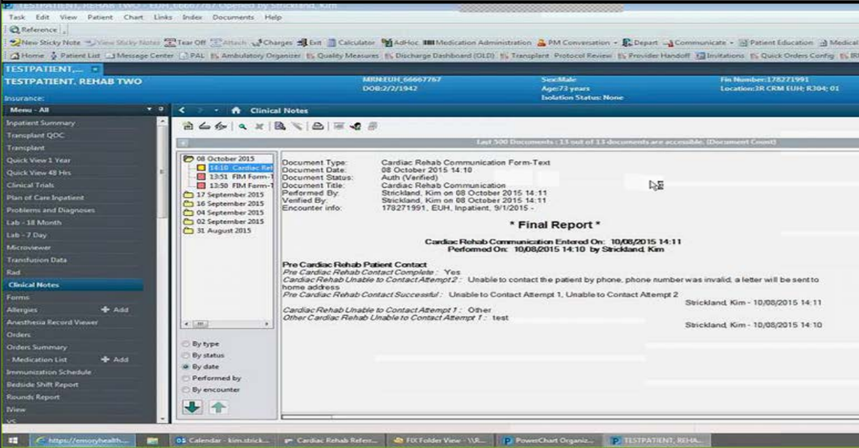
Referrals
Change Concept
Use Data to Drive Improvement in Referrals to CR
1. Determine inpatient referral metrics to CR
2. Determine outpatient referral metrics to CR
3. Use CR referral performance measures in a quality improvement system
Change Ideas
4. Regularly provide a dashboard with CR referral metrics, goals, and performance
5. Implement a CR Registry to identify, track, and manage patients who are referred to a CR program
6. Identify patients who had a cardiac event without a referral to a CR program
Tools & Resources

Slide 24
Adherence
Change Concepts:
Identify populations at risk for low engagement
Improve patient engagement

Slide 25
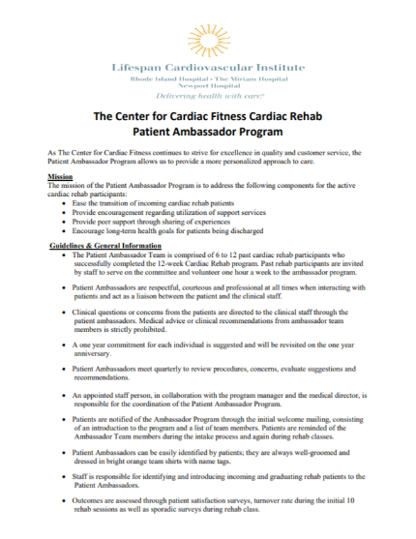
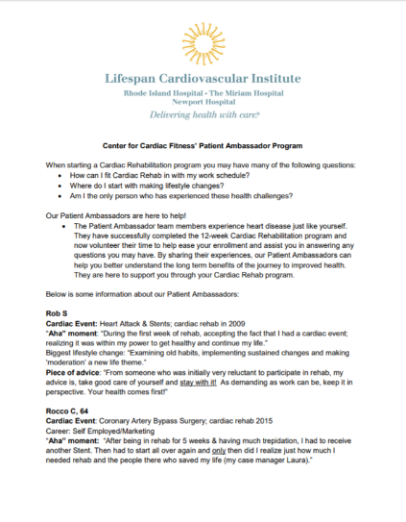
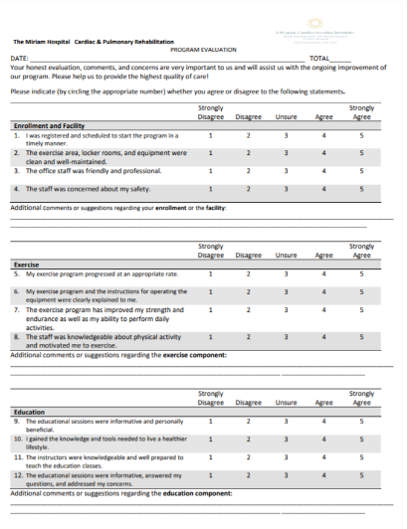
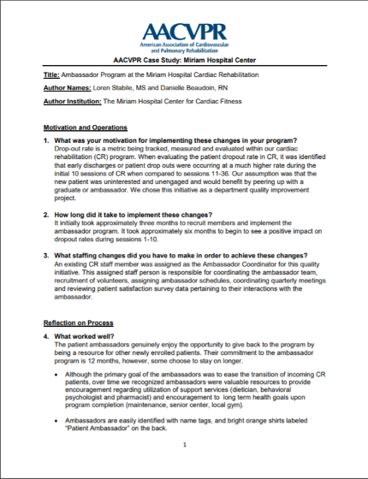
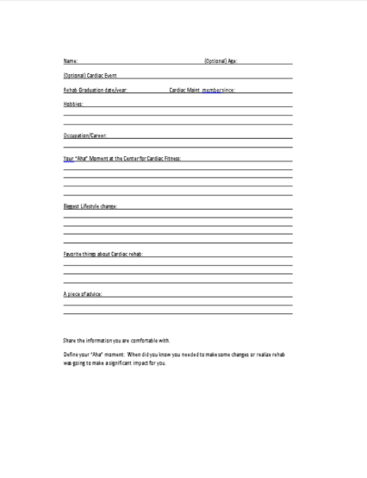
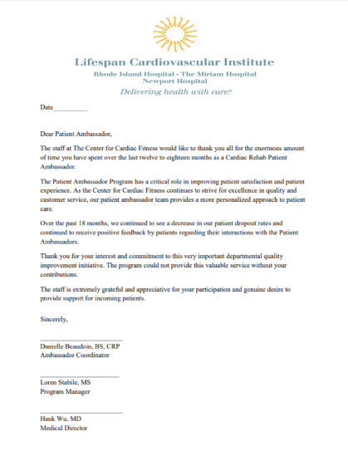
Adherence
Change Concept
Improve Patient Engagement
1. Incorporate motivational and financial incentives for meeting goals for session attendance
2. Automate reminders and communication
3. Connect enrolled patients with a graduate or phase 3 participant Patient Ambassador or “sponsor”
Change Ideas
Tools & Resources

Slide 26
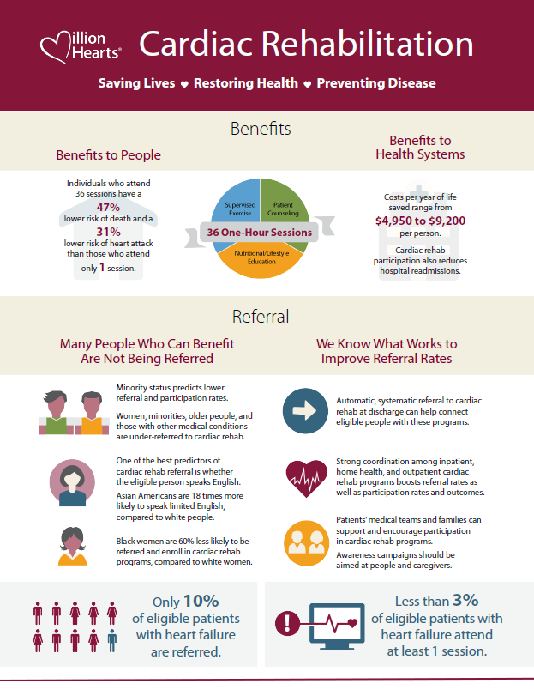
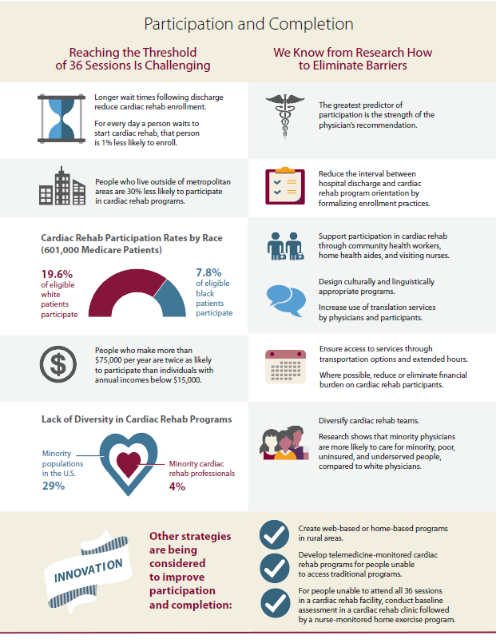
CR Resources
CR Webpage – https://millionhearts.hhs.gov/tools-protocols/tools/cardiac-rehabilitation.html
CR Change Package
CR Communication Toolkit
CR infographic and factsheet
Videos of CR patient stories

Slide 27
Million Hearts® Cardiac Rehab Collaborative (CRC)
Joining together to reach 70% CR participation by 2022
CR professionals, clinicians, and health care teams; hospitals and health systems; CR participants and family members; payers; and employers
Over 200 members from 90 orgs
Shared ‘action plan’ of objectives; report progress
Quarterly calls and ad-hoc meetings
Email MillionHeartsCRC@cdc.gov to join

Slide 28
Questions?
Hilary Wall – hwall@cdc.gov
The opinions expressed by authors contributing to this project do not necessarily reflect the opinions of the US Department of Health and Human Services, the Public Health Service, the Centers for Disease Control and Prevention, or the authors’ affiliated institutions. Use of trade names is for identification only and does not imply endorsement by any of the groups named.

Slide 29
Questions?
Please submit your questions for the moderated question and answer session.

Slide 30
Improving Cardiac Rehabilitation Utilization at Lake Regional Health System
Jennifer Newman, RN, BSN, cPT
Director of Cardiac Services
Lake Regional Health System
Osage Beach, Missouri

Slide 31
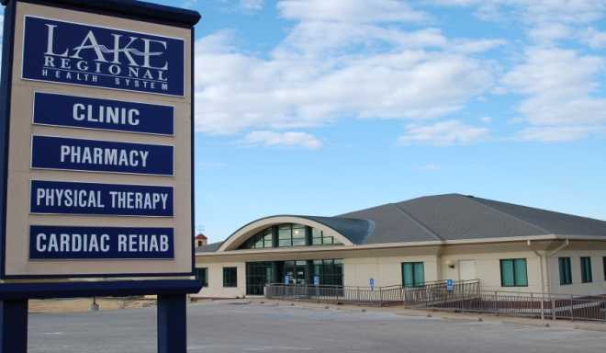
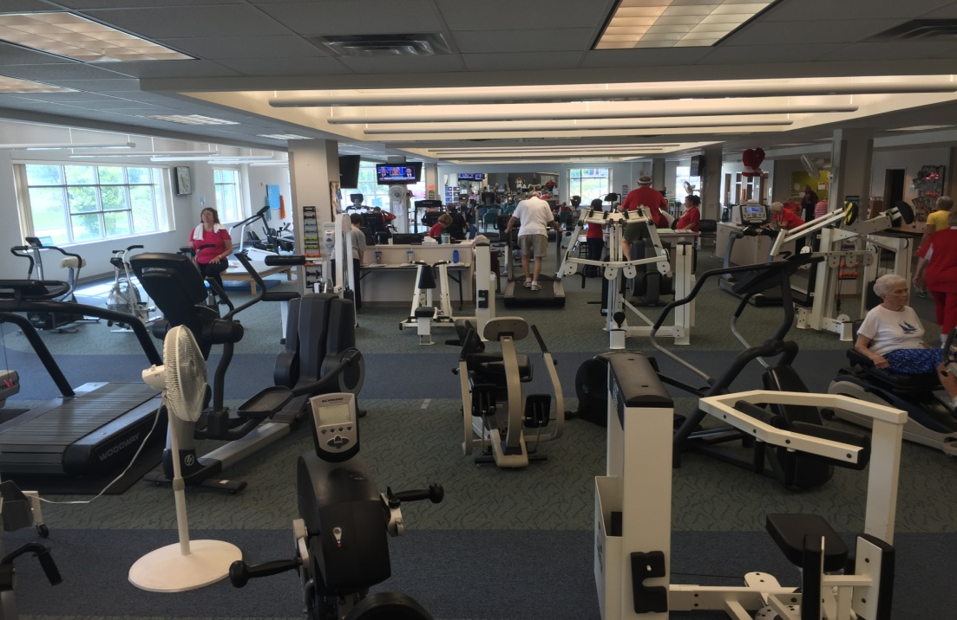
Cardiopulmonary Rehabilitation
Lake Ozark
Eldon
Osage Beach
Laurie
Camdenton
Notes:
45000 patient contacts per year
5 locations
Phase 1/2/3

Slide 32
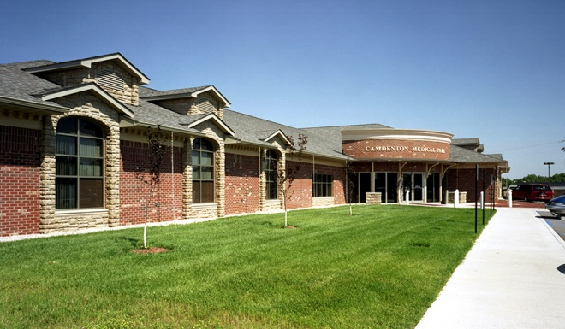

Slide 33
Quality improvement tool
Target is improved care
Listing of process improvements that cardiac rehabilitation champions can implement
Change concepts
Change ideas
Tools
Resources
Cardiac Rehabilitation Change Package

Slide 34
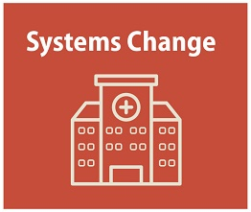
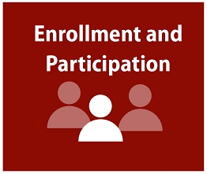
1 Tool
3 Tools
4 Tools

Slide 35
Make CR a Health System Priority
Tool – Presentation to the Board of Trustees
Tool – Update to department managers

Slide 36
System Changes
Old System
Improved System
90 min
Door to door
Patient
Registration
30-45 min
CR
90 min
Dietician
15-30 min
Lab
15-30 min
Registration
CR
Dietician
Lab Draw
Patient

Slide 37
Standardization
Tool - Process Mapping for CR Referrals
Tool - Physician Referral/Order Policy
Tool - Admission Guidelines

Slide 39
Educate patients about the benefits of CR.
Tool - Phase I Program Guidelines for inpatient education

Slide 40
Use Data (analytics) to Drive Improvement
Tool - Tracking of participants by diagnosis, physician for targeting
Data by Physician
Data by Diagnosis
PCI – 48%
CABG – 25.3%
A/MVR – 9.3%
NSTEMI – 8%
CHF – 5%

Slide 41
Patient Graduation Rate
National Average 55%

Slide 42
LRHS Referral Capture Rate
National Average 30%

Slide 43
Our Impact
CHF/COPD/CABG Readmissions
Decreased ED utilization
Liaison between providers and patients
Functional capacity improvement
Breathing Retraining
Quality of Life

Slide 44
Questions?

Slide 45
Questions?
Please submit your questions for the moderated question and answer session.

Slide 46
Learning Network - Listserv
Join the Patient Navigator Community:
patientnavigatorfocusmi@lists.acc.org

Slide 47
Webinar Series 2019
Coming Soon!

