Slide 1

June 20, 2018
Patient Navigator Program Success
Webinar #3

Slide 2
Agenda
Time | Topic | Presenter
12:00 pm | Welcome and Introductions | Dr. Ty Gluckman
 | Successes from Patient Navigator 1.0
12:05 pm | Improving Follow Up Rates: Utilization of Phantom Appointments and Lace Tool | Randy Cash, MSN, RN, CCCTM Aurora BayCare Medical Center
12:25 pm | Q&A | All
12:35 pm | Successes from the Patient Navigator Program | Kim Marshall, BSN, RN, CPHQ, AACC University of Colorado Hospital
12:50 pm | Q&A | All
12:55 pm | Wrap-up and Next Steps | Dr. Ty Gluckman

Slide 3

Improving Follow Up Rates
Utilization of Phantom Appointment and Lace Tool

Slide 4


Aurora BayCare Medical Center
Located in Green Bay WI
167 Bed Facility
Delegate Hospital for Patient Navigator 2.0 (Focus MI)

Slide 5


Our Team
Director – Dr. Scott Weslow
Director of Quality – Julie Pomasl, RN
Quality Improvement Coordinator – Julie Manny, RN
Transitional Care RN/ Patient Navigator – Randy Cash, RN
© Aurora Health Care | 5

Slide 6

Patient Navigator 1.0
An area for Improvement
Areas for Improvement
  Follow Up Visits
    Baseline data for follow up visits at the start of Patient Navigator was 74%
    Patients discharged on weekends not receiving appointment prior to discharge
    Patients not understanding importance of follow up.
    Discharged without fully understanding disease process.
  Assessing Risk of Readmission
    No process in place
© Aurora Health Care | 6
Notes:
At the start of Aurora BayCare Medical Center’s (ABMC) participation in the American College of Cardiology’s (ACC) Patient Navigator Program facilitated improvement efforts within the Congestive Heart Failure (CHF) and Acute Myocardial Infarction (AMI) populations, ABMC was excelling with the ACTION Registry®-GWTG™ metrics, the CHF Performance measures, identification of both AMI and HF patients, and providing specific patient education. Conversely, areas that needed more attention included assessing the risk of readmission, as well as scheduling the 7 day follow up appointment for CHF patients, and ensuring the appointment was attended. Prior to implementation, there was no process in place to account for patients discharged on the weekends to ensure that the follow-up appointment was on their discharge paperwork, and there was also poor compliance with attendance at the follow-up appointment. Additionally, there was not a process in place to assess risk for readmission.

Slide 7
Patient Navigator 1.0
Interventions
Transitional Care RN
Phantom Appointment
LACE tool
  Length of Stay
  Acuity
  Comorbidity
  Emergency room visits within last six months.
© Aurora Health Care | 7
Notes:
At ABMC, a Transition of Care Nursing position was created to address these issues in a effort to reduce the CHF and AMI 30 day readmissions. the Transition of Care Nurse position that was created is used to provide a more thorough review of education to patients and their families. The Transition of Care Nurse then telephonically contacts CHF patients after discharge at specific intervals for 30 days to ensure that they are comfortable managing their care at home, stressing the importance of attending their appointments, arranging services as needed, and providing further education.
Using a multidisciplinary approach and partnering with the Cardiology outpatient clinic, a process was developed in which a phantom appointment is created for weekend discharges and appears on the patient’s discharge paperwork.

Slide 8
© Aurora Health Care | 8
Notes:
. An algorithm was established to account for the step by step procedure for nursing to follow to ensure the patient would have a follow up appointment prior to discharge. This phantom appointment is made for the patient for the following Wednesday and the nurse leaves this message with the answering service so the Cardiology office is alerted Monday morning; if there are any conflicts the office will resolve this.

Slide 9
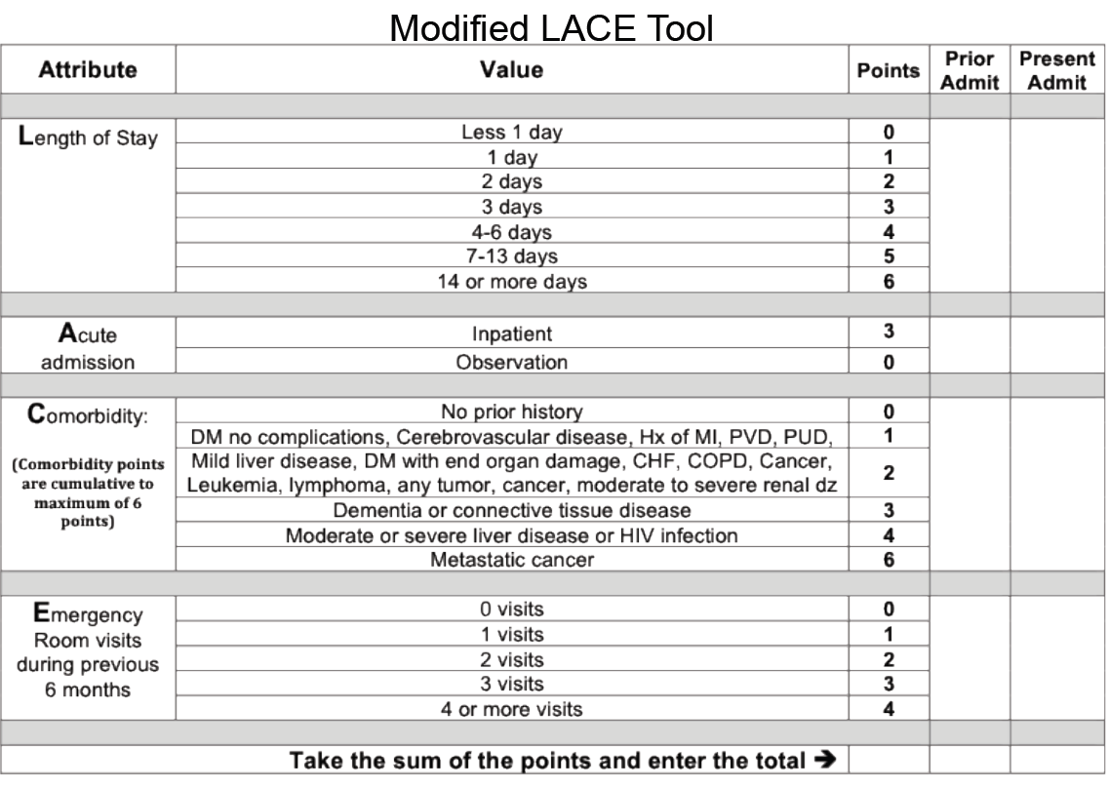
© Aurora Health Care | 9
Notes:
Assessing the risk for readmission was another opportunity to intervene upon. The need to have this process automated was evident. Soon after the start of the Patient Navigator Program, the LACE tool was embedded within the electronic medical record, EPIC, and the Transitional Care Nurse uses the LACE score to assess the AMI and HF patients with each admission.

Slide 10
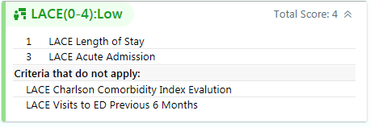

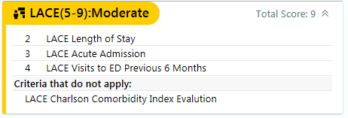
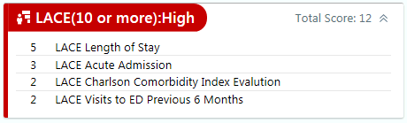
LACE tool in EPIC
This is a column you can add in EPIC to show on your patient lists screen
This is what the LACE tool looks like in Patient Story
© Aurora Health Care | 10
Notes:
Assessing patients for risk of readmission was not documented prior to the program; however, by the end of the program, 100% of both AMI and HF patients were assessed for their risk for readmission using the LACE tool.

Slide 11

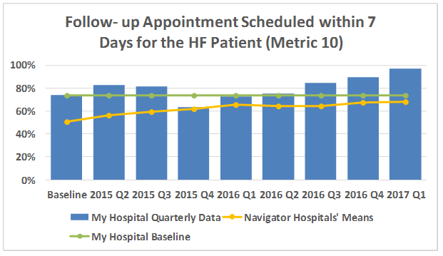
Follow-Up Appointment
© Aurora Health Care | 11
Notes:
Prior to implementation, compliance in scheduling a follow-up appointment within 7 days for CHF patients AND having it on the discharge paperwork was 74% at baseline. Post implementation of the phantom appointment, compliance has improved to 96.7% by March 2017 meeting the 95% goal

Slide 12
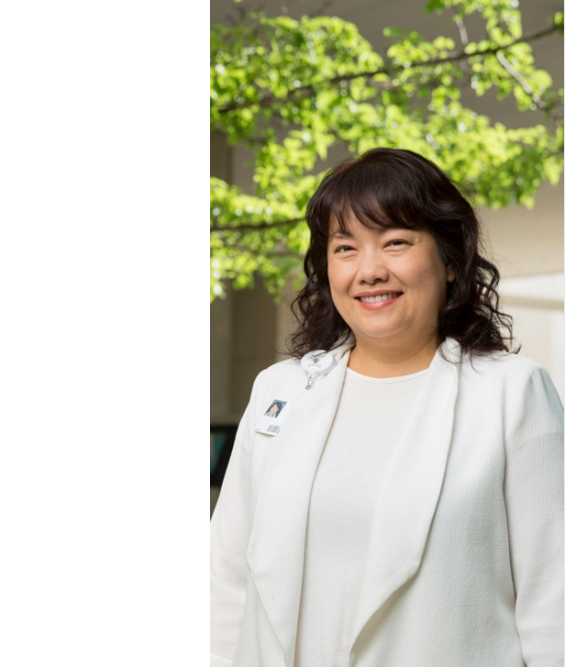
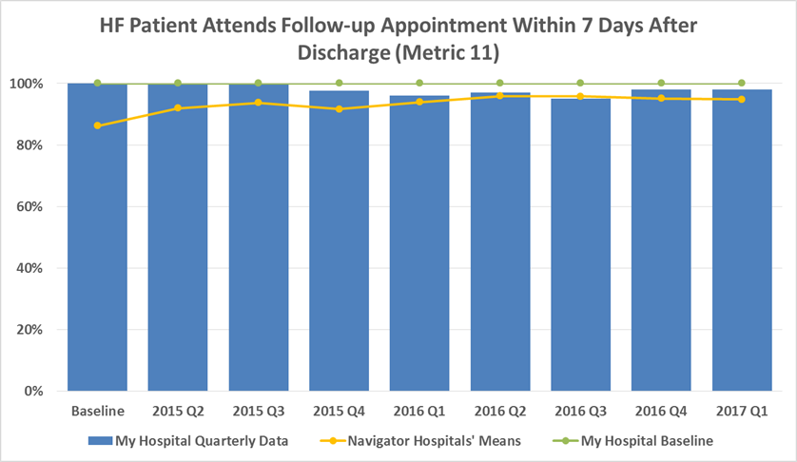
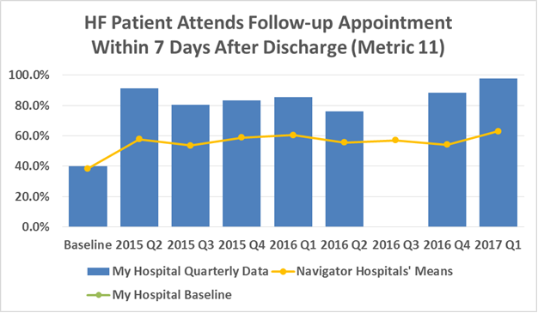
CHF Patient Follow up Percentage
© Aurora Health Care | 12
Notes:
. For the metric regarding follow-up appointment attendance, baseline data showed 40% compliance. After implementation, compliance has improved by 49% to 98% by March 2017.

Slide 13

Thank You!
Aurora BayCare Medical Center

Slide 14
Successes from the Patient Navigator Program
6.20.2018

Slide 15
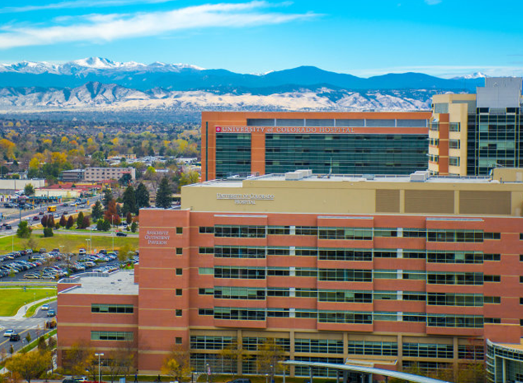



University of Colorado
Hospital - UCHealth
Kim Marshall, BSN, RN, CPHQ, AACC
Clinical Quality Specialist

Slide 16
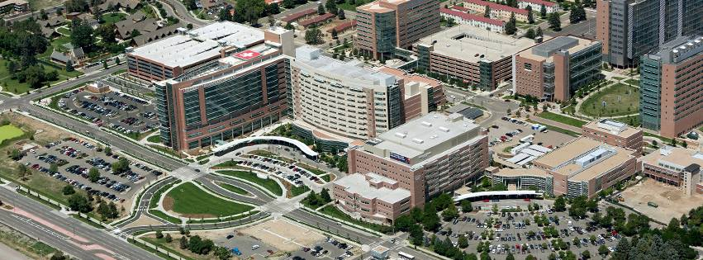
Academic Medical Center
Level II Trauma Center- applying for level I
4^{the} Consecutive Magnet Designation- driving for 5
Honor Roll Best Hospitals ranked #15 By U.S. News & World Report
  Cardiology 32nd In The Nation 2017-2018
673 Licensed Beds
6387 Employees
31,599 Admissions
99,893 ED Visits
1,110,280 Clinic Visits
Notes:
statistics for FY17; Closest hospital to DIA, region (all along the front range) all hospitals have a cath lab making competitive market

Slide 17
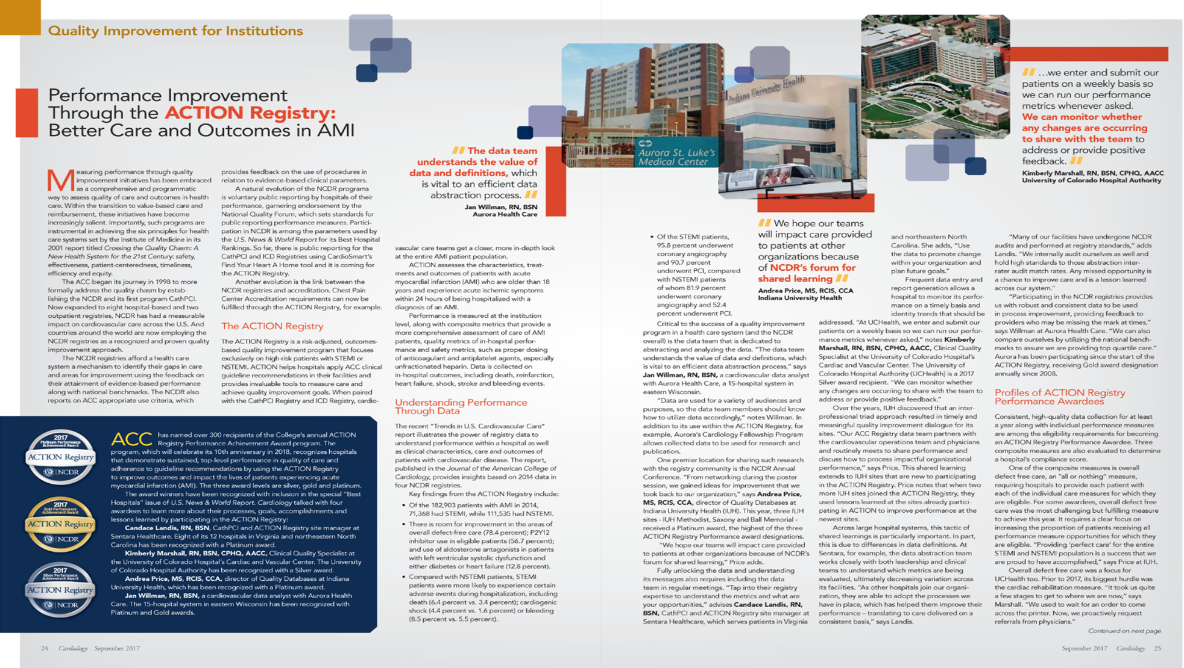
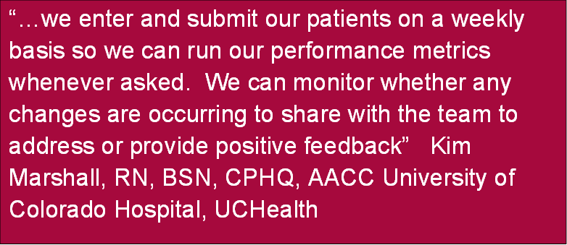
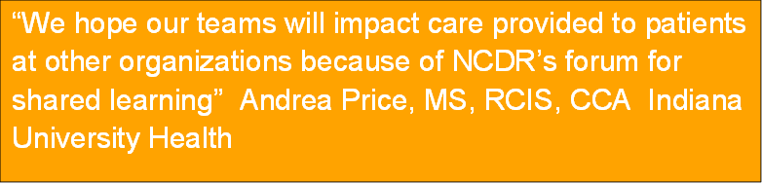
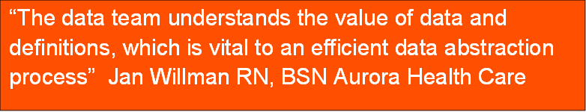
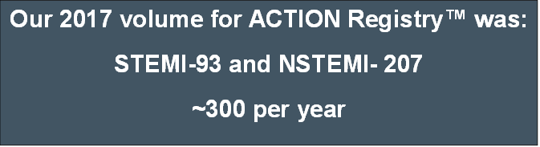
®
Notes:
In Cardiology September 2017
Volumes reflect R4Q32017
Great to be asked even as silver recipient to offer input into this article
Reference few key talking points in the article// all help assist with QI

Slide 18
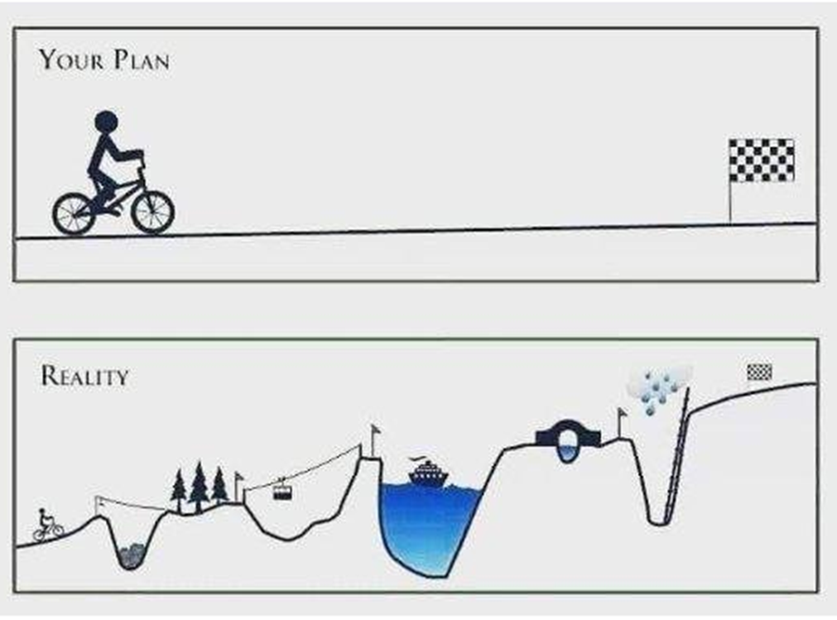

Process Improvement: How we think it looks vs. reality…
Implement
Brainstorming
Plan
IT
Gathering
Notes:
My life. Emphasize the timeline as well (forever) not a 100 day rapid cycle initiative. Spend time highlighting “reality”
Note IT is usually for data, we have the NCDR backing us up!!

Slide 19
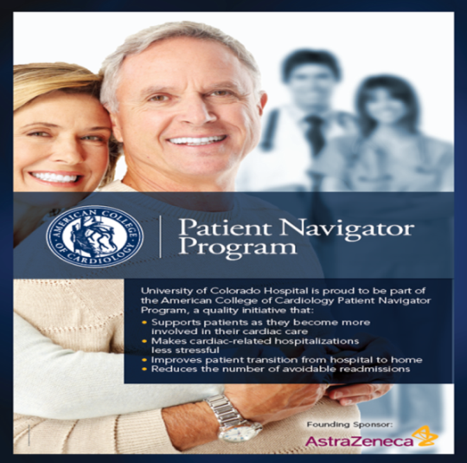


Team Dynamics
2014- D₂B Team - Met quarterly
        ED care team, Cath Lab Staff, QIS
2015- Joined the ACC Patient Navigator Program
  Continued D₂B team
  Initiated MI Committee involving IP care team
2017- Our ACC Accreditation journey began for Chest Pain
2018- ACC Accreditation site visit was on May 3rd, Accredited May 25th
Notes:
Team dynamics!!!
2014 team thought we were doing OK. Bring in ARG data, had a lot of areas to improve but this focus was D2B time consistently under 90 minutes. Provider thought TIMI flow stopped clock. (Communication key)
2015 2 separate teams to respect time and team members (not “my domain” concept)
2015 not until August that care management rounds initiated with cardiac resident team and multidisciplinary team to address DC needs.

Slide 20


Challenges
Right people
Timing/ “domain”
Engagement
Facilitating versus team ownership
Notes:
Challenges getting team together
Takes time to enlist the right people; Finding a time that works for team members/ physicians
May cycle through few members until have group that is engaged.
Wax and wane around facilitating versus team running.
Present agenda, managing dialog to keep on track versus stimulating ideas.

Slide 21
AMI Committee Charter
Align organizational strategies, business priorities, and patient safety
    Reduce AMI Mortality and Readmissions
Mission
  Consistent with the mission of the University of Colorado Hospital to improve lives, in big ways and small, the mission of the Chest Pain Program is to improve cardiac care for the ACS patient through evidence based practice, monitoring key quality outcome indicators, education and efficient utilization of resources
Notes:
2017 we thought Cardiac Bundle would go live!! Do we stay on track, where do we need to refocus energy
Hospital and Service Line strategic goal to reduce Mortality and Readmissions. CR known have big impact in addition to overall defect free care.
Challenged do we see direct correlation with reduction in Mortality and Readmissions by our CMO.
To help align the team as strategically decide areas to improve. Want to align with organizational strategies, business priorities, and patient safety.

Slide 22
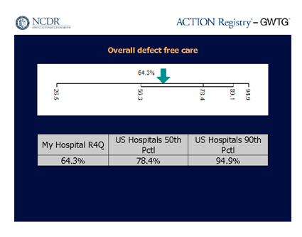
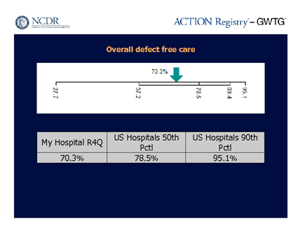
Identifying a Strategy
2014Q4
2015Q4
Using NCDR dashboard, drill down to outliers
    Cardiac Rehab was our biggest defect
Transparency is key- identify audience
Patient Navigator Program initiated - strategic power behind efforts
Notes:
Identifying strategy: we picked ODFC because it is an NQF measure.
The D2B team all I had in 2014. We then recognized needed to address beyond the D2B times. Care of the patient after the cath lab in my facility.
Created MI team to bring other care team members into the FOLD
Using the NCDR dashboard, drill down to the outliers. Cardiac Rehab was our biggest defect.
Transparency is key- to the right audience
Patient Navigator Program was initiated to put some strategic power behind our efforts

Slide 23
Strategic Goal- “Inspire a Shared Vision”
Organizations's Goal
Reduce AMI
30 day Mortality and Readmit
ACC Patient Navigator Program
Increase Overall Defect Free Care
AMI Committee Goal
All AMI patients seen by CR
Obtain an order for CR referral
Notes:
SMART GOALS! Why/What/How
CR referrals were being discussed but did not have the power behind to help facilitate the leadership support needed to move the barometer. PNP helped move the dial.
Shows emphasis of having Admin and Providers onboard.
Highlight done during Care manager multidisciplinary rounds

Slide 24

Sharing Becomes Transformational
Notes:
Role of Abstractor/ RSM
My years of wisdom. Share your data. Many different ways over and over. We all read little differently. It is Ok to be challenged with the data. It makes us validate and review so all care team members can understand. The more intimate you are with the data the better you can explain it.

Slide 25

“Defending” your Data
“I will look into it”
“I never looked at it that way”
“I made an error and have corrected”
Notes:
Try not to respond defensively. We are human, not super human.
Again the more intimate you are with the data, the better can instill faith in the values and utilize them.

Slide 26
Monthly Dashboard
AMI Quality Metrics |  |  | updated 5/30/2018
source: ACTION Registry® | FY16 (Jul 15 to Jun 16) | FY17 (Jul 15 to Jun 16) | FY18 to date | US 50th pctl | US 90th pctl
Aspirin on Arrival | 100.0% | 100.0% | 99.5% | 99.6% | 100.0%
Num/Den | 188 of 188 | 201 of 201 | 205 of 206
Eval of LVSF | 95.0% | 99.2% | 97.5% | 98.1% | 100.0%
Num/Den | 207 of 218 | 261 of 263 | 234 of 240
Time to PCI within 90 min (STEMI only) | 100.0% | 100.0% | 100.0% | 97.1% | 100.0%
Num/Den | 75 of 75 | 58 of 58 | 63 of 63
Aspirin at Discharge | 99.5% | 100.0% | 100.0% | 99.4% | 100.0%
Num/Den | 184 of 185 | 217 of 217 | 198 of 198
Beta Blocker at Discharge | 98.6% | 98.8% | 98.7% | 98.3% | 100.0%
Num/Den | 204 of 207 | 246 of 249 | 230 of 233
ACE-I or ARB for LVSD at Discharge | 100.0% | 97.4% | 96.4% | 93.5% | 100.0%
Num/Den | 11 of 11 | 38 of 39 | 27 of 28
Statin at Discharge | 99.5% | 99.6% | 98.7% | 99.7% | 100.0%
Num/Den | 207 of 208 | 252 of 253 | 229 of 232
Adult Smoking Cessation | 97.4% | 97.6% | 93.2% | 100.0% | 100.0%
Num/Den | 74 of 76 | 80 of 82 | 68 of 73
Cardiac Rehab Referral | 87.3% | 86.9% | 95.7% | 86.1% | 99.6%
Num/Den | 186 of 213 | 212 of 244 | 225 of 235
Aldosterone at Discharge | 25.0% | 47.8% | 50.0% | 14.8% | 44.0%
Num/Den | 2 of 8 | 11 of 23 | 11 of 22
Notes:
Monthly dashboard shared at every MI meeting
Power of transparency, team members focus in on certain elements they can effect. Everyone thinks they are doing okay until you share the data…

Slide 27
Transparency
Notes:
How is our readmission rate going…. (update graph)
2016 we implemented AMI FU to be done 7-10 days
Monthly case reviews in committee meetings

Slide 28
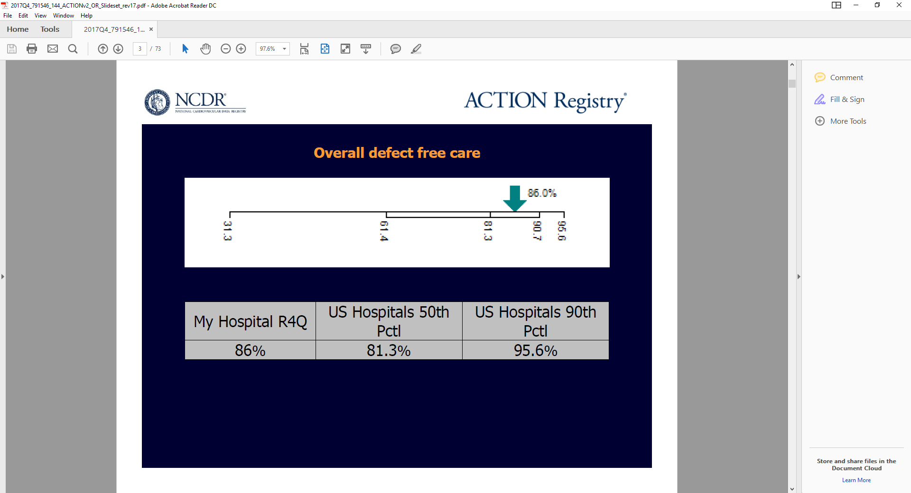

Overall Defect Free Care
2017Q3
2017 Q4
Notes:
Current outcomes

Slide 29

Notes:
2017- sad to report that because of Q12017 we did not get recognition form ACTION this year ☹

Slide 30

Improve Overall Defect Free Care
- Our baseline data showed us at 65%. Initial tracking demonstrated as low as 60% in Q3 2015.
- It was recognized that there was opportunity for improvement with obtaining Cardiac Rehab (CR) referral while inpatient.
- Having the OP order for patients to attend CR is just the beginning of patient participation.
- Our CR team is looking at restructuring group orientation, extending some evening classes, utilizing new kitchen for education classes, and other innovative ways to encourage patient attendance. The next phase of improving the care we offer our AMI patient population.
- As of Q2 2017, with a rolling four quarters, our Overall Defect Free Care for our AMI patients is 85.6%.
- Improvements attributed to:
1- Designated CR staff member attending daily cardiology rounds and working collaboratively with our provider team to obtain a CR OP referral prior to patient’s discharge.
2- Admission order set with CR consult order
3- CR staff placing external OP referral for CR
Source: ACTION Registry®
Notes:
Final visit for the ACC PNP was in September of 2017- Concept of past /current/ future state
Increase the proportion of AMI patients with an Overall Defect Free Care from 64% to >75% - Goal: Improve Overall Defect Free Care from 64% to >75%

Slide 31
Another Visual
Overall Defect Free Care
2015Q3 = 65%
Cardiac Rehab Referral
1- Designated staff attend daily cardiology rounds to obtain referral prior discharge
Innovations
1- Restructuring CR group orientation
2- Extending evening classes, utilizing new kitchen for education classes
3- Other innovations to encourage patient attendance
2018Q1 = 85.2%
2- Admission order set with CR consult order
3- CR staff place external OP referral
Notes:
Started small in 2014 now all parties involved in 2018 for accreditation
2015Q3 Baseline Overall Defect Free Care
Strategic alignment with Cardiac Bundles/ PNP/ Accreditation may impact speed of PI in a larger institution.
Defining MI

Slide 32
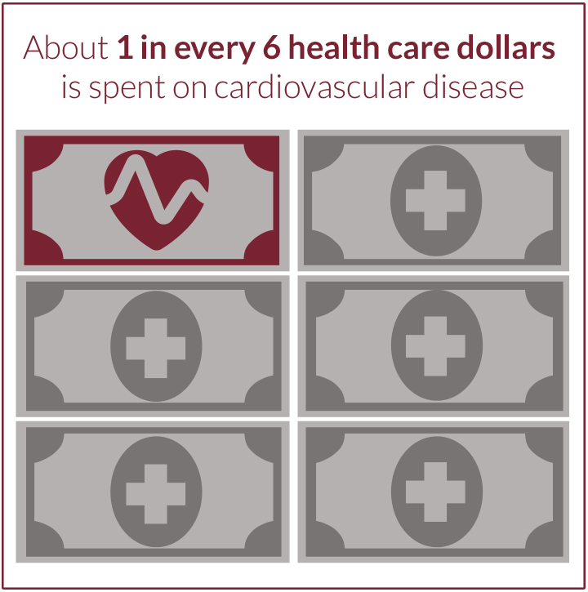
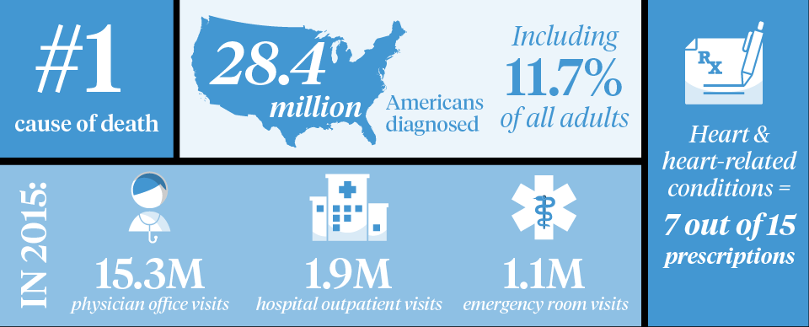
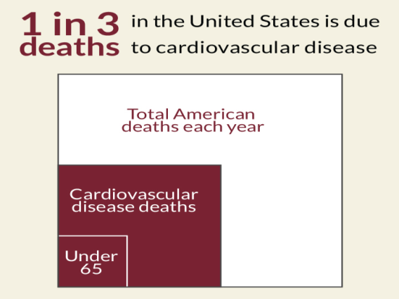
2018 = New Era - Same Goals
Accreditation
Clinical Efficiencies- Bundled Payment efforts
$$$$
Notes:
Started small in 2014 now all parties involved in 2018 for accreditation
Strategic alignment with Cardiac Bundles/ PNP/ Accreditation may impact speed of PI in a larger institution.
Defining MI

Slide 33
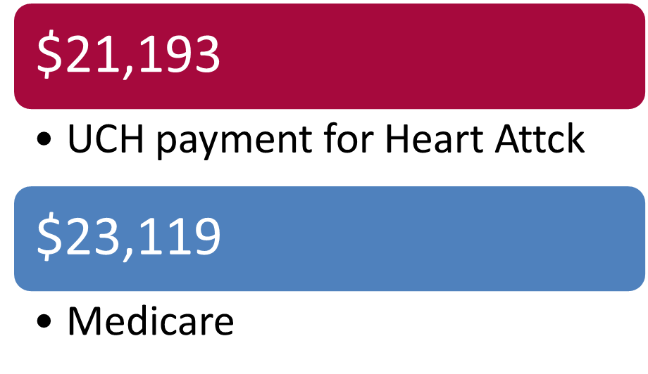
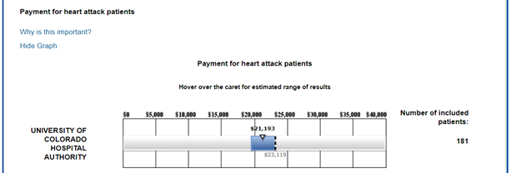
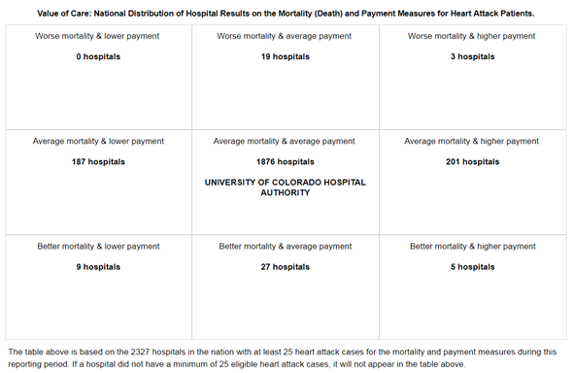
Hospital Compare
Average mortality & average payment
1876 hospitals
UCH
Notes:
Look into CMS FY 2018 Hospital Inpatient Quality Reporting (IQR) Program

Slide 34
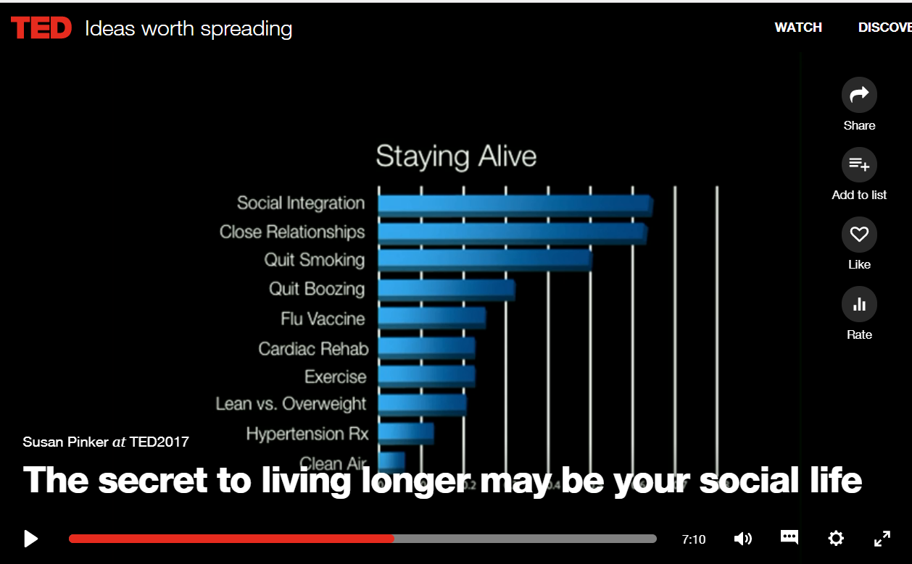
Impact of Cardiac Rehab
https://www.ted.com/talks/susan_pinker_the_secret_to_living_longer_may_be_your_social_life/transcript
Notes:
Social Integration; go out and socialize with your peers. Continue to encourage CR at your organization
Julianne Holt-Lunstad is a researcher at Brigham Young University and she addressed this very question in a series of studies of tens of thousands of middle aged people much like this audience here. And she looked at every aspect of their lifestyle: their diet, their exercise, their marital status, how often they went to the doctor, whether they smoked or drank, etc. She recorded all of this and then she and her colleagues sat tight and waited for seven years to see who would still be breathing. And of the people left standing, what reduced their chances of dying the most?

Slide 35
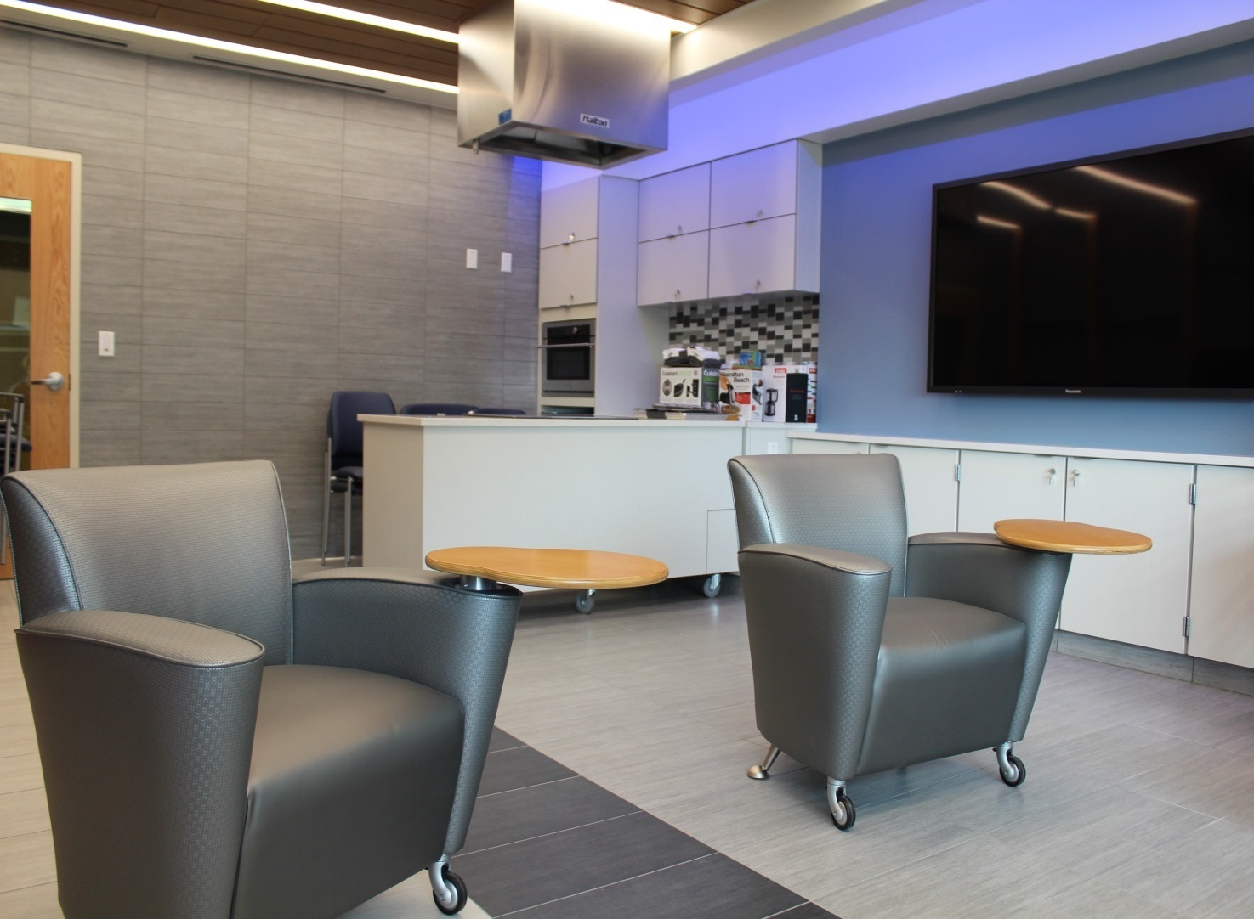
Summary
Possibilities for patient-centered education are endless!
Notes:
During presentation I showed several ways to illustrate same information and related information.
Don’t give up on transparency even if have to “get back to you”.
Next steps include engaging the patients after discharge, and how to keep them engaged.
Photo - New Bickham education center -
Made possible from very generous family contribution. Includes demonstration kitchen.

Slide 36
Questions?

Slide 37
Upcoming Webinars
Webinar 4: Thursday, November 29th, 12 - 1 pm EST

Slide 38
Learning Network - Listserv
Join the Patient Navigator Community:
patientnavigatorfocusmi@lists.acc.org

Slide 39
Questions?
Please submit your questions for the moderated question and answer session.

