Slide 1
Work Flow Process Fetal Pilot
Shazia Mohsin
Pediatric echo lab director-akuh

Slide 2
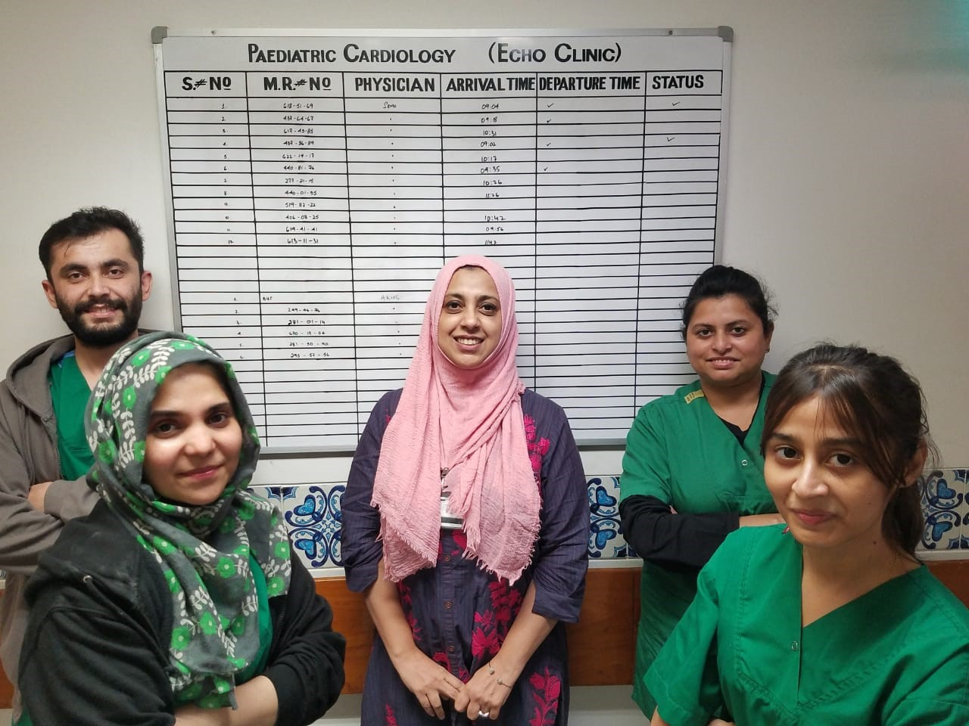
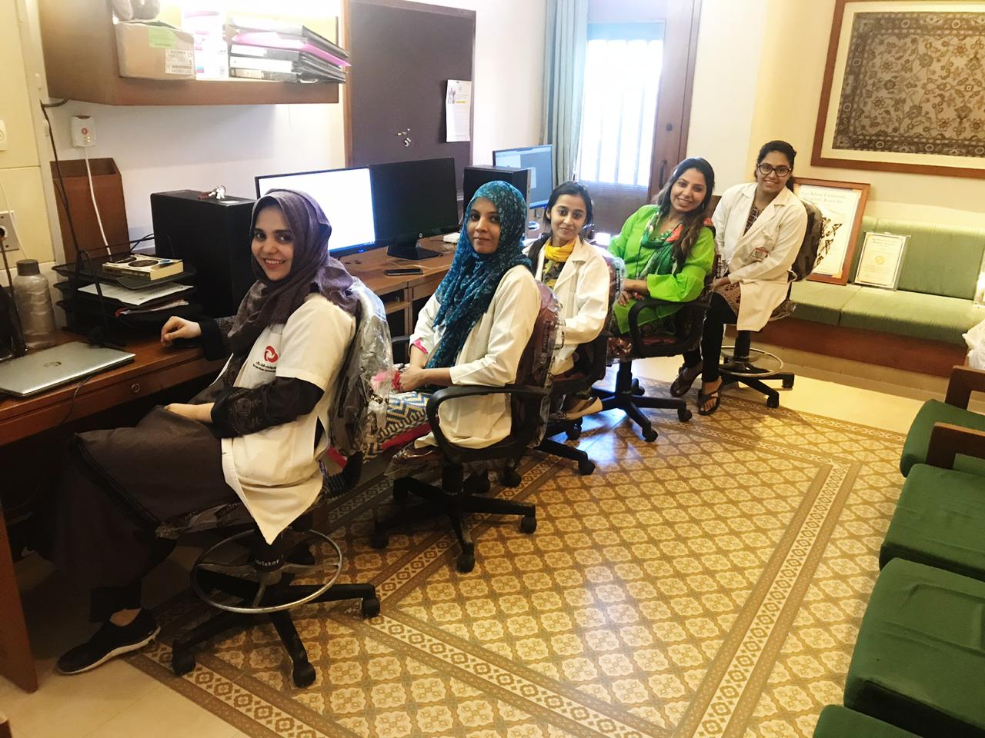
Our Team
Dr Shazia Mohsin- Echo Lab Director
Salima Ashiq Ali -Technical Director
Ms. Hina Ali Huda, Ms.Zamzama - Senior Sonographers
Mr Kawish Trainee sonographer
Ms Amelia Robert Sedation Nurse

Slide 3
ACPC Quality Network
Quality Metrics Report
Quarter 2, April-June 2020

Slide 4
Fetal Pilot.

Slide 5
Echo Lab Processes
QNET Fetal Metric Teaching
Data submitted to QNET
Comprehensiveness: Excel sheet , 10 studies randomized
Diagnostic Accuracy: Neonates born with CHD notified and fetal echoes tracked
Prenatal detection: All CHD undergoing intervention tracked from NICU and Fetal echoes traced.

Slide 6
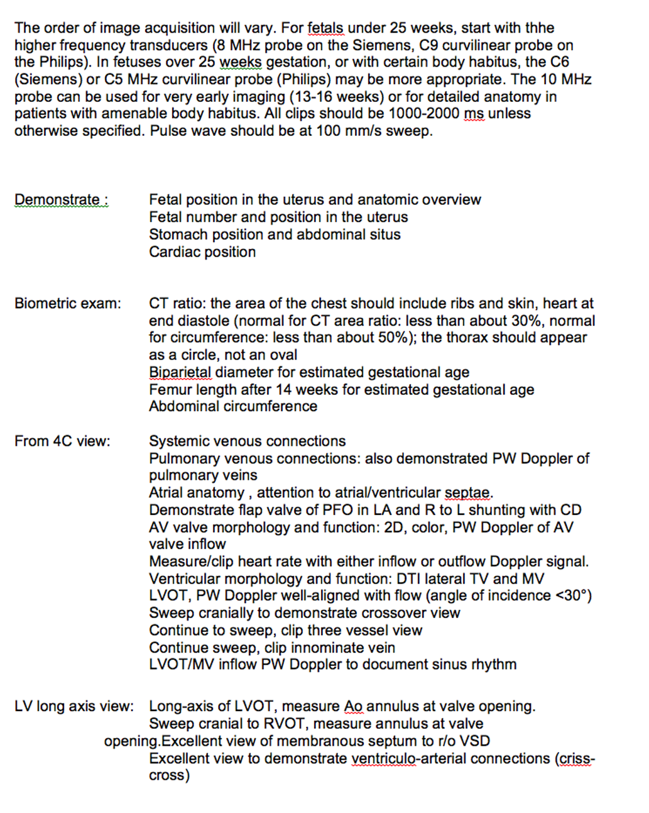
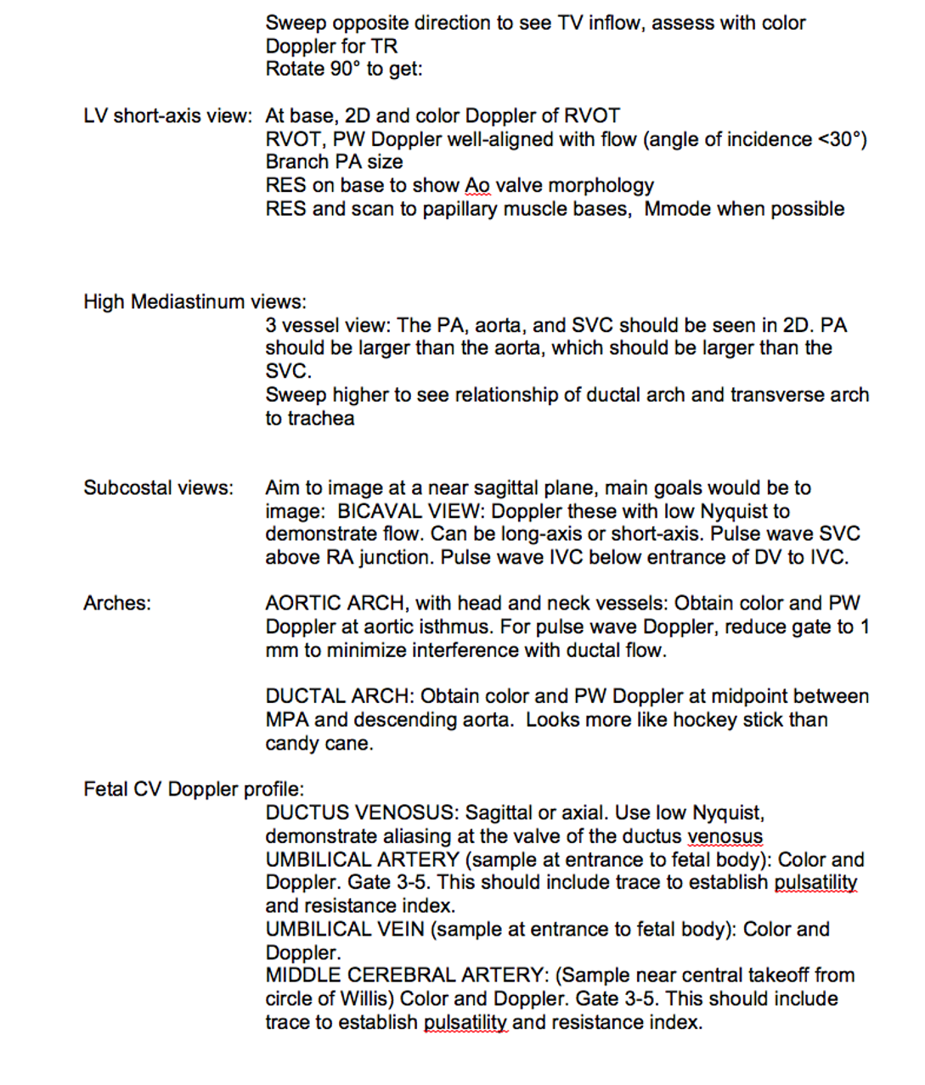
Existing Protocol Comparison

Slide 7
Deficiencies identified
Pulmonary venous connections
Two pulmonary veins seen by 2D imaging OR color Doppler, one from each side.
Aortic and ductal arch morphology
Both arches seen in two planes, axial 3-vessel-trachea view and sagittal view.
Proximal right and left branch pulmonary arteries
Each branch PA seen.
Two pulmonary veins (one from each side)

Slide 8
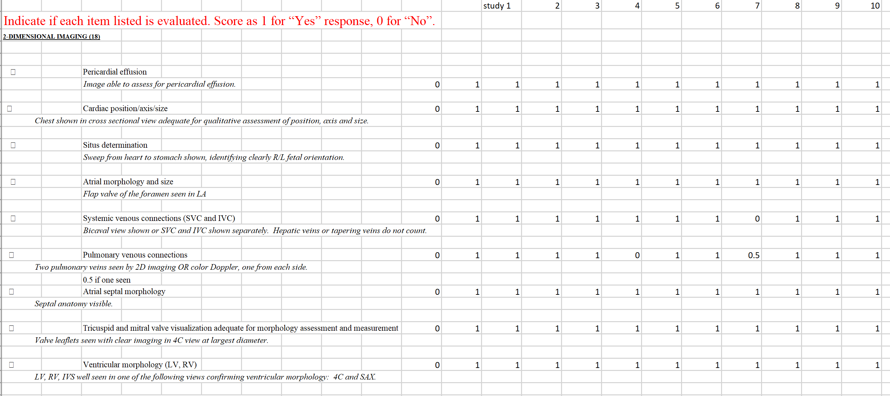
Pilot Quality Metric 1: Comprehensive Fetal Echocardiographic Examination

Slide 9
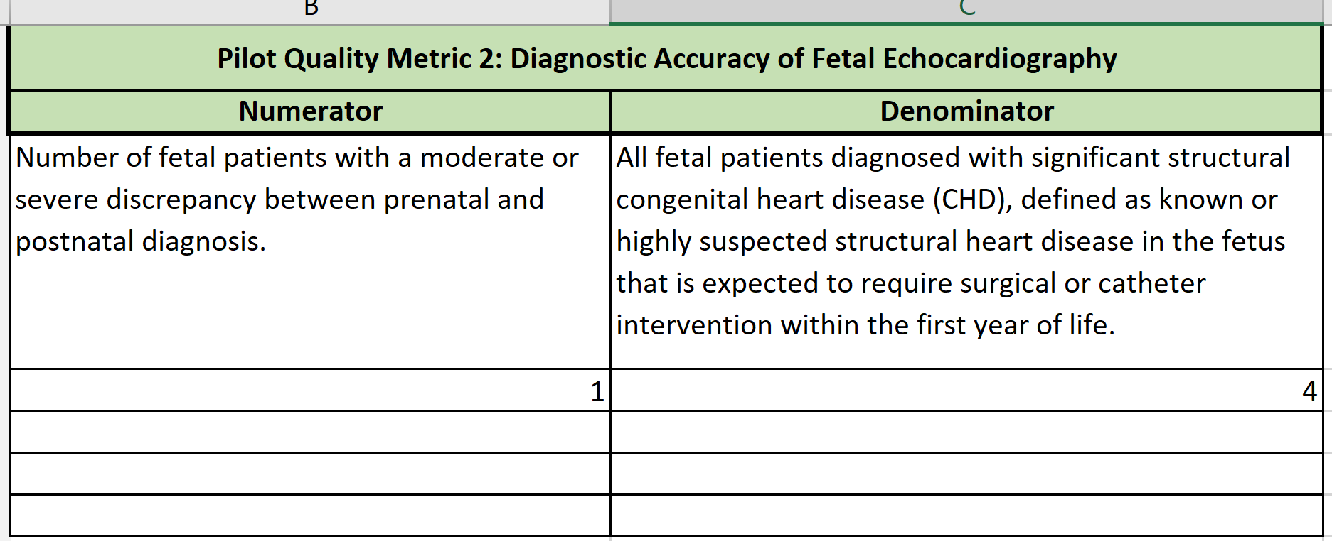
Pilot Quality Metric 2: Diagnostic Accuracy of Fetal Echocardiography

Slide 10
Pilot Quality Metric 3: Prenatal Detection of Severe Structural Congenital Heart Defects

Slide 11
Metric in Context of the Population
Education of OB colleagues
Appropriate scanning of outflow tracts
Appropriate scanning of pulmonary veins
QI not driven by insurance reimbursements- Plan a delivery at a center equipped with cardiology and NICU.
One opportunity to scan.
TOF patient missed Dx: No follow up scans were done, families do not return for follow up especially once they are given a diagnosis, cost is a big factor.

Slide 12
QNET-Collaboratio

Slide 13
QI metric that is important in our community
Patients who had fetal diagnosis of CHD and did not make it to a pregnancy
Socio economic factors impact the decision of the family to carry the pregnancy
Prenatal Diagnosis affecting the TOP:
Numerator= All patients undergoing Intervention in 1st 6 months of life(At AKU or outside)
Denominator: Number of patients who had a prenatal diagnosis of CHD with expected or possible intervention. ( HLH will be a sub group analysis)
Comparison: Number of scans performed on patients with CHD in HIC versus LMIC

