Slide 1
Nemours A.I. duPont Fetal Pilot Workflows
Matthew J. Campbell, MD, MSHP
9 March 2021

Slide 2
Workflow for Fetal Echo Completeness:
Login to syngo dynamics
In the top right search, change “Today’s” to “Field search”
Study date: choose time frame
Choose study type-> ECH echocardiogram fetal
Report contains “Initial”
A list of names pops up. Highlight the name and click report to manually review if the read was normal and if there were imaging difficulties.
If meets all inclusion criteria, record name and date of study, on the reviewer worksheet to distribute to reviewers.

Slide 3
Workflow for Fetal Echo Diagnostic Accuracy
Our Fetal coordinator curates list of all the fetal patients born at that time with the maternal name, MRN, and the fetal diagnosis, as well as the infants DOB, MRN, and the postnatal diagnosis, and sent it via excel.
Review list and delete all the patients who did not meet inclusion criteria
Manually review the prenatal and postnatal echo reports for the infants whose fetal diagnosis met inclusion criteria.

Slide 4
Workflow for Prenatal Diagnosis Rate
Set up the Master Daily Schedule

Slide 5
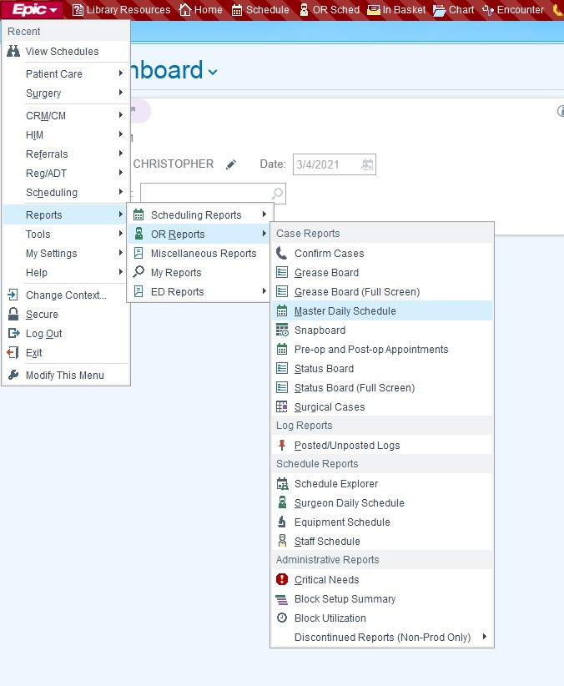
In epic, in the top left hand quarter click on the EPIC dropdown.
Go to reports
Go to OR reports
From OR reports click on “master daily schedule.”
First generated a “master daily schedule” in epic that had all cardiac ORs and Cath labs for a specified date range.
Saved report as ‘fetal QI pilot.’
Clicked “Run’

Slide 6
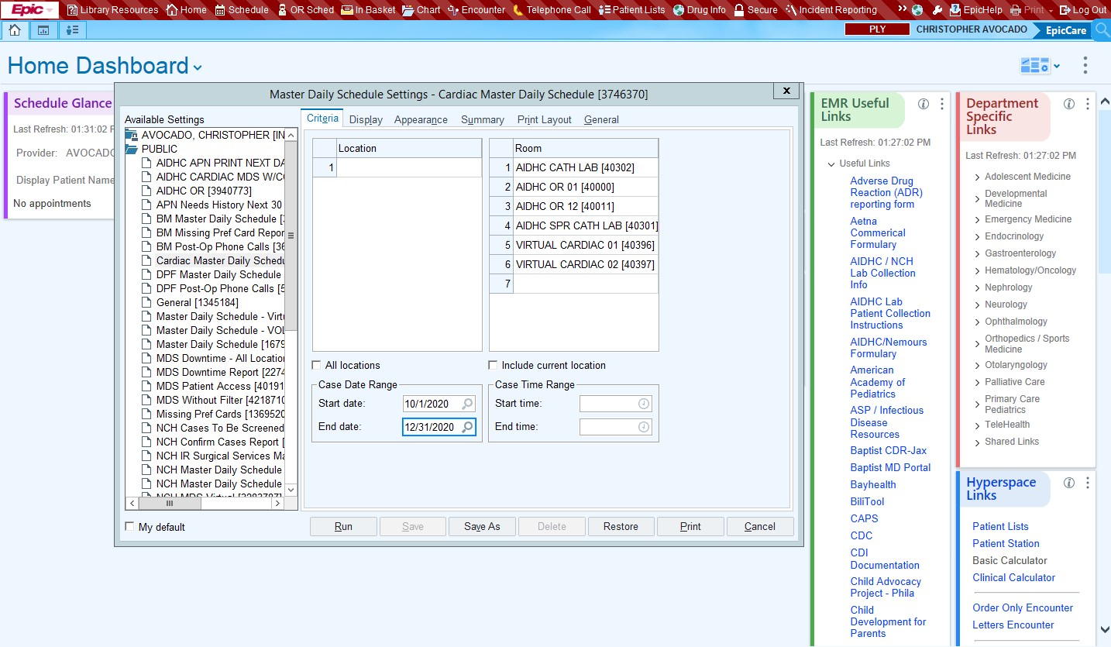

Slide 7
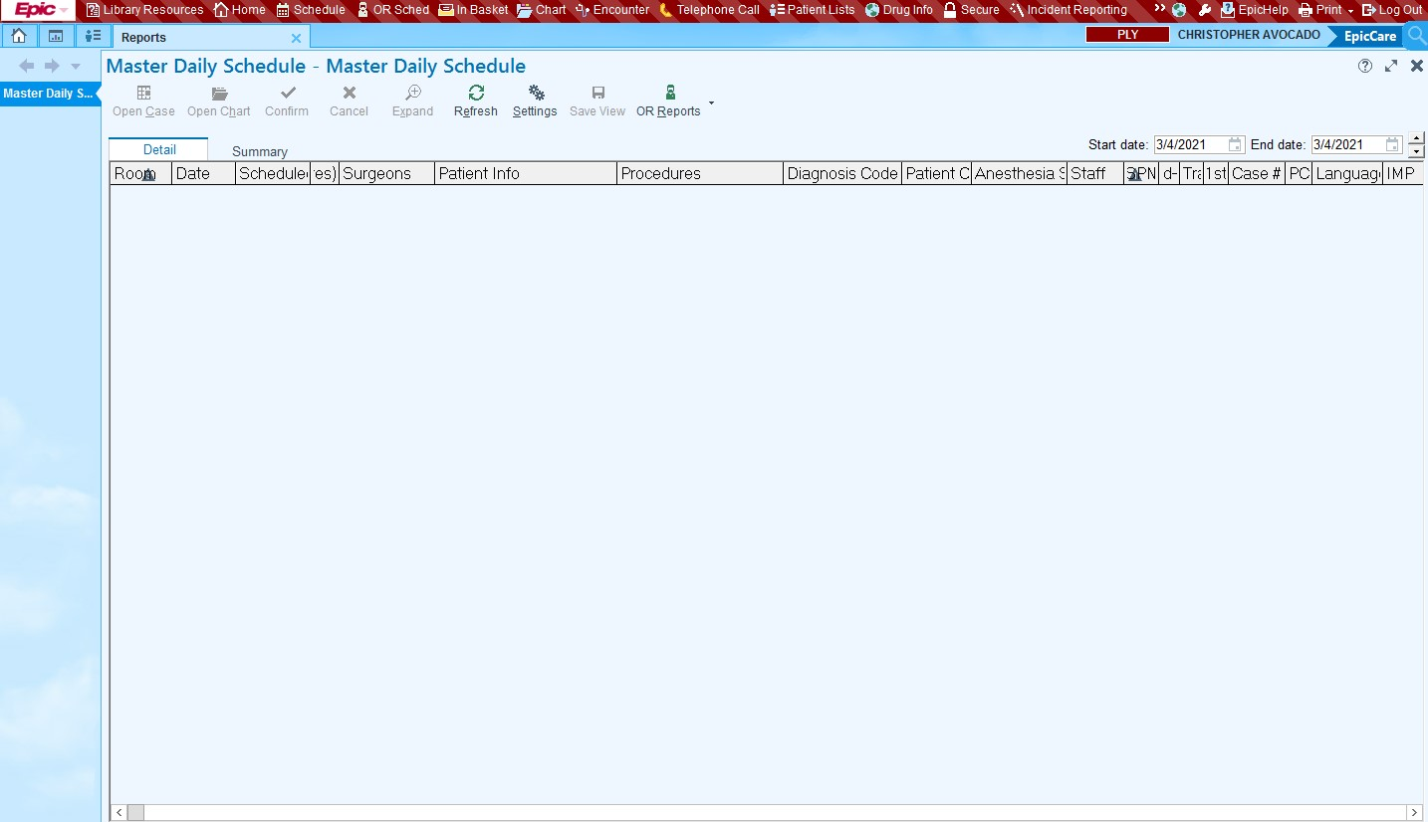

Slide 8
Sorting the list
A list of names and MRNs is pulled up. I clicked on “Age” to sort the patients by age at procedure.
The second column is called “case procedure” and describes the actual procedure done. I reviewed that to look for any interventions in the patients under 28 days of life. Using those MRNs I then manually reviewed their chart with the fetal list to see if they had been prenatally diagnosed, and if they were not on the fetal list, I looked through their H+P to see if they had been prenatally diagnosed elsewhere.

Slide 9
Questions?

Slide 10
Acknowledgments
Dr. Srivastava, Carol Prospero and Stepanie Ng

