Slide 1
Children’s Healthcare of Atlanta Fetal Echocardiography QI Quality Metrics

Slide 2
Processes
Prenatal Detection of Severe CHD
Query Lumedx Apollo* for Cardiothoracic Surgery (CTS) cases and cath interventions performed on patients that meet metric criteria (interventions performed @ <28 DOL, except exclusions) and within date-range
*Lumedx Apollo/LX is a database used for archival and discussion of CHOA patients in our patient care conference

Slide 3
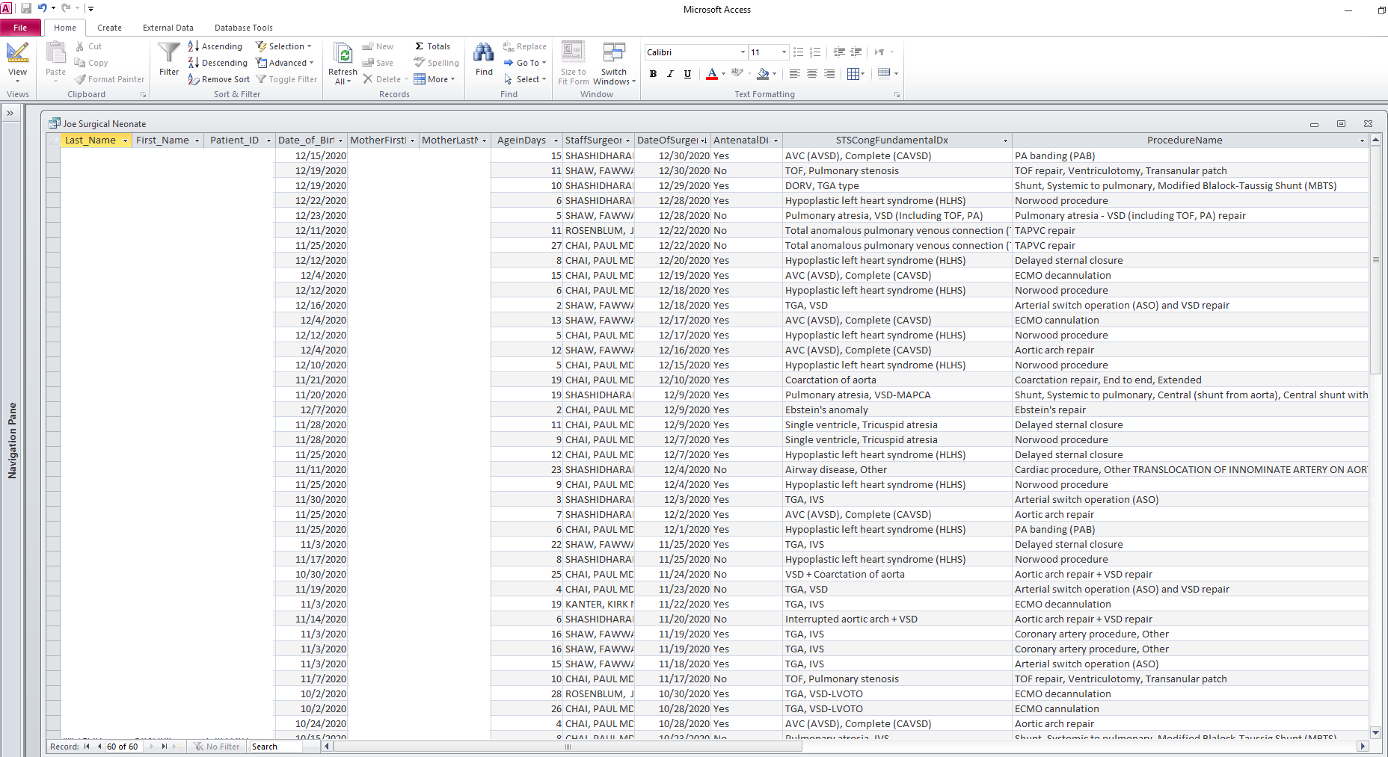

Slide 4
Processes
Prenatal Detection of Severe CHD
Query Lumedx Apollo* for Cardiothoracic Surgery (CTS) cases and cath interventions performed on patients that meet metric criteria (interventions performed @ <28 DOL, except exclusions) and within date-range
Query each patient’s Epic chart for birth history of prenatal Dx
Query Epic for mother’s for mother’s name and record of prenatal echo
If not found, Query Lumedx LX for record of prenatal echo
Compare matched (surgical/cath intervention with fetal echo) data
Data is then submitted to QNet
*Lumedx Apollo is a database used for archival and discussion of CHOA patients in our patient care conference

Slide 5
Processes
Comprehensive Fetal Echocardiogram
Fetal technical director (FTD) performs date-range search in Syngo (PACs) system for 10 complete normal fetal cases, randomized and inclusive of all sonography staff
FTD assesses for completeness for each case based on worksheet checklist
Worksheet scores are tabulated and data is input onto spreadsheet
Data is then shared with Medical director and technical staff
Data is then submitted to QNet

Slide 6
Processes
Fetal Echo Diagnostic Accuracy
All postnatal trans-thoracic echo (TTE) exams are compared to the fetal echo DX and data is input into the internal Lumedx LX database

Slide 7
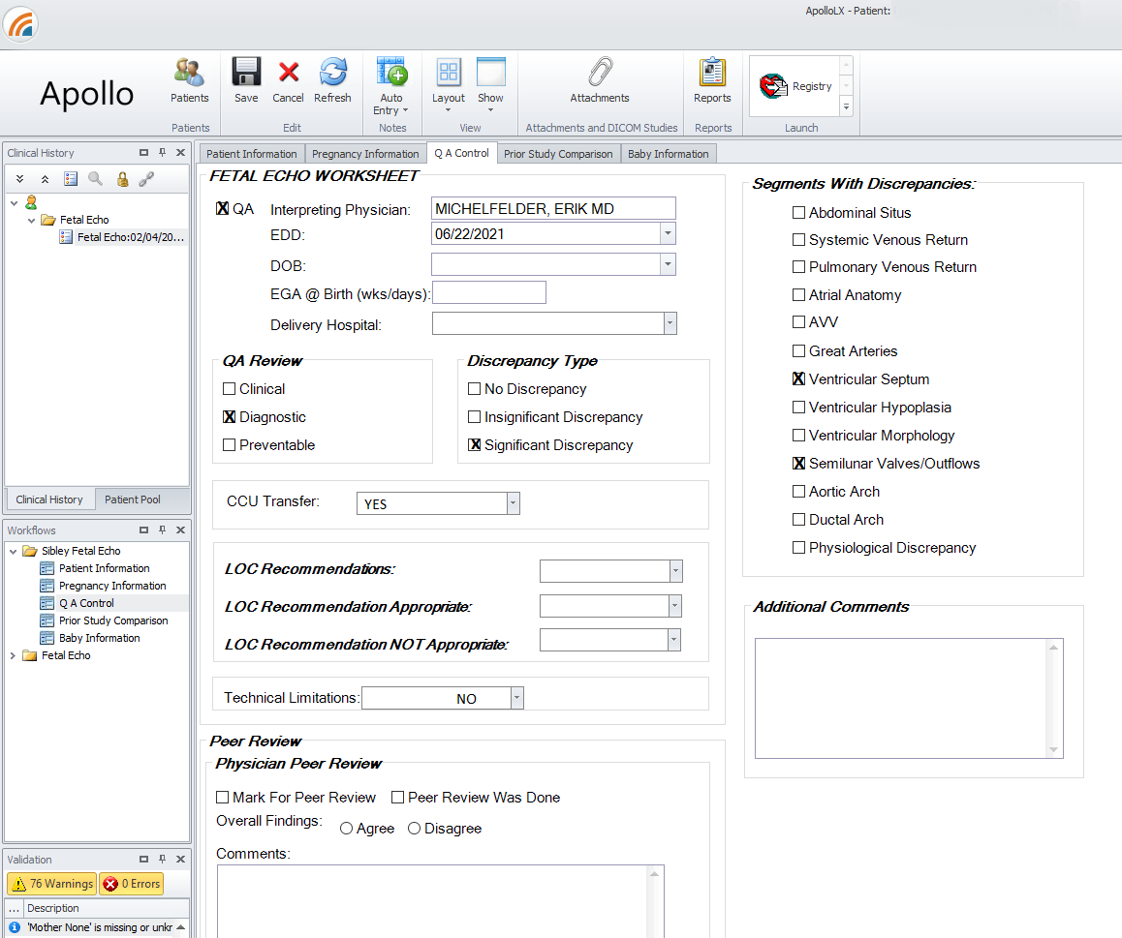
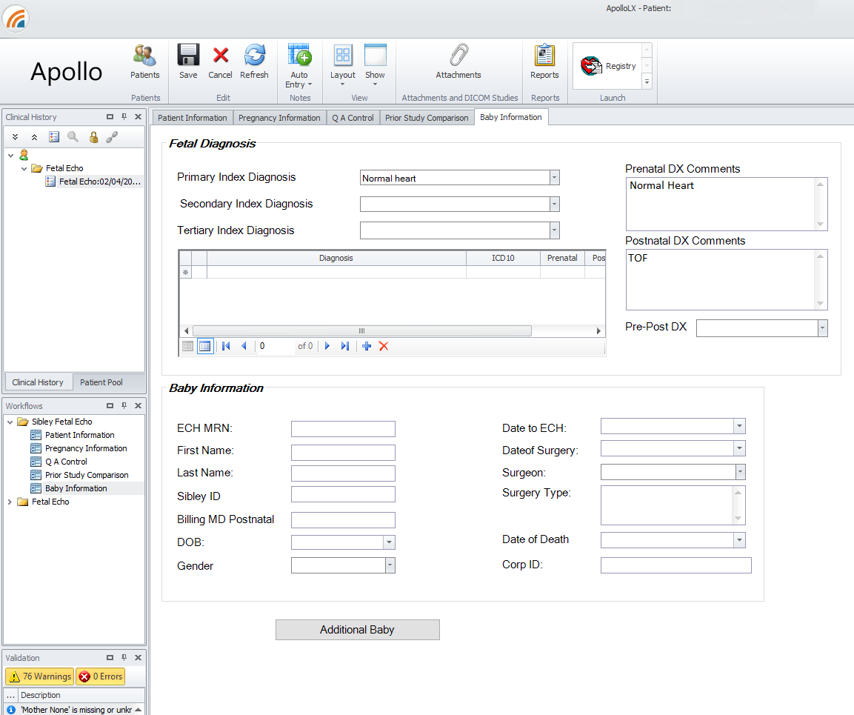

Slide 8
Processes
Fetal Echo Diagnostic Accuracy
All postnatal trans-thoracic echo (TTE) exams are compared to the fetal echo DX and data is input into the internal Lumedx LX database
FTD performs date-range search for fetal cases with diagnostic discrepancies (in accordance with QNet metric criteria) in Lumedx LX fetal database
All cases that fit criteria within the date-range are documented and a metric worksheet is filled out for each
Results are tabulated and data is sent to QNet
Results are then communicated to fetal imaging team during quarterly QA meeting

