Slide 1
Implementing ACC’s ACPC Quality Network Fetal Pilot Measures
Suma Potiny Goudar
Lisa A. Hom
Children’s National Hospital
March 9th, 2021

Slide 2

Meet the Team:
Medical Director Fetal Heart Program: Mary Donofrio
Pediatric Cardiologist Fetal Heart Program: Suma Potiny Goudar
Fetal Heart Program Clinical Coordinator: Stephanie Bowers
Medical Director for Cardiology Quality and Safety: Ashraf Harahsheh
Nurse QI Facilitator for the Heart Institute: Lisa Hom
Heart Institute Data Manager: Charnetta Contee
Heart Institute IR Manager: Sam Sabouni
PC4 Registry Coordinator: Mickey Tirfe
IMPACT Registry Coordinator: Ileen Cronin
Notes:
Assemble the team, obtain buy-in from Program Director
We were able to accomplish with one team meeting and the rest through smaller 2 person meetings or email

Slide 3





Where does the data reside?
MADAM:
Local Fetal
Database
EMR
Chart
Review
STS
Registry
IMPACT
Registry/
GE system
PC4
Registry

Slide 4
Comprehensive Fetal Echocardiographic Examination
Sample of 10 studies for review
Must represent all sites and sonographers
5 fetal sonographers, 3 sites
Challenge: screening technically difficult studies
Sample selection:
  Each sonographer selected 2 normal echos for review
  If worked in two sites, one from each site
Studies reviewed by lead sonographer and attending
  Paper checklist completed

Slide 5
Comprehensive Fetal Echocardiographic Examination
Data entered in excel spreadsheet as a scorecard
100% in most, 90% in 3 areas
Lessons learned:
  Selection bias:
    Echo reporting system: drop down selection for normal and suboptimal image quality
    Filter and randomly select echoes using the reporting system
    Educate readers to ensure these drop downs are used consistently
  Important to have at least two people review

Slide 6
Diagnostic Accuracy of Fetal Echocardiography
Fetal log maintained for all patients diagnosed with congenital heart disease
Monthly review of all deliveries
Compare prenatal echo findings to postnatal echo findings
Self report of patients with postnatally diagnosed CHD and normal fetal echocardiograms

Slide 7



Prenatal Detection of Severe Structural Congenital Heart Defects
Initially from PC4 pulled by discharge date then filtered by date of intervention.
Ultimately used GE Cath system instead of IMPACT registry
Filtered for < or = 28 days of age at time of intervention
* PC4 and STS have a field for pre-natal diagnosis
Fetal team validates the field in PC4 monthly
by Fetal Heart Program Coordinator, Stephanie, RN
Notes:
Denominator:
Pulled same query from PC4, STS and IMPACT registries to ensure complete and accurate list. Initially for PC4 pulled by discharge date then filtered by date of intervention.
Ultimately used GE Cath system instead of IMPACT registry
Filtered for < or = 28 days of age at time of intervention
* PC4 and STS have a field for pre-natal diagnosis
Numerator:
Only 1 of the 4 patients was followed by the fetal program and was in the MADAM database.
* Fetal team validates the field in PC4 monthly by Fetal Heart Program Coordinator, Stephanie, RN

Slide 8
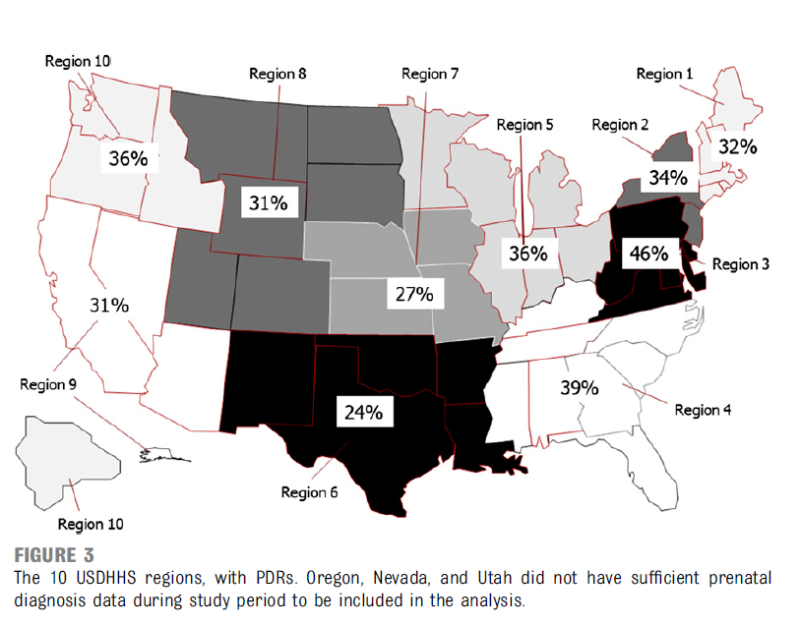
ACC ACPC quality metrics fetal pilot (Nov 15-Dec 16th, 2020)
Metric Name | Raw Numbers | Percent compliant
Comp Fetal Echo | 337/340 (audit-10 studies) | 99%
Diag Acc of Fetal Echo | 0/21 (total) | 100%
Prenatal Detection | 1/3 (total eligible) | 33%
N=4
Notes:
Final check and verification of results by Program Director prior to submission
Focus on low prenatal detection rate, clarified with ACC working group ok to exclude patients from outside your system who come for intervention – our hospital sees a significant number of global services patients from the middle east.

Slide 9
Contact Information
Lisa A. Hom, RN Esq
Phone: (202) 476-5063
Email: lhom@cnmc.org
Suma Potiny Goudar, MD
Phone: (202) 475-2020
Email: sgoudar@cnmc.org

