Slide 1
American College of Cardiology Metric 033: Comprehensive Fetal Echocardiographic Examination
Luciana Young, MD, FACC, FASE
Professor of Pediatrics, University of Washington
Director of Echocardiography, Seattle Children’s Hospital
ACPC QNet Learning Session
March 9, 2021

Slide 2
Metric 033: Comprehensive Fetal Echocardiographic Examination
Coauthors:
Theresa Tacy, MD – Lucille Packard Children’s Hospital, Stanford, CA
Angira Patel, MD – Ann & Robert H. Lurie Children’s Hospital of Chicago, Chicago, IL
Craig Fleishman, MD – Arnold Palmer hospital for Children, Orlando, FLA
Leo Lopez, MD – Lucille Packard Childrens’ Hospital, Stanford, CA
Alicia Chaves, MD – University of Maryland, Baltimore, MD
Mary Donofrio, MD – Children’s National Medical Center, Washington, DC
Anita Moon-Grady, MD – UCSF Benioff Children’s Hospital, San Francisco, CA

Slide 3
Metric 033: Comprehensive Fetal Echocardiographic Examination
Purpose:
To assess completeness of initial fetal echocardiograms with hearts interpreted to be structurally normal
Provide a simple baseline strategy for evaluating compliance with standard fetal cardiac imaging techniques
Identify areas for sonographer, physician and/or laboratory improvement in fetal scanning

Slide 4
Metric 033: Comprehensive Fetal Echocardiographic Examination
Design:
Prospective worksheet with retrospective review of stored fetal echo images
The Comprehensive Fetal Echo Assessment worksheet includes a total of 34 elements for each exam reported. Each element is graded as a “YES” only if all components are visualized
The Average Completeness Score will be assessed for initial fetal echocardiograms performed on fetuses with hearts interpreted to be structurally normal
Numerator: Sum of the Comprehensive Fetal Echo Assessment worksheet scores for all fetal echos included in the denominator
Denominator: Number of complete fetal echos assessed during the measurement time period

Slide 5
Metric 033: Comprehensive Fetal Echocardiographic Examination
Exclusion criteria:
Studies identified as incomplete or limited
Fetuses with abnormal cardiac anatomy, rhythm or function
Fetuses that have had a prior echocardiogram at the institution
Fetuses with poor acoustic windows or technically limited exams

Slide 6
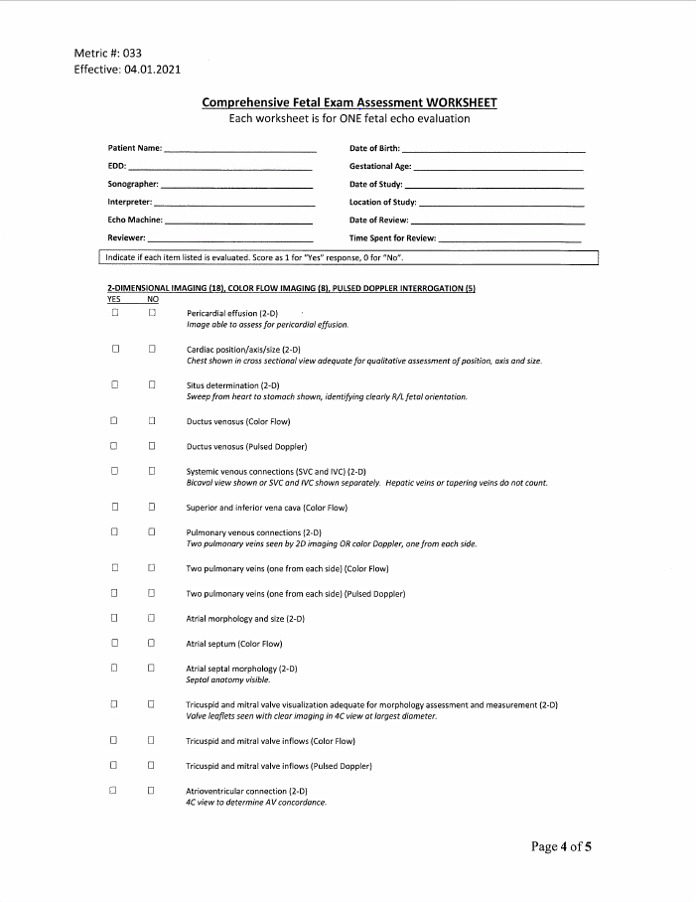
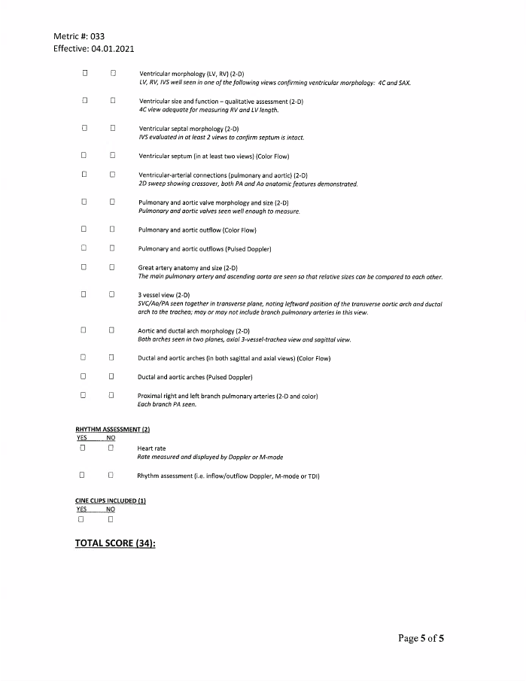

Metric 033: Comprehensive Fetal Echocardiographic Examination

Slide 7
Metric 033: Comprehensive Fetal Echocardiographic Examination
Data collection:
The metric will be reported by each echocardiography laboratory performing transabdominal echocardiography on a quarterly basis
For each quarterly assessment, a minimum of 10 fetal echos will be reviewed
Suggested process:
Data will be assessed by the lab director or their designate and reviewed with the laboratory staff involved in performed and interpreting fetal echos at quarterly quality assurance meetings
Challenges to implementation:
Time required to identify, select and review fetal echocardiograms

Slide 8
Metric 033: Comprehensive Fetal Echocardiographic Examination
References:
Donofrio MT, Moon-Grady AJ, Hornberger LK, Copel JA, Sklansky MS, Abuhamad A, et al. Diagnosis and treatment of fetal cardiac disease: a scientific statement from the American Heart Association. Circulation. 2014; 129(21):2183-242.
Fetal Echocardiography Task Force: American Institute of Ultrasound in Medicine Clinical Standards Committee; American College of Obstetricians and Gynecologists: Society of Maternal-Fetal Medicine. AIUM practice guidelines for performance of fetal echocardiography. J Ultrasound Med. 2013; 32:1067-1082.
Lee W, Allen L, Carvalho JS, Chaoui R, Cope J, Devore G, Hecher K, Munoz H, Nelson T, Paladini D, Yagel S; ISUOG Fetal Echocardiography Task Force. ISUOG consensus statement: what constitutes a fetal echocardiogram? Ultrasound Obstet Gynecol. 2008; 32:239-242.
Rychik J, Ayres N, Cuneo B, Gotteiner N, Hornberger L, Spevak PJ, Van Der Veld M. American Society of Echocardiography guidelines and standards for performance of the fetal echocardiogram. J Am Soc Echocardiogr. 2004; 17:803-810.
Allan L, Dangel J, Fesslova V, Marek J, Mellander M, Oberhansli I, Oberhoffer R., Sharland G, Simpson J, Sonesson SE; Fetal Cardiology Working Group: Association for European Paediatric Cardiology. Recommendations for the practice of fetal cardiology in Europe. Cardiol Young. 2004; 14:109-114.

