Slide 1
Prenatal Detection of Severe Structural Congenital Heart Defects
ACPC QNET Learning Session
March 9, 2021
Kenan Stern, MD
Mount Sinai Children’s Heart Center

Slide 2
Prenatal Detection of Severe Structural Congenital Heart Defects
Team (physicians and sonographers):
  Joe Kreeger
  Anitha Parthiban
  Sowmya Balasubramanian
  Rick Michelfelder
  Chris Statile
  Ann Kavanaugh-McHugh
  Sarina Behera
  Katie Jo Stauffer
  Divya Suthar
  Kenan Stern

Slide 3
Prenatal Detection of Severe Structural Congenital Heart Defects
Benefits of prenatal detection:
  Reduce neonatal morbidity and mortality
  Affords the family the opportunity to make pregnancy related decisions such as termination.
Prenatal detection rates in the United States vary by lesion, but were 42% overall on a recent study, and slightly higher (50%) in neonates with CCHD.⁵
Quartermain MD, et al. Pediatrics. 2015

Slide 4
Prenatal Detection of Severe Structural Congenital Heart Defects
Through use of this metric, centers will
  be able to track rates of prenatal detection of severe structural CHD
  identify targets for improvement, such as certain lesion types and barriers to effective prenatal screening.
  ***It is anticipated that interventions meant to improve prenatal detection will cross disciplines to include all those involved in the care of pregnant women and their fetuses.

Slide 5
Prenatal Detection of Severe Structural Congenital Heart Defects
Numerator – Number of patients who had a prenatal diagnosis of structural congenital heart defect (CHD) in which intervention was expected or possible
Denominator - All patients undergoing initial surgical or catheter intervention for a structural congenital heart defect at ≤ 28 days of life
Exclusions – Non–structural lesions (e.g. cardiomyopathy for ECMO, VAD or heart transplant); Anomalous coronary artery origin (e.g. ALCAPA), PDA.

Slide 6
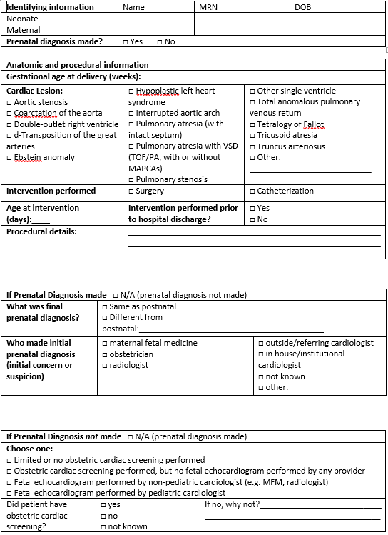
Prenatal Detection of Severe Structural Congenital Heart Defects
Data Collection/Process:
  Active reporting: Quarterly review of data, specific to center
    Medical record/Chart review
    STS or other surgical registries or databases
    IMPACT or other catheterization registries or databases
Worksheet →

Slide 7
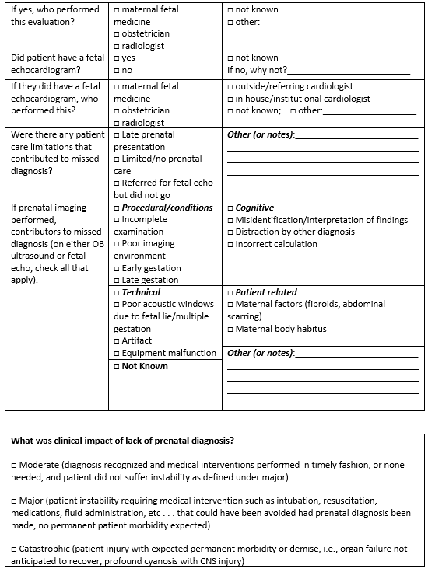
Prenatal Detection of Severe Structural Congenital Heart Defects

Slide 8
Prenatal Detection of Severe Structural Congenital Heart Defects
Challenges to implementation:
  Labor intensive to review surgical and catheterization cases.
  Difficulty linking child records to maternal records.
  ***Lack of documentation and details of prenatal diagnosis.
    e.g. transfer from outside institution

