Slide 1
Tools for Integration of Pharmacist Expertise in AMI care: Patient Education
Leadership Saves Lives

Slide 2
Rationale for the approach
As part of their root cause analysis, several hospitals identified opportunities to improve patient education resources, particularly around medication management.
Some hospitals created new resources to streamline and simplify information. Others focused on critical review and revision of existing patient education materials.
Coalition members reflected that drawing upon diverse expertise (nursing, cardiology, pharmacy, marketing) resulted in more comprehensive and user-friendly tools.
This deck highlights two tools, one focused specifically on medication management, and the other focused on cardiovascular health more broadly.

Slide 3
Tool #1: Common Medications for the Heart

Slide 4
Tool #1: Perspectives from the front line
“We have Krames, which is an education system, and all the new medications are in there. When you print it for a patient discharge, it’s literally 50-some pages. Patients wouldn’t read all that. We came up with a one page cheat sheet of some clinical pearls that you really need to grasp out of those 50 sheets. We thought by getting rid of the fluff, we can really educate patients a little bit better, and hopefully, they’ll be more compliant, and understand their medication and how it works.”
--- Guiding Coalition Member

Slide 5
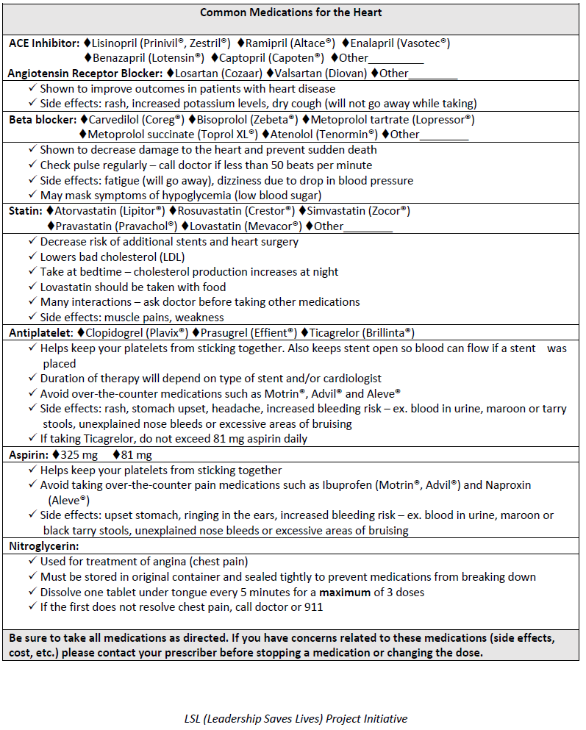

Slide 6
Tool #1: Implementation experience
“The point of going over this tool is just to make sure we catch them and specifically education, especially like on the N-type platelets so the patients don’t bounce back with re-occlusions. We feel like we can make some interventions there.”
“I think it [the roll out] all went smoothly. We’ve got a great group to work with, and everybody sees the value of doing it because they know those stack of sheets are just too much.”
“It is now available electronically and patients can view it in their medical record on the hospital patient portal.”
--Guiding Coalition Members

Slide 7
Tool #2: My Heart and I

Slide 8
Tool #2: Perspectives from the front line
“We looked at the education material that we were giving our MI patients. That was quite an eye-opener…no wonder they had so many questions when I saw them for follow-up!”
“Patients aren't compliant with their meds all the time….If they feel like they're doing well, they don't take it. They'll stop their platelet agents…They may not get follow up with their primary care doc. In the new discharge book, we put all the meds they may be on and what they're for and why they should take it. We tried to incorporate a lot into this book.”
--- Guiding Coalition Members

Slide 9
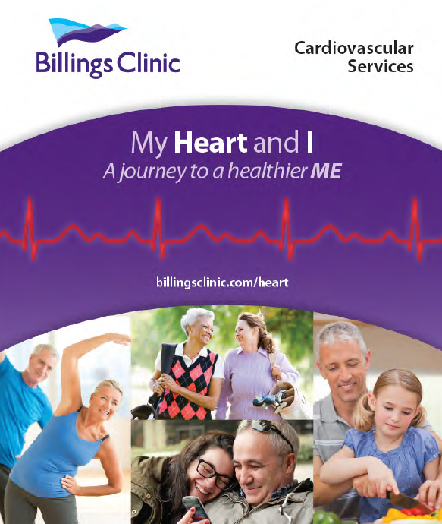

Slide 10
Tool #2: Implementation experience
“We looked at it from a business standpoint [to get funding]. It cost a thousand bucks to print it, but one patient, one procedure from a referring doc makes up for that right away, one bypass. After they looked at it from that standpoint, it got approved.”
“Our hardest part was trying to nail down giving them enough information, without having too much wording in the book. The more you have written down, the less likely they really are to actually read and retain it. Trying to figure out, what is the really important information that the patient absolutely needs to know, and making sure that that was in there.”
-- Guiding Coalition Members

Slide 11
Disclaimer
These materials were generously shared by: Billings Clinic and Mosaic Life Care.
They are intended to serve as a starting point for conversations about how to improve integration of pharmacy expertise throughout the care process for patients with AMI, and should not be interpreted as an ACC-endorsed clinical guideline.
We encourage hospital teams to adapt these approaches to their own needs and local context.

