Slide 1
Tools for Integration of Pharmacist Expertise in AMI Care: Proactively Engaging Multidisciplinary Care
Leadership Saves Lives

Slide 2
Rationale for the approach
Many LSL hospitals faced constraints in implementing pharmacists rounding on all patients with AMI, particularly for patients with 24-48 hour stays, and admissions spanning weekends. LSL guiding coalitions included pharmacists, who led development of creative solutions to integrate pharmacist input early and throughout the entire care process.
One hospital developed a comprehensive planning tool to integrate roles for physicians, nurses, nutritionists, case managers, cardiac educators and others. Pharmacy inputs begin in the emergency department and at multiple points through discharge.

Slide 3
Perspectives from the front line
“We've always had very, very receptive physicians. There is not a single physician that I've come across that does not swallow up our attendance and want us there. Same thing with nurses. Everybody knows the importance of pharmacy. I would say if someone is off, we just can't get somebody there. Staffing is our biggest challenge.”
--Guiding Coalition Member

Slide 4
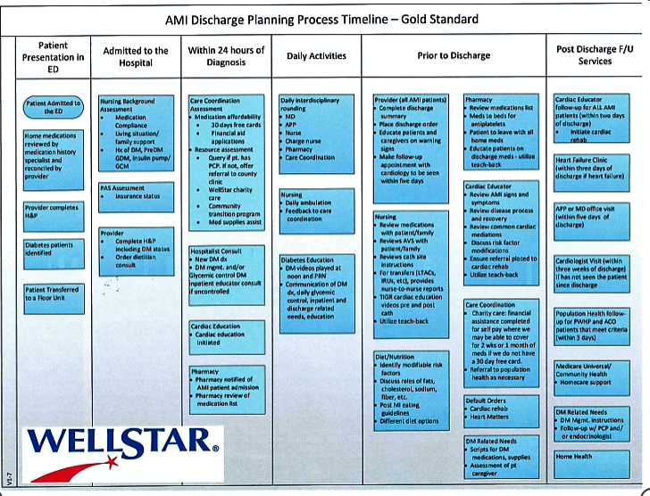

Slide 5
Implementation experience
“One of the things that we’ve done to keep the momentum going is standing weekly meetings for this project…even when we hit hurdles, at least it has kept everybody up to date and things moving forward.”
“We’re looking at a transition of care program between the in-patient and the out-patient world…an in-patient clinical pharmacist reviews all of the discharge medication reconciliation, sits down with the patient, makes sure they’re educated on all their medications.”
“[This process] has helped Pharmacy’s relationship with…cardiologists. They consult us more and trust that we’re following patients and we’re going to catch things more so than before…we’ve always had a good relationship with the physicians, but it’s a better relationship now.”
-- Guiding Coalition Members

Slide 6
Disclaimer
These materials were generously shared
by Wellstar Kennestone Hospital.
They are intended to serve as a starting point for conversations about how to improve integration of pharmacy expertise throughout the care process for patients with AMI, and should not be interpreted as an ACC-endorsed clinical guideline.
We encourage hospital teams to adapt these approaches to their own needs and local context.

