Slide 1
Tools for Integration of Pharmacist Expertise in AMI Care: Information Technology Solutions
Leadership Saves Lives

Slide 2
Rationale for the approach
LSL hospitals sought to integrate pharmacy expertise into care of all patients with AMI; barriers included resource limitations, lack of standardized processes for consultation requests, and delays in timely identification of patients needing pharmacy input.
At several sites, the coalitions worked very closely with IT to innovate within the hospital electronic record system. Through these collaborations, coalitions developed notes templates to improve pharmacist workflow, protocols and resources for medication reconciliation, and tools to help pharmacists identify all AMI patients (including those with NSTEMI) for rounding and/or education.
Solutions were lower cost alternatives to additional staff and also empowered pharmacists as in integral part of the broader care team.

Slide 3
Perspectives from the front line
“Cardiology has always been very welcoming to pharmacy. The cardiologists would like us to be more involved. A lot of it comes down to the amount of resources that we have spread among so many programs. That’s the rate-limiting step for us. They want us involved with all their AMI patients. The idea is, though, how do we automate the operations so we can allow more pharmacists to hop on the floors and get them to make the rounds?”
--- Guiding Coalition Member

Slide 4
Trigger for pharmacy consult
The team created a new section in their electronic record (iForm) “Diagnosis/Consults” where the cardiologist must select one diagnosis. Boxes below STEMI and NSTEMI boxes autopopulate and trigger a pharmacy medication therapy management (MTM) consult. The diagnosis field is a hard stop in the form so that the cardiologist cannot move on without checking one. Pharmacist consults go to pharmacist work que, where the staff pharmacist notifies clinical pharmacist. Two additional consults that were also linked to STEMI/NSTEMI are cardiac rehab referral and cardiovascular educator consult – other issues that have come out of the LSL initiative.

Slide 5
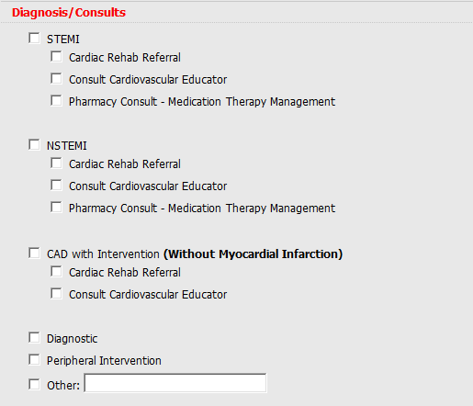
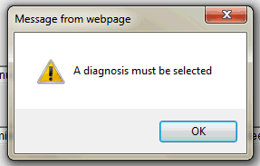
Coronary Cath Post-Procedure iForm

Slide 6
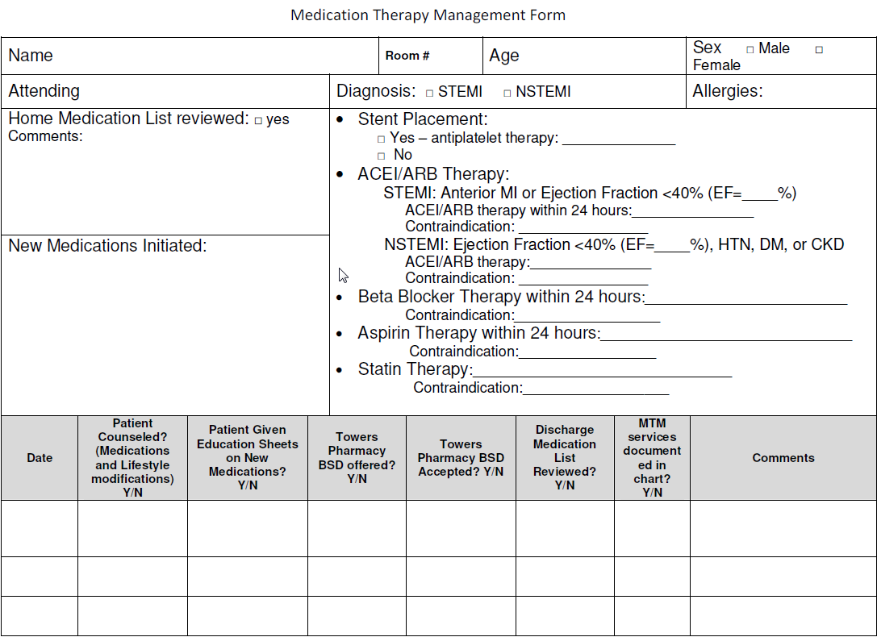
Standard MTM Form

Slide 7
Implementation experience
“Using the cath lab iForm to automatically order an MTM [medication therapy management] consult [was new]. Up until May of ’15, we did not have that automatic iForm consult. We were really doing a very manual process of patient identification. Once we got that consult put automatically in place, then it worked seamlessly. I think throughout the entire project we ended up identifying 89 percent of them.”
“We are still not capturing 100% of patients, [though] we are seeing much more AMI patients. Medically managed patients are identified through daily check-ins with the cardiac educators and ICU pharmacist. We get the consults much earlier than before, so there is more time to do what we need to do.”
--- Guiding Coalition Members

Slide 8
Disclaimer
The materials for the Integration of Pharmacy Expertise Practice Brief were generously shared by Baptist Health Care: Baptist Heart and Vascular Institute.
They are intended to serve as a starting point for conversations about how to improve integration of pharmacy expertise throughout the care process for patients with AMI, and should not be interpreted as an ACC-endorsed clinical guideline.
We encourage hospital teams to adapt these approaches to their own needs and local context.

