Slide 1
What is Leadership Saves Lives?
Leadership Saves Lives

Slide 2
Each year, over 800,000 people in the US have a heart attack
About 200,000 die
Risk-standardized mortality rates vary substantially

Slide 3
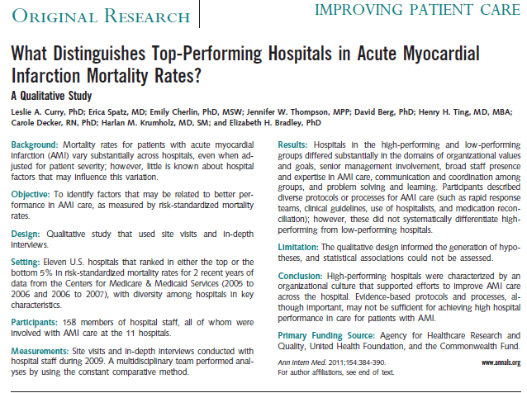
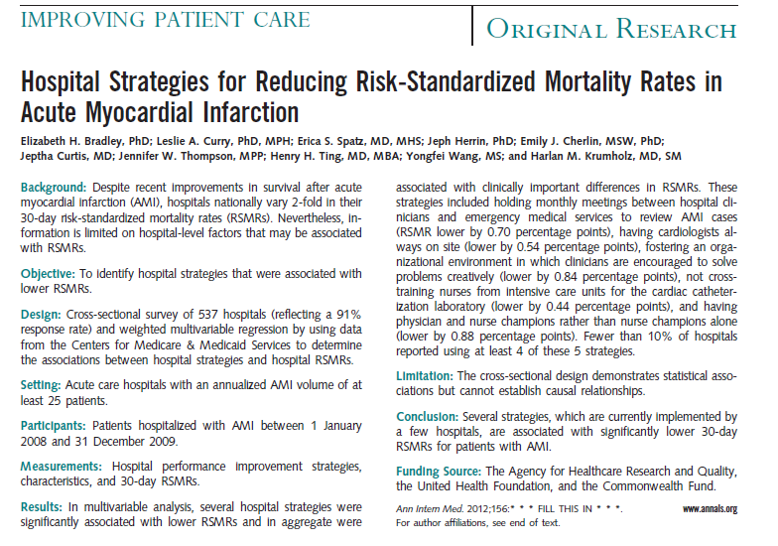
Hospital organizational culture is associated with lower RSMR for AMI

Slide 4
Can organizational culture be changed?

Slide 5
Leadership Saves Lives
Intervention to promote organizational culture change in US hospitals & improve outcomes for patients with AMI
Outcomes:
Uptake of 5 evidence-based strategies
Changes in key dimensions of culture
Change in RSMR for AMI
Mixed methods evaluation to measure change AND describe the process of change

Slide 6
Outcome #1 Evidence based strategies
Physician and nurse dyad AMI champions
Creative problem solving
Monthly meetings with EMS to review AMI cases
Nurses not cross trained from ICU for CCL
Pharmacists rounding on all patients with AMI
Bradley et al., Annals of Internal Medicine, 2012

Slide 7
Outcome #2 Domains of organizational culture
Learning environment
Psychological safety
Commitment to the organization
Senior management support
Time for improvement
Curry et al., Annals of Internal Medicine 2011; Bradley et al., Circulation QCO, 2017
Notes:
:

Slide 8
Outcome #3 Risk standardized mortality rates
Hospital-level mortality rate for patients with AMI within 30 days of admission
Publicly reported by Centers for Medicare and Medicaid Services
Included in value-based purchasing programs
Three year averages; 18 month lag in reporting

Slide 9
Convene
Convene
Convene
Workshop
Workshop
Workshop
Workshop
Workshop
Workshop
Workshop
Workshop
Month 0
Remote Support
Month
24
Interviews and Observations
Interviews and Observations
Interviews and Observations
Survey
Survey
Survey

Slide 10
Key informant interviews
Wave 1: n=162
Wave 2: n=118
Wave 3: n=113
Observations (56 hours)
Qualitative
Merge
Describe what changed and how
Surveys
Wave 1: n=146 (87%)
Wave 2: n=153 (83%)
Wave 3: n=162 (96%)
Quantitative

Slide 11
Results

Slide 12
Uptake of strategies over time

Slide 14
Time for improvement

Slide 15
Senior management support
“Because administration was on the coalition, we could bring the stories to them and they saw the importance, so they allocated money…When you have the right people at the table…we got things done quicker.”
(Nurse Manager)

Slide 16
Learning environment
“We have some very creative people, but there hadn’t been a lot of permission to…think out of the box…and to realize that some of the best ideas came from a respiratory technician. As that openness developed, some of those great ideas were really valued.”
(Chief Medical Officer)
p < .01

Slide 17
Mean risk-standardized mortality rates
Mean risk-standardized mortality rates

Slide 18
We observed change in organizational culture in 6 of 10 hospitals

Slide 19
Summary
Hospital organizational culture can be positively influenced
Hospitals demonstrating positive change also had significantly greater reductions in RSMRs
Fostering organizational culture that supports high performance can help hospitals achieve significant improvements in important clinical outcomes

Slide 20
References
Bradley EH, Curry LA, Webster TR, Mattera JA, Roumanis SA, Radford MJ, McNamara RL, Barton BA, Berg DN, Krumholz HM. Achieving rapid door-to-balloon times: How top hospitals improve complex clinical systems. Circulation, 2006; 113:1079-1085. PMID:16490818
Bradley, E. H., Brewster, A. L., Fosburgh, H., Cherlin, E. J., & Curry, L. A. (2017). Development and psychometric properties of a scale to measure hospital organizational culture for cardiovascular care. Circ Cardiovasc Qual Outcomes, 10(3). doi: 10.1161/CIRCOUTCOMES.116.003422
Bradley EH, Curry LA, Spatz ES, Herrin J, Cherlin EJ, Curtis JP, Thompson JW, Ting HH, Wang Y, Krumholz HM. Hospital strategies for reducing risk-standardized mortality rates in acute myocardial infarction. Annals of Internal Medicine, 2012; 156(9):618-26 PMCID: PMC3386642.
Bradley EH. Brewster AL, Mcnatt Z, et al. (2017). How guiding coalitions promote positive culture change in hospitals: a longitudinal mixed methods intervention study. BMJ Qual Saf, doi: 10.1136/bmjqs-2017-006574
Cherlin EJ, Curry LA, Thompson JW, Greysen SR, Spatz E, Krumholz HM, Bradley EH. Features of high quality discharge planning for patients following acute myocardial infarction. Journal of General Internal Medicine 2013; 28:436-443. PMCID:PMC3579981.
Curry LA, Krumholz HM, O’Cathain A, Plano Clark VL, Cherlin E, Bradley EH. Mixed methods in biomedical and health services research. Circulation: Cardiovascular Quality and Outcomes. 2013; 6:119-123.

Slide 21
References
Curry L, Nembhard I, Bradley E. Qualitative and mixed methods provide unique contributions to outcomes research. Circulation, 2009; 119:1442-1452. PMID:19289649.
Curry LA, Spatz E, Cherlin E, Thompson J, Berg D, Ting H, Decker C, Krumholz HM, Bradley EH. What distinguishes top performing hospitals in acute myocardial infarction rates? Annals of Internal Medicine, 2011; 154:384-390. PMID:21403074
Curry, L. A., Linnander, E. L., Brewster, A. L., Ting, H., Krumholz, H. M., & Bradley, E. H. (2015). Organizational culture change in U.S. hospitals: a mixed methods longitudinal intervention study. Implement Sci, 10, 29. doi: 10.1186/s13012-015-0218-0
Curry LA, Brault MA, Linnander EL, et al. (2017). Influencing organizational culture to improve hospital performance in care of patients with acute myocardial infarction: a mixed methods interventiion study. BMJ Qual Saf, doi: 10.1136/bmjqs-2017-006989
Krumholz HM, Curry LA, Bradley EH. Survival after acute myocardial infarction (SAMI) study: The design and implementation of a positive deviance study. American Heart Journal, 2011; 162:981-987. PMCID:PMC3688068.
Landman AB, Spatz ES, Cherlin EJ, Krumholz HM, Bradley EH, Curry LA. Hospital collaboration with emergency medical services in the care of patients with acute myocardial infarction: Perspectives from key hospital staff. Annals of Emergency Medicine. 2013; 61:185-195. PMCID:PMC3688052.

