Slide 1

BPCI-Advanced
Alternative Quality Measures – ICD
Ginger Biesbrock PA-C, MPH, PA-C, AACC
Executive Vice President, Care Transformation
MedAxiom
Notes:
Bundled Payments for Care Improvement (BPCI) Alternative Quality Measures – ICD measures

Slide 2
Disclaimer: The Centers for Medicare & Medicaid Services (CMS) did not produce or endorse these materials nor does CMS assume responsibility for or make any guarantees of the completeness, accuracy, or reliability of any information contained herein.
Notes:
Disclaimer: The Centers for Medicare & Medicaid Services (CMS) did not produce or endorse these materials nor does CMS assume responsibility for or make any guarantees of the completeness, accuracy, or reliability of any information contained herein.

Slide 3
3
I. Introduction of BPCI-Advanced
Notes:
Introduction of BPCI-Advanced

Slide 4
4
BPCI Advanced: How it works
Providers are given a bundle-specific Target Price to manage an episode of care, e.g. $30k for a PCI
In BPCIA, a provider is responsible for managing all aspects of care during a discrete episode.
Episode includes a specific anchor admission or outpatient procedure (the “trigger event”), and all costs within 90 days of discharge
Provider Options
PGP – Physician Group Practices
ACH – Acute Care Hospitals
Providers keep savings if costs are below the Target Price or may owe money back to CMS if expenditures are higher than the Target Price
Quality measures included which incentivize high quality and penalize low quality
Notes:
BPCI Advanced is a voluntary program from CMS for fee for service Medicare beneficiaries. The program gives providers a bundle-specific target price to manage an episode of care. The episode includes a specific anchor admission or outpatient procedure and all the costs of care for 90 days post discharge. The provider is responsible for managing all aspects of care during that episode. Providers are allowed to keep the savings if costs are below the target price or may owe money back to CMS if expenditures are higher than the target price. In addition, quality measures are included which incentivize high quality and penalize low quality.

Slide 5
Model Year 4 – Options
BPCI Advanced Quality Measures
Notes:
BPCI Advanced Quality Measures

Slide 6
6
Option 1 - Administrative Quality Measures Set
All-cause Hospital Readmission Measure scored for all bundles
Advanced Care Plan scored for all bundles
AHRQ Patient Safety Indicators (PSI 90) scored for all bundles
Perioperative Care: Selection of Prophylactic Antibiotic: 1st or 2nd Generation Cephalosporin
Hospital-Level Risk-Standardized Complication Rate Following Elective Primary THA/TKA
Hospital 30-Day, All-Cause, Risk-Standardized Mortality Rate Following CABG
Excess Days in Acute Care after Hospitalization AMI
Notes:
There are two options for quality measures. The first set is the Administrative Quality Measure set and includes the following:
All-cause Hospital Readmission Measure scored for all bundles
Advanced Care Plan scored for all bundles
AHRQ Patient safety indicators scored for all bundles
Several additional quality measures that are bundle type specific including Excess Days in Acute Care after Hospitalization for Acute Myocardial Infarction
These measures are submitted through claims and are monitored by CMS for performance.

Slide 7
Option 2 – Alternative Quality Measures Set
New in 2021
Developed with extensive input from -
  Professional health associations
  Clinical data registries
  Clinicians
Notes:
A second option introduced for 2021 is the Alternative Quality Measure Set. ACC was imperative in assisting with the development of this set.

Slide 8
A Few Details about Alternative Quality Measures
8
Select EITHER Administrative or Alternative Quality Measure sets for each clinical episode
Participants will need to be, or become, members of the relevant registry, or multiple registries, if they select Alternate Quality Measures that are reported by registries
AQMs utilizing registry data will be baselined against 2020
Notes:
Providers must select either administrative or alternative quality measure sets for each clinical episode. As you will see, these measure sets often include registry data elements. The participants will need to be, or become, members of the relevant registry. Alternative Quality Measures utilizing data will be baselined against 2020 performance.

Slide 9
Quality Measure Score Calculation Details
9
Quality score is calculated for each individual clinical episode
For Episode Initiators that participate in multiple clinical episodes, the quality scores for each clinical episode will be combined into a Clinical Quality Score at the EI level
The Clinical Quality Score at the EI level is weighted by the respective Clinical Episode Volumes
The Clinical Quality Score is converted into a percentage and applied to the Net Total Reconciliation Amount
All applicable measures carry equal weight
Notes:
The quality score is calculated for each individual clinical episode. For providers that participate in multiple clinical episodes, the quality scores for each clinical episode will be combined into a clinical quality score at the provider level. The clinical quality score at the provider level is weighted by the respective clinical episode volumes. The score is converted into a percentage and applied to the Net Total Reconciliation amount. All applicable measures carry equal weight.

Slide 10
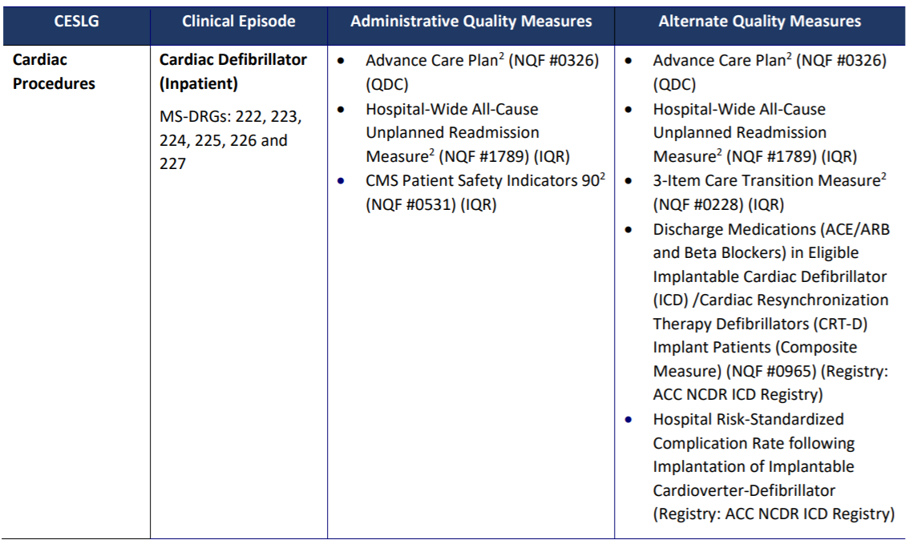
Cardiac Defibrillator - Inpatient
Notes:
The NCDR ICD registry is utilized in two clinical episodes for this program which include inpatient Cardiac Defibrillator and outpatient Cardiac Defibrillator. The measures included for the Inpatient Cardiac Defibrillator episodes include discharge medications (ACE/ARB and Beta Blockers) in eligible Implantable Cardiac Defibrillator (ICD)/Cardiac Resynchronization Therapy Defibrillators(CRT-D) Implant patients, Hospital risk-standardized complication rate following implantation of Implantable Cardioverter-Defibrillator

Slide 11
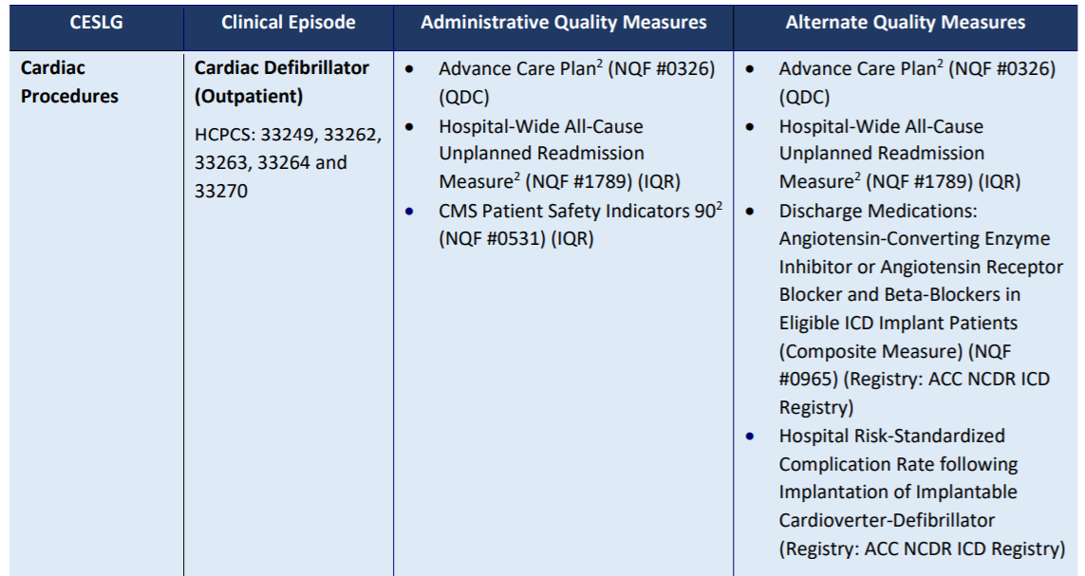
Cardiac Defibrillator - Outpatient
Notes:
The measures included for the Outpatient Cardiac Defibrillator episodes include discharge medications: Angiotensin-Converting Enzyme Inhibitor or Angiotensin Receptor Blocker and Beta-Blockers in eligible Implantable Cardiac Defibrillator (ICD) implant patients, Hospital risk-standardized complication rate following implantation of Implantable Cardioverter-Defibrillator.

Slide 12
For more information
https://innovation.cms.gov/media/document/bpci-advanced-quality-faqs
https://innovation.cms.gov/innovation-models/bpci-advanced/quality-measures-fact-sheets
https://innovation.cms.gov/innovation-models/bpci-advanced
https://innovation.cms.gov/media/document/bcpi-model-overview-fact-sheet-my4
https://innovation.cms.gov/media/document/bpci-advanced-clinical-episodes-quality-measures-correlation-table-my4
Notes:
For more information, we have included the above links.

