Slide 1
TOF Metrics - QNET
Pei-Ni Jone MD, Associate Professor of Pediatrics, Pediatric Cardiology
Children’s Hospital Colorado, University of Colorado School of Medicine
November 18, 2017
Notes:
Dear professors and students, thank you for inviting me to give this presentation. I would like to specially thank Dr. Haag for inviting me here today. I am going to talk about echocardiography in diagnosis and follow up of pediatric pulmonary hypertension.

Slide 2
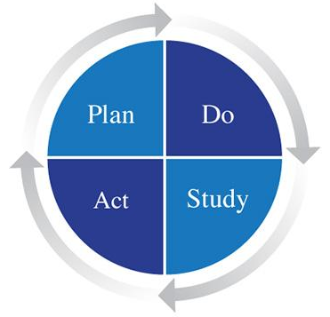
Tetralogy of Fallot (ToF) patients who received a test for 22q11.2 deletion
Children’s Hospital Colorado
Quarter 4, 2016 – 52%
10 people involved in the team
Pulled patients from EPIC
Challenge – 40 cardiologists in the practice
Meeting to discuss how to improve
Pre-op order sets for all the TOF patients going to surgery to get 22q11 tested
E-mail to cardiology faculty – awareness
Searching for the test in EPIC was cumbersome so that was changed

Slide 3
Tetralogy of Fallot (ToF) patients who received a test for 22q11.2 deletion - Change Strategies
Children’s Hospital Colorado
Quarter 1, 2017 – 57%
Not much improvement
Team met – Change Strategies
Capture all TOF patients before going to surgery
TOF patients in EPIC are flagged
Very long process
Nursing staff in clinic to remind providers
Lecture about 22q11 deletion to Heart Institute
Discussion of this metric in Faculty staff meeting
KEY DRIVERS
Identification of patients with TOF who require 22q11 screening
Increase knowledge of providers and patients about importance and benefit of genetic screening for 22q11 in patients with TOF
Appropriate testing and referral of patient requiring screening
Documentation of TOF and genetic testing results with results to carry through in problem list /patient history

Slide 4
Tetralogy of Fallot (ToF) patients who received a test for 22q11.2 deletion
KEY DRIVERS
INTERVENTIONS
Children’s Hospital Colorado
Quarter 2, 2017 – 67% (10% increase!)
Team Met – Strategies to improve
E-mail individual providers
Monthly e-mail reminders
Reminder in surgical conference
Identification of patients with TOF who require 22q11 screening
Identify patients with TOF and determine if 22q11 testing has been performed prenatally or postnatally.
Implement site specific means of flagging/testing 22q11 in patient
Increase knowledge of providers and patients about importance and benefit of genetic screening for 22q11 in patients with TOF
Develop educational program for
parents to understand importance
of genetic screening for 22q11
deletion in patients with TOF and to
increase knowledge of available
resources
Appropriate testing and referral of patient requiring screening
Develop educational program for
pediatric cardiologists regarding
need for 22q11 testing
Documentation of TOF and genetic testing results with results to carry through in problem list /patient history
Establish and implement clinical pathway tool and order set for patients with TOF to include genetic screening for 22q11 deletion and genetics consultation

Slide 5
TOF Metric – Lesson learned
Team work – divide the chart review work
Implementation of different strategies
Raise awareness – lecture
Faculty meeting to discuss
Nursing staff to remind
E-mail reminders
Individual provider
Pre-surgical testing – insurance will pay

Slide 6
Results
How to improve more?

Slide 7
Thank You
Acknowledgements:
Dunbar Ivy, MD
Joe Kay, MD
Shannon Buckvold, MD
Melanie Everitt, MD
Brian Fonseca, MD
Uyen Truong, MD
Dale Burkett, MD
Michael Ross, MD
Jenny Zablah, MD
Bettina Cuneo, MD
Katie Chatfield, MD

