Slide 1
Boston Children’s Hospital Heart Center
ACPC Quality Network Pilot Experience:
Counseling for Elevated Body Mass Index
Lauren Hartwell, MPH Candidate
Quality Improvement Consultant, Cardiology

Slide 2
Overview
Change Strategies
Project Timeline
Challenges
Lessons Learned
Ongoing Efforts

Slide 3
QNet Quality Improvement Pilot Elevated BMI Project Team
Site Administrator: Susan Saleeb MD
Data Collection & Analysis: Lauren Hartwell MPH(c)
BMI Pilot Physician Lead: Sarah De Ferranti MD MPH
BMI Pilot Team:
Sarah Atwood RN | Kevin Friedman MD | Ronald Lacro MD
Jennifer Bachman CPNP, MSN, RN | David Fulton MD | Jami Levine MD
Caroline Brantley MS, RD, LDN | Naomi Gauthier MD | Laura Mansfield MD
David Brown MD | Skylar Griggs RD | Renee Margossian MD
Steven Colan MD | Michelle Gurvitz MD | Mary Mullen MD, PhD
Lauren Danforth BSN, RN | David Harrild MD, PhD | Jane Newburger MD, MPH
Sarah De Ferranti MD MPH | Lauren Hartwell MPH(c) | Terry Saia PNP
Jesse Esch MD | Mariam Irshad MPH | Susan Saleeb MD
Jeremy Fox MD | Kathy Jenkins MD, MPH | Tajinder Pal Singh MD
Notes:
3
Highlight diversity of team - includes 2 nurses, 2 nurse practitioners, 2 dieticians, 2 departmental QI experts, and 19 physicians

Slide 4


QNet Quality Improvement Pilot Strategies for Improving BMI Counseling
Change Strategies
Analyzed available medical record system for opportunities to flag elevated BMI
Existing entries in “Problem List”
Electronic linking of education sheets
Automatic EMR calculation and permanent storing of percentiles
Working on electronic red flag for elevated BMI
Notes:
4

Slide 5

QNet Quality Improvement Pilot Strategies for Improving BMI Counseling
Change Strategies, continued
Developed new BMI patient/family education sheet with insights from:
Preventive cardiology group
Nutritionists
Nurses
Parent focus group
Partnering with new Cardiac Rehabilitation Program
Notes:
5

Slide 6
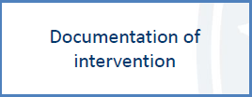
QNet Quality Improvement Pilot Strategies for Improving BMI Counseling
Change Strategies, continued
Recruited RN support to identify eligible patients
Alert physician of need for counseling
Distribute counseling materials
Assist in documentation of counseling – IT change
Notes:
6

Slide 7
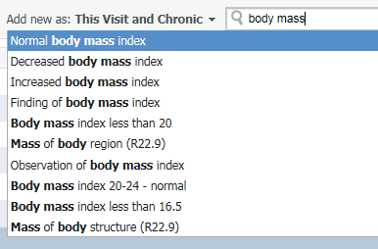
QNet Quality Improvement Pilot Strategies for Improving BMI Counseling
Change Strategies, continued
Encouraged physicians/NPs to document counseling in multiple ways:
Select from “Problem List”
Use Autotext statements
Enter in discussion section of letter
Document referral to local or Heart Center nutritionist
Notes:
7

Slide 8
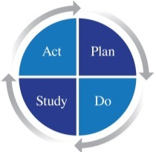
QNet Quality Improvement Pilot Elevated BMI Project Timeline
Recruited physicians, nurses, and dieticians
Disseminated metric details, MOC timeline & requirements
Kick-off meeting of working group
Reviewed baseline data
Reviewed nutrition education handouts
Brainstormed changes
Recruited IT to facilitate EMR changes
Developed new BMI education sheet – distributed to clinics
Email to cardiologists to raise awareness
Refined BMI education sheet through parent focus group
Developed and refined staff education
Engagement through broad contact
Jan/Feb 2017
Mar 2017
Apr/May 2017
Jun/Jul 2017

Slide 9
QNet Quality Improvement Pilot Elevated BMI Project Timeline
Reviewed Q2 2017 data – initial assessment post-intervention
Involvement of fellows through education
Targeted education to RNs, NPs, and CAs in clinic
Discussed best practices for weight management counseling
Submitted BMI education form for hospital-wide use
Seeking BMI prevalence data on CHD and other patients
Continuing education to nursing staff
BMI screening tips distributed to nursing staff
BMI education sheet approved for hospital use
Aug 2017
Sep 2017
Oct 2017

Slide 10

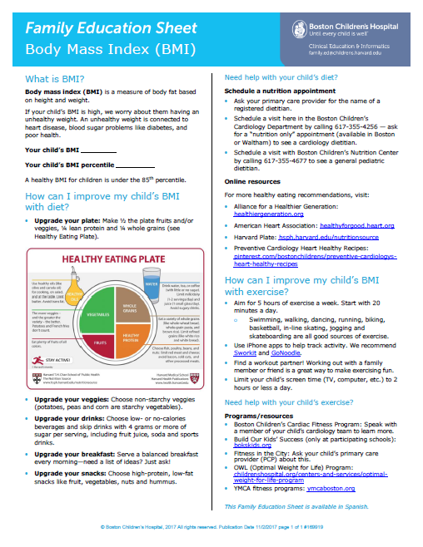
Education Sheets for Elevated BMI Counseling
Notes:
10

Slide 11
QNet Quality Improvement Pilot Counseling for Elevated BMI
Challenges
Large department (> 70 cardiologists)
Spreading the word
Small core group involved in QI
Numerous subspecialists and sub-subspecialists
Maintaining interest
Change is slow - - message stagnates
Email, postings ineffective
Message fatigue
Inboxes overburdened
Notes:
11

Slide 12
QNet Quality Improvement Pilot Counseling for Elevated BMI
Challenges (continued)
Variable Buy-In
Single encounter patients
Patients with active issues – recent procedure, etc.
“Job of the pediatrician”
Counseling is “ineffective”
Easy to measure counseling, hard to measure effect
Metric fatigue (meaningful use, etc.)
Metric may need some exclusions
Trisomy 21, other syndromes
Acute care issues
Notes:
12

Slide 13
QNet Quality Improvement Pilot Counseling for Elevated BMI
Lessons Learned
Sharing vetted counseling material is appreciated (true for both BMI and TOF)
Sharing data is powerful
Center performance over time
Comparison to national mean
MOC helps a lot!!!
Notes:
13

Slide 14
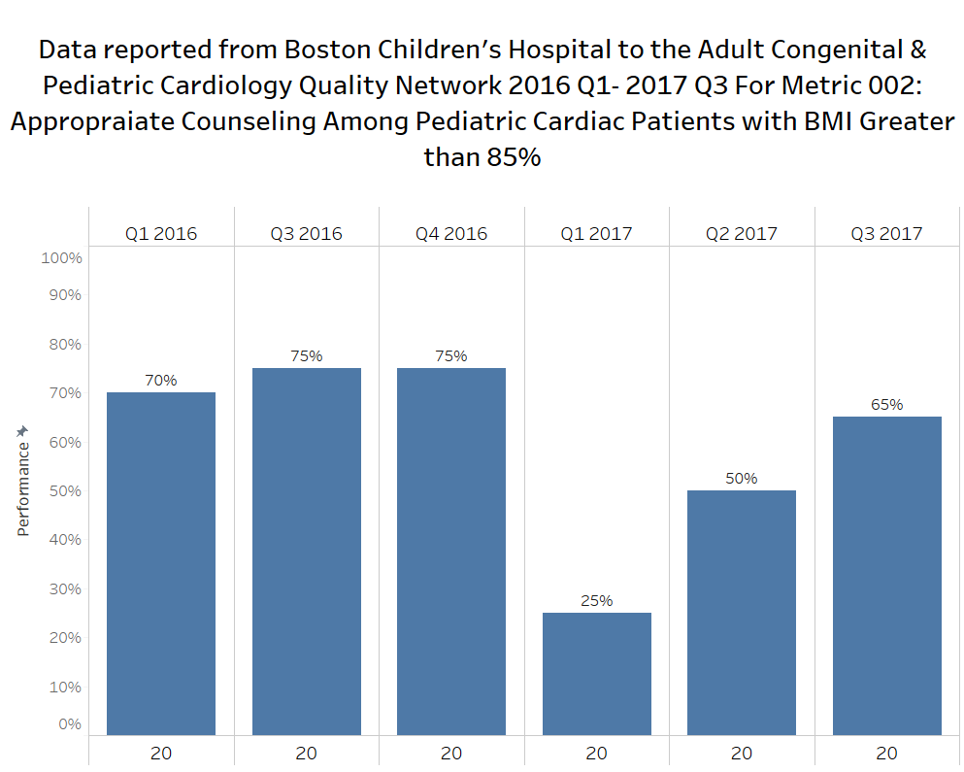
BCH Heart Center QNet Results Counseling for Elevated BMI
Notes:
14

Slide 15
QNet Quality Improvement Pilot Counseling for Elevated BMI
Ongoing Efforts
Automated flag for elevated BMI – RED
Ongoing cardiology staff and fellow education
Future Cardiology Grand Rounds, Fellows clinics
Disseminating best practices for counseling
Applying metric to adult cardiac patients
Particular efforts to target CHD patients
Ongoing review of elevated BMI prevalence data
Integration into Cardiac Fitness Program
Notes:
15

Slide 16

Thank You!

